Slide 1
Business Model Canvas & Market Research

Slide 2
Business Model Canvas
A tool
A one-page business plan
Visual
Allows for changes easily
Video : https://www.youtube.com/watch?v=QoAOzMTLP5s

Slide 3
Your Purpose

Slide 4
Problem
What problem are you solving?
Think about this from your target customers perspective

Slide 5
Step into Your Customer Shoes

Slide 6
Questions Questions Questions
The key is to learn to ask questions
This will help to shape and bring life to your vision
At this stage of your journey you will discover which types of customers you want
Who you will be competing against for their money - Competition
What are their wants and needs – Information about your customers

Slide 7
Your Ideal Customer

Slide 8
Know Your Customers
Develop a thorough understanding of the needs of potential customers and your ability to quickly identify needs will help develop even better relationships
Avoid assumptions and stereotyping

Slide 9
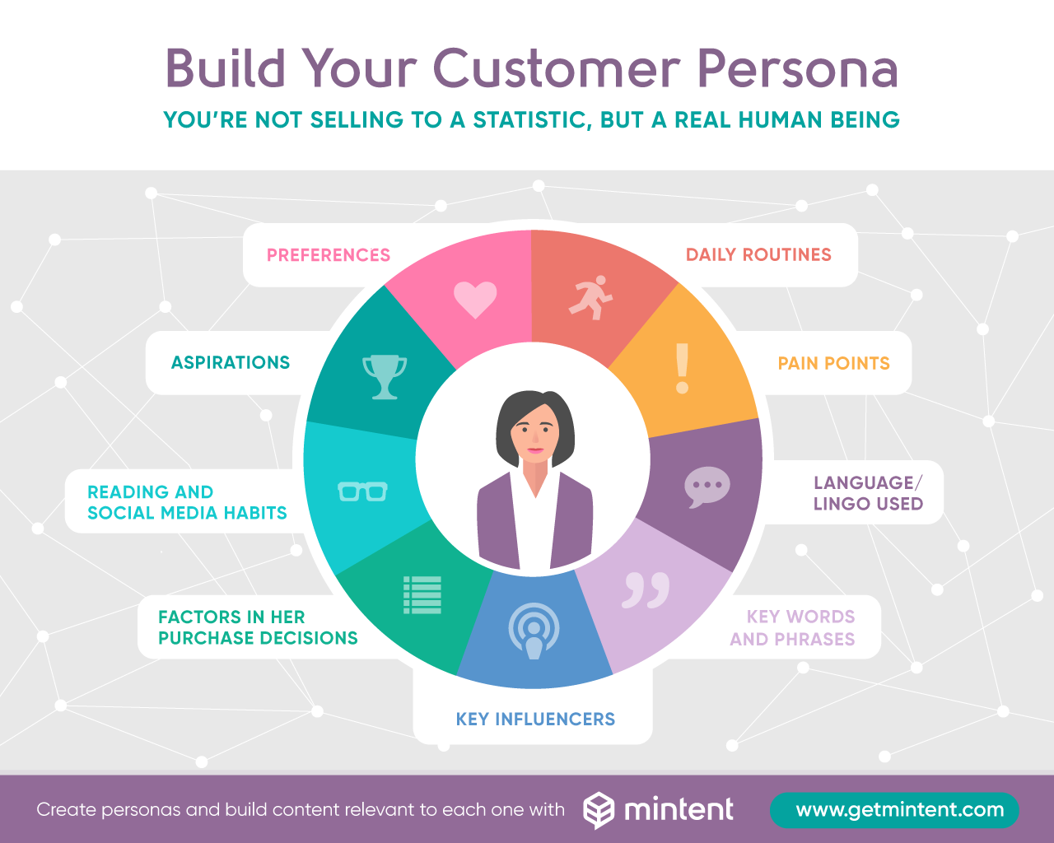
Target Market & Customer Personas Source: Mintent

Slide 10
Who are your targeting?

Slide 12
Resources
What are the most important resources required
Finance
Skills
Intellectual Property
People and organisations you work with (e.g. partners and suppliers)
Premises and the equipment you use
Process for taking payments (if relevant)

Slide 13
Resources
How will the plan be turned into action?
Premises
Equipment - a list of necessary equipment and the price of each item
Staff - details of what roles need to be filled, including job descriptions
Suppliers - details of various suppliers and the credit terms they will offer
Compliance - details of regulations regarding health and safety at work and any other regulations specific to the business or sector, together with a demonstration of how these will be complied with

Slide 14
Licensing - details of any licences or permits that are needed to trade in the proposed line of business
Insurance - a statement of what insurance cover is required, including details of relevant

Slide 15
Partners
Describe the people who are crucial to your organisation and any staff changes you plan as part of your business plan. This may include:
biographies of your management team
an overview of any planned changes to your management structure.
Also use this section to describe any skills gaps in your team, and how you plan to fill them

Slide 16
Value Proposition
https://www.youtube.com/watch?v=ReM1uqmVfP0

Slide 17
Regulators
These could include:
HMRC, Companies House
Regulatory or compliance
Licences

Slide 18
Schedule Your Time

Slide 19
Market Research

Slide 20
Market Research
Justify the need for your business
Demonstrate there is a gap in the market

Slide 21
You will learn
The importance of Market Research
Process
Techniques
Terminology
Sources

Slide 22
Set Clear Objectives
Definition
“A specific result that a person or system aims to achieve within a time frame and with available resources.”
www.businessdirectory.com

Slide 24
Your research should include
Your Industry
Customers
Competition
Suppliers
Pricing
Location
Marketing and Communications

Slide 25
When
schedule your time
How
How will you collect/gather the results

Slide 26
External Environment
What is happening in the world, which may have an effect on your business?

Slide 27
PEST Analysis
P = POLITICAL
E = ECONOMICAL
S = SOCIO- CULTURAL
T = TECHNOLOGICAL
L = LEGAL
E = ENVIRONMENTAL
How will the above impact your business?

Slide 28
Sources of Market Research
Trade/Professional Associations
Libraries (City Business Library, British Library)
Market Research Reports
Test trading
Banks
Newspapers
Trade press
Internet

Slide 29
Research techniques
Primary Research
Interviews
face-to-face interviews
focus groups
telephone
questionnaire
observation
polls

Slide 30
Market Research Sources
Some examples of good sources of secondary research
British Library
City Business Library
Zoopla
www.statistics.gov.uk
Local Authorities websites

Slide 31
Who are your Customers?
What segment of the population?
Where are they, geographically?
What struggles and challenges do they have?
Why do they have these problems?
What can YOU do to solve these problems?

Slide 32
Demographic factors
Age
Stage in family life cycle
Occupation
Economic circumstances
Lifestyle
Social Influence variables
family background
peers

Slide 33
Education
Career and working life
Daily life
Paint points, goals, challenges
Finances
Personality and personal life
Online behaviour
Product preferences

Slide 34
Where to find information about customers
Social Media
Review Sites – Trustpilot, Revoo

Slide 35
Who Do They Listen To?
Peers
Role Models
Opinion Leaders
Radio Stations

Slide 36
Where Do They Socialise/Network?
Networking events
Clubs
Societies
Professional Associations
Faith Groups

Slide 37
What do they read?
Local/National Newspapers
Magazines
Newsletters
Blogs
Social Media

Slide 38
Who do they follow on social media

Slide 39
What are they passionate about?

Slide 40
Quality Questions
Asking the right questions and researching your market properly will underpin the success of your business
You will be able to find out if you are targeting the right customers, if you are selling the right services and products to customers at the right time and at the right price

Slide 41
Keep an eye on the competition

Slide 42
Study the Competition
Start a file on each competitor.
Include:
Promotional materials e.g. leaflets
Advertising
Website details
USP (unique selling point)
Location
Have they won any awards
Memberships & Associations

Slide 43
Who are your competitors?

Slide 44
Who will your suppliers be?

Slide 45
Justify
Your business idea
Demonstrate you understand your sector
Show a clear understanding of customers, their wants and needs
Keep it simple, be disciplined with your time

Slide 46
Business Opportunity Profiles
Use the resources to help you complete your plan
Business Planning Guidelines and Business Opportunity Profile

Slide 51
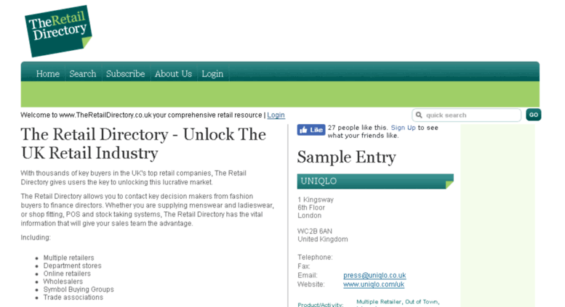

Slide 52
Identify Your Target Market

Slide 53
Commitment

Slide 54
Keep it simple

Slide 55
Any Questions?

