Slide 1
Welcome to Summer Term 2021
Types of text, purpose of text

Slide 2
Week 7: Aims and objectives
Put words in alphabetical order.
2. Learn about different types of text and how to recognise them.
3. Practise reading different types of text and find the purpose of text.
4. Read some example exam activities.
.

Slide 3
Spell the words you hear

Slide 4
Alphabetical order – put these words in alphabetical order
abcdefghijklmnopqrstuvwxyz….
childcare
councillor
crime
economic
education
environment
services
suggestions

Slide 5
Spelling test

Slide 6
What is the definition of text?
How would you define the meaning?
Can you think of some examples?

Slide 7
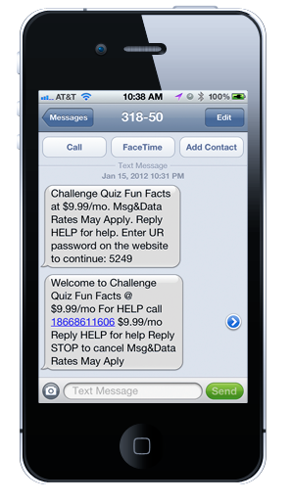
What is text?
A text message on phone

Slide 8
What is text?
a menu

Slide 9
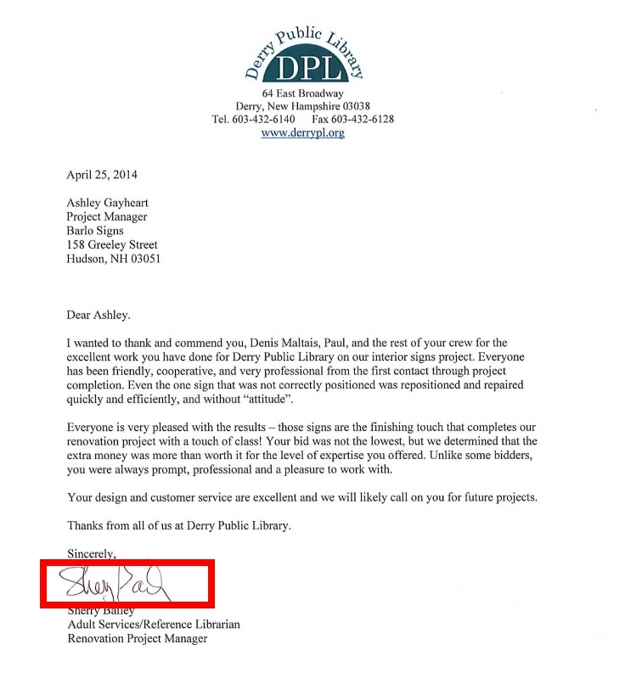
What is text?
a letter

Slide 10
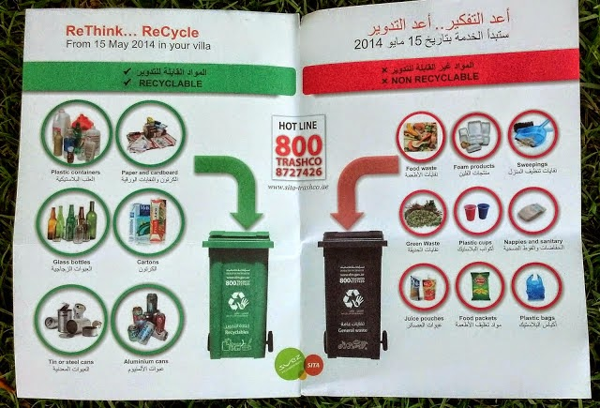
What is text?
a leaflet

Slide 11
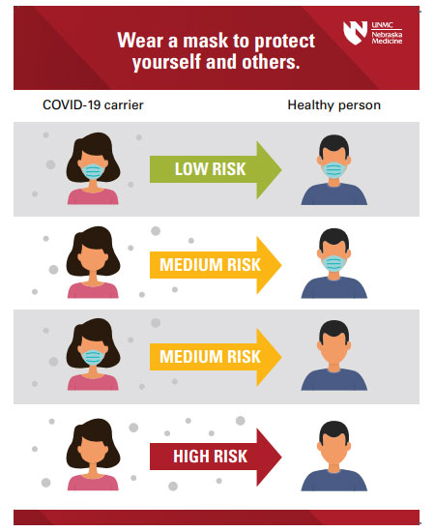
What is text?
a notice
a poster

Slide 12
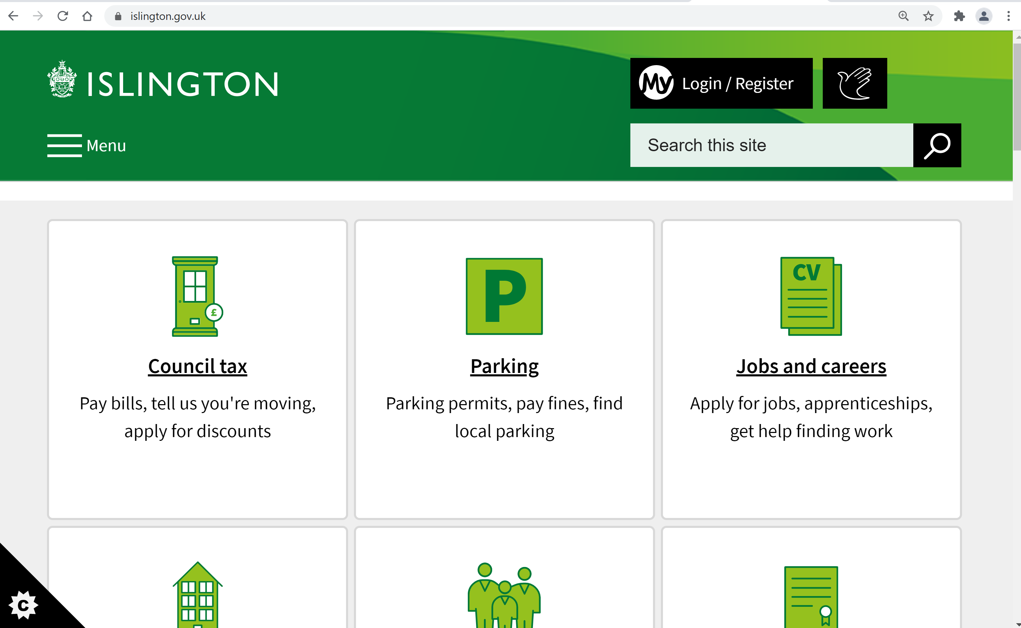
What is text?
a web page

Slide 13
What is text?
an advert

Slide 14
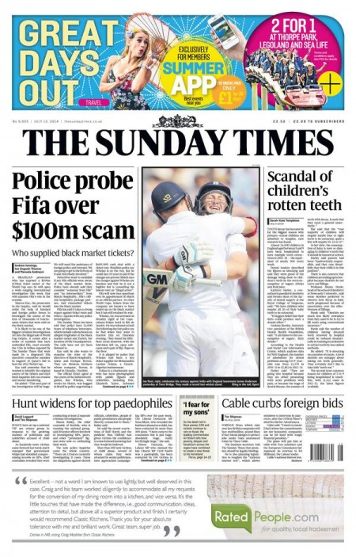
What is text?
a newspaper article
(a magazine article)

Slide 15
What is text? Text is any type of writing
It could be
a letter
an email
a recipe
a note
a leaflet
instructions
an article in a newspaper or magazine
writing on a webpage
an advert.

Slide 16
What is the purpose of the text?
When you’re reading the text think about the purpose of the text or why it has been written.
to discuss
to describe
to give information
to invite
to persuade
to give instructions

Slide 17
What is the purpose of the text?
When you’re reading, think about the purpose of the text or why it was written.
An advert might want you persuade you to buy something. •
A letter from school might give you information about something or invite you to something.
An article might describe something or discuss different ideas.
A notice might tell you to do something/warn you.
A leaflet might give you instructions or explain how to do something.

Slide 18
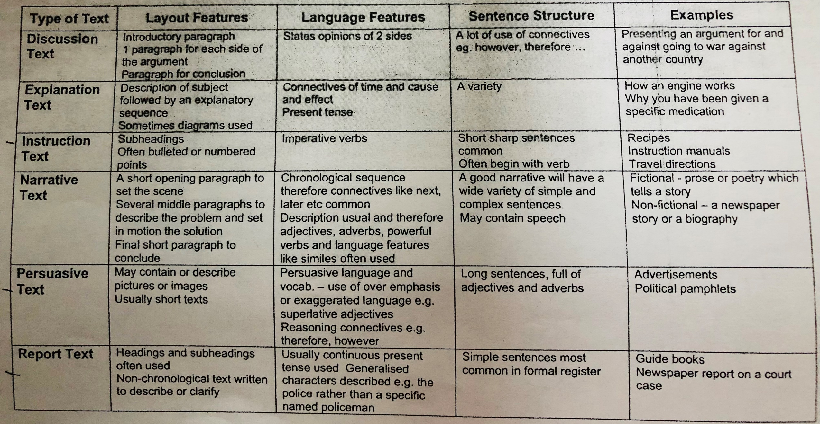

Slide 19
Reading sample paper – examples of questions about text

Slide 21
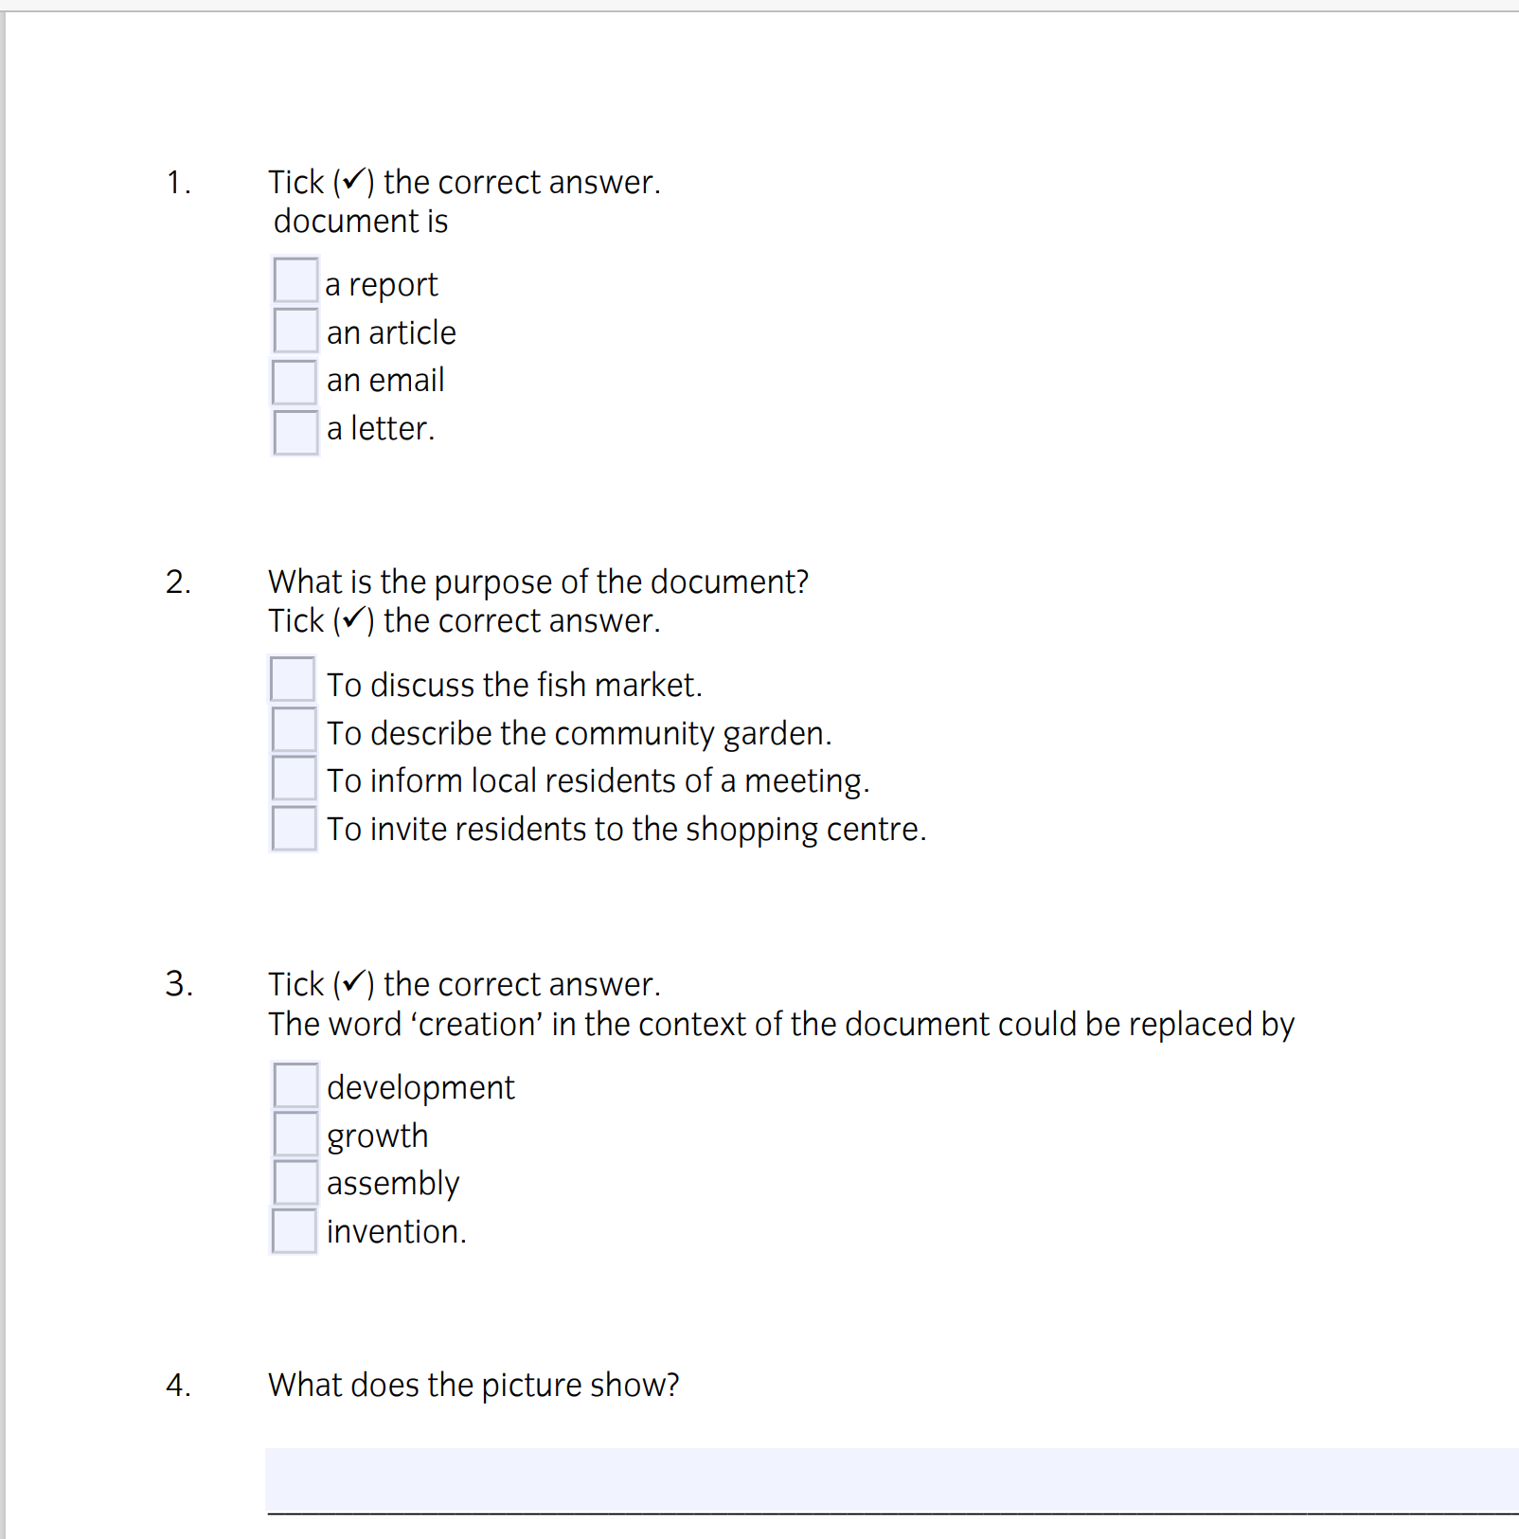

Slide 24
A
B
C
D

Slide 25
A
B
C
D

Slide 26
Functional Skills English
Reading Level 2
Sample Paper 3
Resolutions
Source Documents and question paper
Level 2 Functional Skills English Writing
Sample paper 3

Slide 28
Summary of lesson
In the lesson, you…(change the verb to its past form)
Put words in alphabetical order/spelling test.
Learned about different types of text and how to recognise them.
Practised reading different types of text and finding the purpose of text.
Read some example exam activities.

Slide 29
The end

Slide 30
Conversation segment
Suggest a topic that you would like to talk about…
the most popular topic wins and you will talk about that.
It can be about anything (non-political):
Any interesting facts you recently learned/discovered
Arts and culture
Books

Slide 31
References

