Slide 1
Types of text

Slide 2
42, Greyhound Road
Birmingham
B42 6HJ
25 April 2021
Mr. E. Splatt
The Manager
Bestdeal Electrics
113 Main Street
Andover
AN4 9ET
Dear Mr. Splatt,
Complaint about member of staff
I am writing to complain about a member of your staff who was very rude to me on my recent visit to your shop………….
I have been a loyal customer of Bestdeal for many years. I would like you to contact me to tell me how you are going to deal with this member of staff.
Yours sincerely
Jane Teller

Slide 7
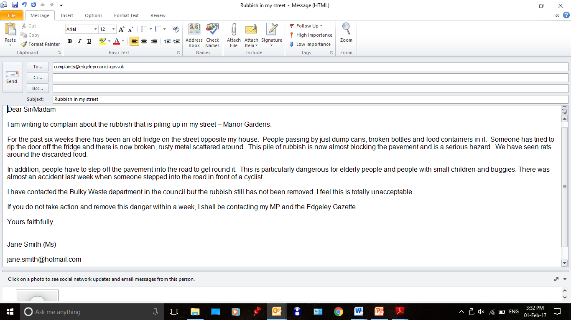

Slide 8
Grandad and two grandsons in "miraculous" escape after car clips side of house and lands upside down
by Alex Kingston 7 January 2022
A grandad and his two grandsons had a "miraculous" escape after the car they were travelling in launched into the air, clipped the side of a house and landed upside down.
The three are lucky to be alive after their vehicle - which was being driven by the elderly man - left the road and launched over a six foot wall. Paramedics found the vehicle teetering upside down on top of a parked car.
Emergency services said it was a miracle nobody was hurt in the accident in Seabridge Lane in Newcastle-under-Lyme, at around 5.30pm today.
A West Midlands Ambulance Service (WMAS) spokeswoman said: "When the emergency services arrived they found a car which had reportedly left the road, cleared a six foot wall and clipped the side of a house before landing on top of a parked car.
Miraculously the three occupants, an elderly man and his two grandsons, believed to be in their late teens, were out of the car and had sustained no serious injuries.”

Slide 10
Nutrition and Health & Wellbeing | Ben support for life
Notes:
The Secret to Keeping Your New Year's Resolution (ahaparenting.com)

Slide 11
Style of writing
Persuasive
Narrative
Explanation
Instructions
Formal/informal

Slide 12
Resources
how to spell - https://howtospell.co.uk/
grammar – University of Bristol - Grammar and punctuation (bris.ac.uk)
vocabulary – English for Everyone worksheets -https://www.englishforeveryone.org/Topics/Word-Definition.html
vocabulary – English Club - https://www.englishclub.com/vocabulary/

Slide 13
Writing process
Planning (essential for thinking)
Drafting (essential in longer writing when
studying but no time in an exam)
Neat copy (marked in exam)
Proofreading ( marked in exam)

Slide 14
You’re stuck for ideas? What do you do?
5Ws
observe – wonder - infer
read the question for tips
think about your own experience
visualise/imagine

Slide 15
Questions
Who
What
Where
When
Why
How

Slide 16
Observe – Wonder - Infer
Observe – what can you actually see or what are the facts?
Wonder – what do you not know but are wanting to find out?
Infer – what might … I think … Maybe …

Slide 17
Homework
Use Observe-Wonder-Infer to write a story about the picture

