Slide 1
Aim of the session:
By the end of the session learners will be able to
talk about holiday
Introduce yourself
meet each other and have induction
talk about the weather today
talk about ILPs –Individual Learning Plan and do diagnostic assessments

Slide 2
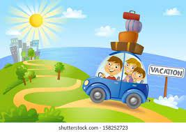
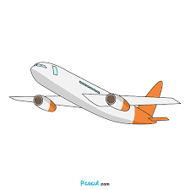
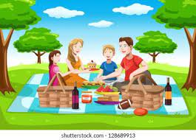
Tell about your holiday.
Seaside?
Picnic in the park?
Camping?
Going abroad?
Visiting friends?
Stay home? Cooking?

Slide 3
What’s the date today?
What’s the day today?

Slide 4
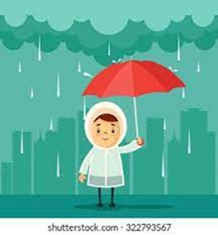
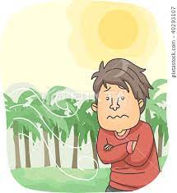
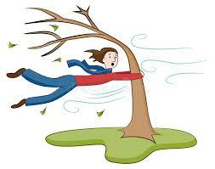
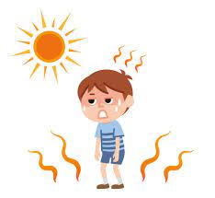
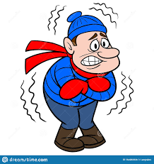
rainy
windy
cool
snowy
sunny
cold
hot
cloudy
warm

Slide 5
The weather
How is the weather today?
It’s ……………….

Slide 6
About me
My name is ………………
I am from ……………. but I live in ……………………
I am a…………….
I have ………………………………….
I like watching TV
I don’t like cooking.
My favourite food is ……………….
I want to ……………………..

Slide 7
Homework
https://www.liveworksheets.com/worksheets/en/English_as_a_Second_Language_(ESL)/Free_Time_activities/Things_i_like_doing_jd1228676vx

