Slide 1
Aim of the session:
By the end of the session you will be able to
Have induction-(new learners)
Introduce yourself & welcome the new learners
Talk about what you like and don’t like
Listen to a conversation and put the information in order
Familiarise with a simple form questions and answer them

Slide 2
What’s the date today? 8/10/2021 yesterday? tomorrow?
What day is it today?
It’s Friday.

Slide 3
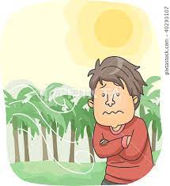
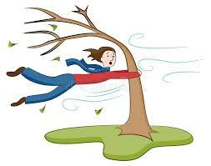
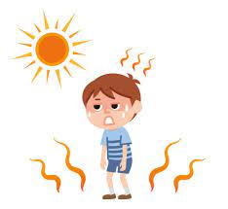
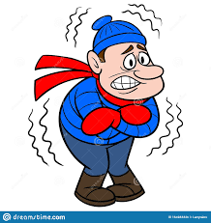
rainy
cool
windy
warm
sunny
snowy
cold
hot
cloudy

Slide 4
The weather
What is the weather like today?

Slide 5
Classroom Language
Repeat
Can you repeat it please?
Mean
What does it mean?
What does cool mean?

Slide 6
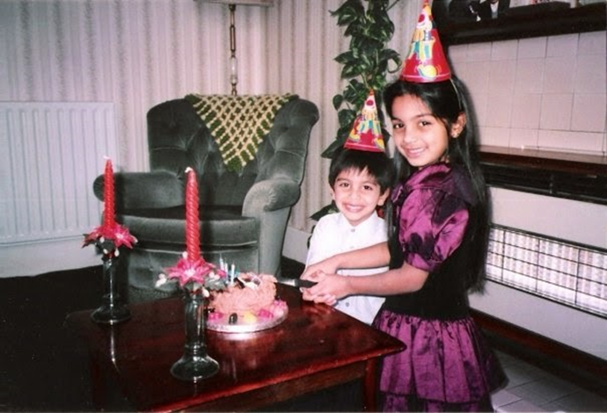
My name is ………………
I am from Turkey but I live in London.
I have 3 brothers, 4 sisters.
I like gym and tennis.
I don’t like onion.
My favourite food is kebap.

Slide 7
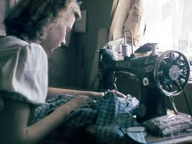
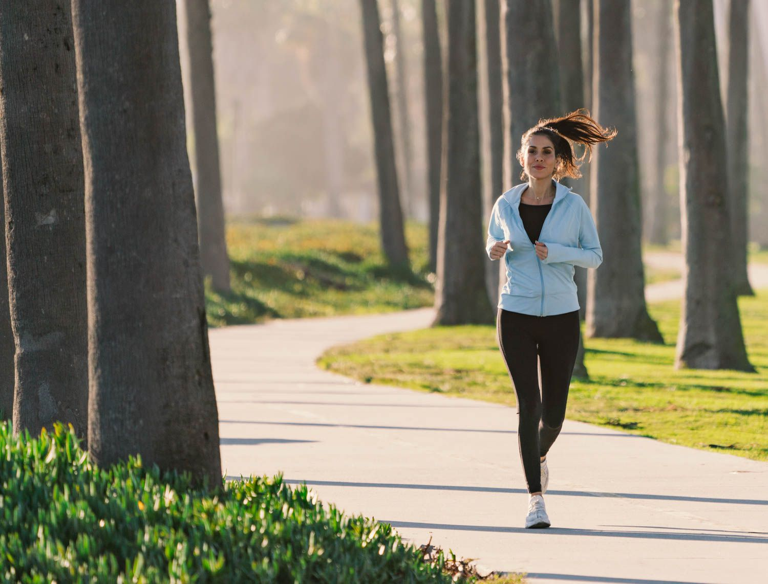
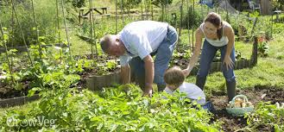
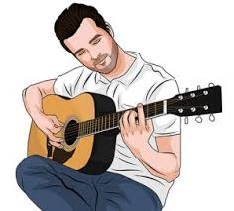
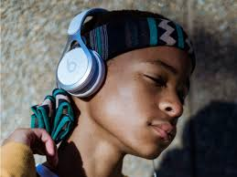
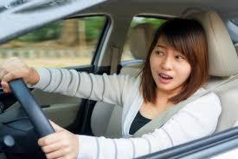
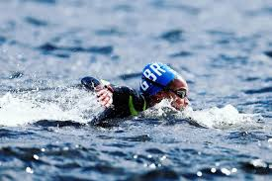
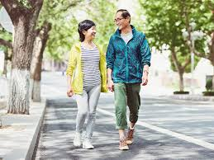
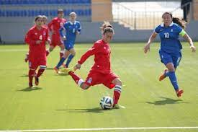
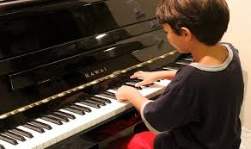
Hobbies- playing football, watching TV, running, singing, playing the guitar, playing the piano, walking, swimming, painting, sewing, gardening, driving, listening to music

Slide 8
Tell me what you like doing.
I like singing, watching TV and playing football.
I like gardening, walking and painting.
I like driving, running and gardening.
Tell me what you don’t like doing.
I don’t like playing the piano and sewing.
I don’t like swimming and playing the piano.
I don’t like playing football and sewing.

Slide 9
Registering with a doctor
https://www.excellencegateway.org.uk/content/etf685
Listen to the conversation and order the information given

Slide 10
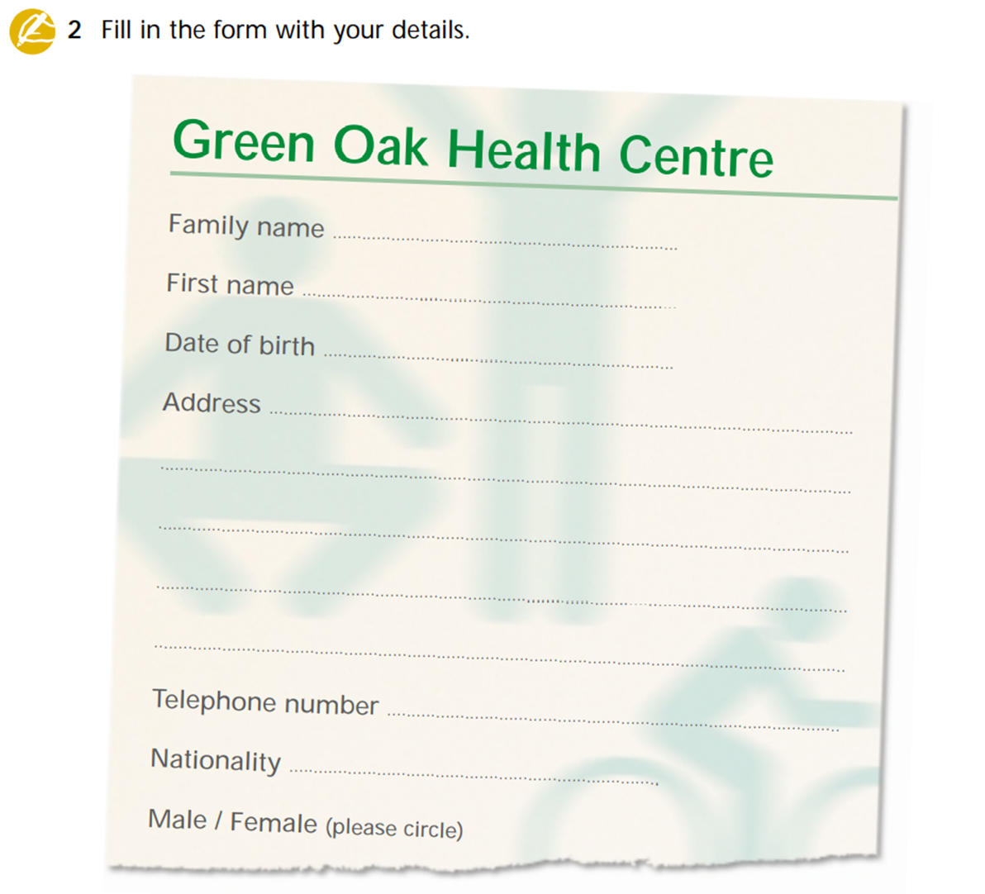
Family name:

