Slide 1
Functional Skills L1/2 English
You are working towards your L1/2 English Qualification.
We will be working on different topics each week until you are familiar with everything you need to know to pass this exam!

Slide 2
Week 4
Main points, purpose and plurals

Slide 3
Lesson Intentions
Identify, understand and extract the main points
Identify different purposes of straightforward texts
Identify regular plurals
Identify and understand the main points, ideas and details in texts
Use reference materials and appropriate strategies (e.g. using knowledge of different word types) for a range of purposes, including to find the meaning of words

Slide 4
Spellings

Slide 5
Answers
accommodation
necessary
parallel
scientific
scenic
Brought
Ought
Though
separate
Thorough
receive
Naughty

Slide 6
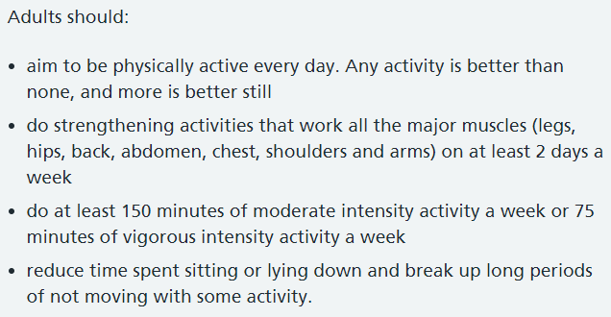
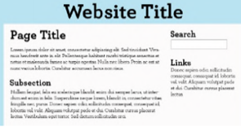
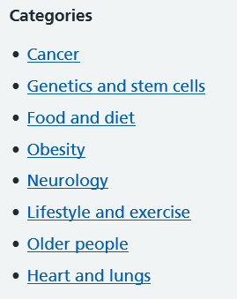
Starter
Match the names, examples and definitions of organisational features that you could be tested on in the exam!

Slide 7
Starter answers
You should have spotted
A title
An index
Bullet points
Numbering
Sub headings

Slide 8
Exam-style question
The purpose of this text is to:
A Persuade young people to not get social media
B Explain the dangers of social media
C Recount an experience with social media
D Instruct on what to do if you are cyberbullied
See your handout

Slide 9
What is purpose?
The purpose of the text is what the text is aiming to do.
Persuade - These texts try to convince you to do something or believe something.
Inform - These texts give us facts and evidence about something.
Recount – These texts tell a story about something that has happened.
Instruct - These texts give the reader step by step directions to follow.
Explain - These texts explain the reason for something.
Describe - These texts illustrate in detail a particular thing or experience.

Slide 10
What is the purpose of this text?
What features have been used to persuade you?

Slide 11
What is the purpose of this text?
What features have been used to persuade you?
Emotional language, to make you feel a certain way, to convince you to agree.
Using ‘you’ to make you feel like the text is talking directly to you, to help convince you that you can help.
Facts and information to support the message and convince you.

Slide 12
The purpose of this text is to:
A Persuade young people to not get social media
B Explain the dangers of social media
C Recount an experience with social media
D Instruct on what to do if you are cyberbullied

Slide 13
Exam-style question
What would be the best alternative title to this article?
A How to stay safe on social media
B Cyberbullying? Here’s what to do
C What are the risks of social media?
D Children and social media
What does alternative mean?
What other titles can you think of?

Slide 14
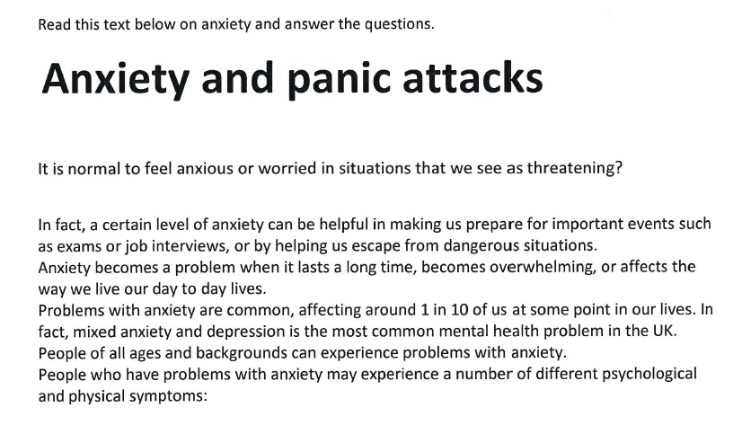
Timed reading task
If you finish early, ask for the stretch!
You have 15 minutes to complete this reading task.
Remember to skim and scan. Get a general understanding then find detail or key points.
1.What is the text about?
2.Write down the main points and we will feed back
Timer: ( 5 minutes)

Slide 15
Plural Rules
If a word ends in ch, o, x, s, sh or z put es on the end
Example
One box- some boxes
One wish- Three wishes
The church- Two churches
Quiz?
Kiss?
Hero?
If a word ends in a consonant then a y then you change the y to ies
Example
Fly-Flies
For most words you add an ‘s’ on the end
Example-
One Car, two cars
If a word ends in a vowel and a y then add a s
Example
Key-Keys
For words ending in f or fe you take the f and fe off and add ves
Example
Shelf-shelves
Knife?
Notes:
Words to read out to class to answer:
Day
City
Wife
Dress
Waltz

Slide 16
Write the plurals of the following singular words
Child
Knife
Woman
Church
Box
fairy
Shelf

Slide 17
Writing Task
Write an email to The Spring Grove Community Centre telling them you have plans to hold a jumble sale and you would like like their permission and support
You could include details of how
people can sell items at the jumble sale
Or how they can donate various items
Write in full sentences and use some techniques to persuade the council to allow your plans to go ahead.

