Slide 1
Functional Skills Level 2 English
You are working towards your Level 2 English Qualification.
There are 3 exams:
Reading Paper
Writing Paper
Speaking and Listening Exam
We are working on different topics each week until you are
familiar with everything you need to know to pass this exam!

Slide 2
Lesson Intentions
To revise and re-cap all topics covered in the FS Exam elements.
To apply reading, writing and speaking and listening skills to worded problem-solving questions.
To identify and practice necessary exam technique.

Slide 3
L2 English workshop
All SOW Topics

Slide 4
Exam Overview
In order to achieve your L2 English qualification, you must pass all 3 components.
Reading Exam
Writing Exam
Speaking and Listening Exam

Slide 5
Reading Exam

Slide 6
Identify, understand and extract the main points and ideas in and from texts
What is this text about?
This text discusses the ways we can maintain a healthy lifestyle and advice for eating a balanced diet.
Pick out some of the main points:
You must eat a variety of foods , and the right amount of these to eat a balanced diet.
The different food groups and how much you should consume e.g. 5 portions of fruit and veg.
Reducing consumption of food and drinks high in fat, sugar and salt is healthier for your body.

Slide 7
Identify different purposes of straightforward texts
Persuade - These texts try to convince you to do something or believe something.
Inform - These texts give us facts and evidence about something.
Recount – These texts tell a story about something that has happened.
Instruct - These texts give the reader step by step directions to follow.
Explain - These texts explain the reason for something.
Describe - These texts illustrate in detail a particular thing or experience.
Come to the amazing circus and see incredible flips, twists and tricks before your very eyes!
We will be holding a parents’ meeting to discuss the up-coming residential on Thursday at 6pm.
Persuade
Inform

Slide 8
Use effective strategies to find the meaning of words and alternatives
Marty is gregarious, unlike his brother who is quiet and shy.
What do you think gregarious means?
a) Make a guess using the word in context.
Marty is the opposite of his ‘quiet and shy’ brother. Gregarious could mean loud and sociable.
b) Use dictionary to look up the definition.
Definition: fond of company; sociable.
……………Which word would replace ‘coupled’? ( use a Thesaurus )- synonyms ( alternative words)
a.Related b. fastened c.attached d.combined

Slide 9
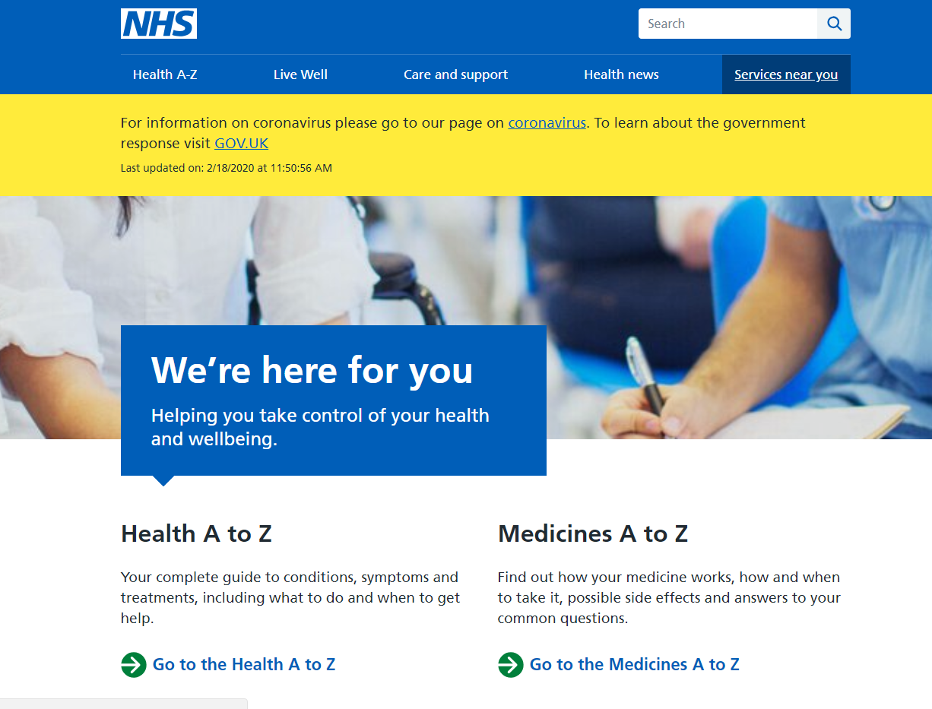
Understand organisational features and use them to locate relevant information
Tabs
Tabs on a website show the different pages you can click on to access information.
Text Box
To clearly display separate and important pieces of information.
Subheadings
Subheadings are titles in the text that tell you what the section is about.

Slide 10
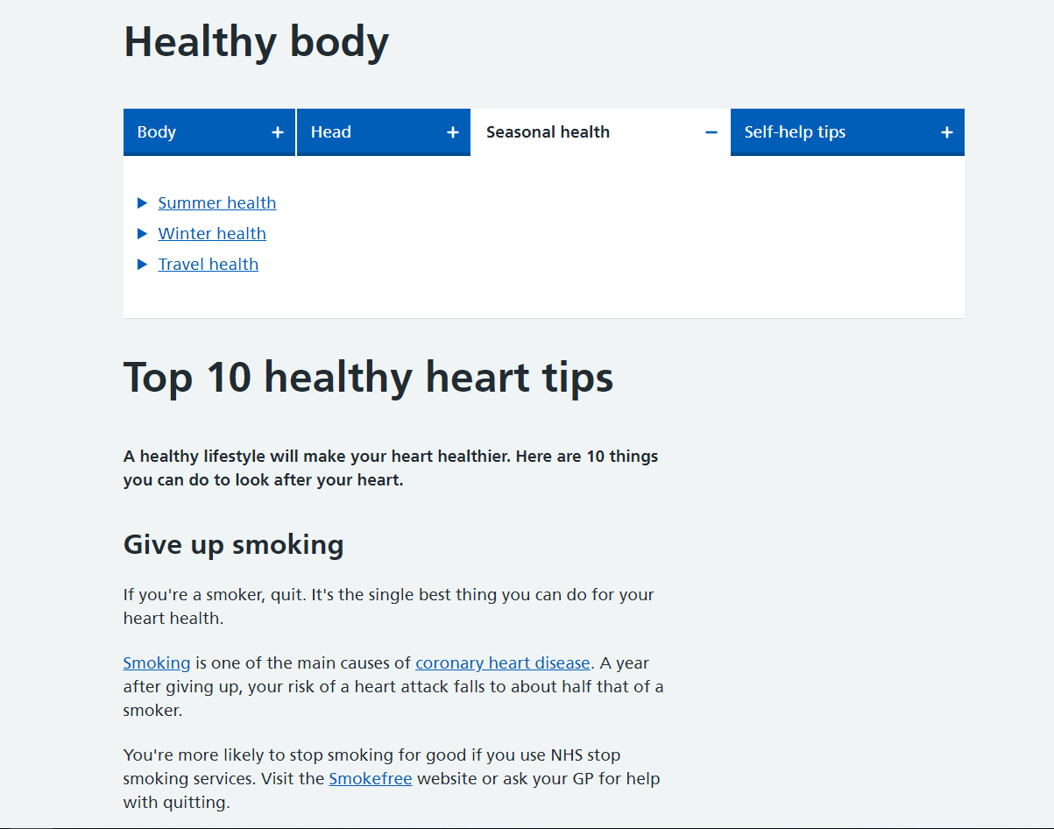
Understand organisational features and use them to locate relevant information
List and Bullet Points
A menu is a list of pages or links on a website. Bullet points separate information so it’s easier to read.
Bold Text
Words might be in bold text or capitals letters to stand out.
Links
A website will use links to take the user to another page/article on the site, or another website.

Slide 11
Sample text
The Disadvantages of Technology in the Workplace
by Mary Nestor-Harper
A quick look around any workplace will tell you that digital technology is essential to business. Computer systems can run factories. Only a few operators are needed to keep the factory running. Every desk has a computer with the latest digital software. But, all this technology comes at a price. Using technology is necessary for businesses to compete in today's marketplace. But there are also some points to think about.
1. At the next desk, John is conducting a job interview via Skype. Sue is walking through the office talking on her phone. Carlos is into the second hour of a webinar. Add these distractions to the normal noise of a busy workplace and it's no wonder that it's hard to get work done. Technology demands attention. The time saving advantages are often outweighed by constant distractions.
2. Mobile phones, email, texting and social media have largely replaced face-to-face communication. Recent research has found that we are losing important personal communication skills*. Too much reliance on electronic and digital methods of communication increases unnecessary electronic messages. This can mean a loss of vital personal contact.
3. Technology is continually being improved. This needs constant and costly upgrading. Each new upgrade requires staff training. This takes time away from regular work. The loss of time coupled with the costs of software upgrades can reduce a company’s profits
QUESTION – Which of the following best describes the writer’s views? Think about the tone/viewpoint/opinion of the writer
a. positive b critical c. Neutral d. angry

Slide 12
Writing Exam
You will be assessed on:
• Communicating information, ideas and opinions clearly, coherently and accurately
• Communicating with appropriate detail to suit purpose and audience
• Using appropriate format, structure and language for purpose and audience
• Writing consistently and accurately in complex sentences, using paragraphs where appropriate
• Using correct spelling, punctuation and grammar

Slide 13
Use a range of punctuation correctly
Full Stops
Use at the end of a sentence when your point is finished.
Question Mark
Use instead of full stop at end of sentence when asking a question.
Exclamation Mark
Use at the end of sentence instead of full stop for a command or when shouting.
Capital letters
Start of sentence
Names of people, places, books and films
Days and Months
Commas
In lists between each part
To add extra information in the sentence
Add the missing punctuation and capital letters:
the ornate mahogany wardrobe was covered with dust
The ornate, mahogany wardrobe was covered with dust.
how dare you speak to me like that
How dare you speak to me like that!
what time does the film start
What time does the film start?
hidden beneath the autumnal leaves the fox watched a rabbit slowly approach
Hidden beneath the autumnal leaves, the fox watched a rabbit slowly approach.
Stretch and challenge –colons and semi colons

Slide 14
Form irregular plurals
Different words follow different rules when becoming plural.
You need to be aware of the words that form irregular plurals.
What are the plurals of these words? TOY –TOYS/ box-boxes
Child –
Woman –
Tooth –
Mouse –
Person –
Children
Women
Teeth
Mice
People

Slide 15
subject-verb agreement, consistent use of tense, definite and indefinite articles
Verbs are action words.
Subjects are the person or thing doing the action of the verb.
The verb form can change depending on whether the subject is singular or plural.
The verb must always agree with its subject.
Single subject = single verb
Plural subject = plural verb
For example: The car park (singular subject) was (verb) full.
The car parks (plural subject) were (verb) full.

Slide 16
Writing L2
Question 1
One flight from London to South Africa produces as much pollution as each passenger heating their own home for a whole year. Aircraft fuel is one of the biggest causes of global warming and climate change.
Should we reduce the amount we fly?
Should we only take holidays in the UK?
Should the price of plane tickets go up to stop so many people flying?
Are people’s rights to have a holiday abroad more important than the planet?
Your task: write an article for a student magazine exploring the issue of so many people flying abroad for holidays and the pollution it causes. (Use 5 Ws – why,what,who,where,when - +how)
(250-300 words)

Slide 17
Speaking and Listening exam

Slide 18
Identify and extract relevant information and detail in straightforward explanations
Start at 44:09
What are the main ideas these students discuss in their discussion?

Slide 19
Communicate information and opinions clearly on a range of topics, making relevant contributions
Make sure you offer your opinion in the discussion but ensure you keep it relevant!
Clarify what others have said by repeating information back to them e.g. ‘So you mean to say…’
Use phrases such as: ‘In my opinion’ or ‘I have experienced’
How to do this
You can agree or disagree with the others in the group, but remain respectful and give reasons.
Do not interrupt if you agree or disagree, allow the other to finish before giving your point of view.
Use phrases such ‘That’s a valid argument, but another way of looking at this is’ or ‘I can see your argument but I disagree because’
How to do this
Make sure you communicate clearly and effectively.
Avoid slang and use formal English. For example ‘I want to’ instead of ‘I wanna’
How to do this

Slide 20
Make requests and ask concise questions and Respond appropriately to questions
In order to do well in the Speaking and Listening exam, you MUST ask at least 1 question and you must respond to questions appropriately.
It is important you use your 20 minutes of preparation time to think and prepare questions you can use to keep the conversation moving. This will ensure you do well in the discussion and help avoid any awkward silences!
Graffiti is ruining public property and encouraging groups of young people into gang culture. Others say graffiti is an expression of art and we should facilitate graffiti in certain areas.
What questions could you ask in this discussion?
Make a list of 3-5 questions

Slide 21
Follow and understand the main points of discussions
What are 3 topics/points that are made during this discussion?
Some of Billie’s fans are celebrities her parents are fans of. This is when she truly understands the reality of her fame.
Billie had a meeting with Stella McCartney and meeting Paul McCartney was a big deal for her.
Billie is a big Spice Girls fan and has watched the film ‘Spice World’ 40 times.
Billie has Tourette’s syndrome and Ellen says she is brave for speaking about it.

Slide 22
Listen to and respond appropriately to other points of view, respecting conventions of turn-taking
How to show you are listening
Eye contact
Nodding
Ask questions
Allow others to speak
Sit upright and face everyone
Do not laugh at other’s responses
Do not interrupt! Make sure you let others finish speaking and give their full opinions before giving yours.
Make sure you let everyone have a chance to speak, and encourage those who are quiet to participate with direct questions such as ‘Megan, what do you think?’ or ‘Aaron, do you agree?’
Your body language is important too, so make sure you face those who are speaking and nod, and make eye contact to show you are listening.

Slide 23
Formal /informal
Prepare a short talk /presentationon a familiar topic and discussion in response to another persons presentation Be prepared to have a short discussion about your talk( 5-8 mins)
Eg,
Holidays
Hobbies
Social networking
Take part in a formal discussion – 10 mins-15 mins
Eg lower voting age
Climate change

