Slide 1
Aim of the session:
By the end of the session learners will be able to
Recap past tense, simple present tense and present continuous tense questions and how to answer them
Recap previous session- hospital letter
use countable and uncountable nouns

Slide 2
What’s the date today? 18/10/2021
The eighteenth of October
What was the date yesterday?
17th October
The seventeenth of October

Slide 3
I can’t see it.
I can’t hear it.

Slide 4
What did you do yesterday?
I stayed at home.
I had my hair cut.
I cleaned my house.
I had a rest because I had backache.
I trimmed my garden.
What do you usually do everyday this time? routine
I have lunch.
I make dinner.
I watch TV.
I cook.
What are you doing now? Now-at moment
I am studying online.
I am sitting on the sofa.
I am listening to my class mate.

Slide 5
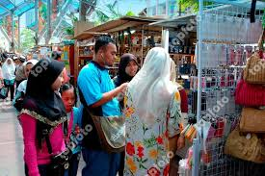
Saturday
What are they doing?
They are shopping.
shopping

Slide 6
Every Saturday
What do they do ever Saturday?
They go shopping every Saturday.

Slide 7
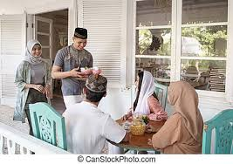
This Saturday
What are they doing?
They are visiting their friends.
visiting

Slide 8
Last Saturday
Every Saturday, we usually go shopping
but last Saturday we visited our friends.
X
ⱱ

Slide 9
Last Saturday
What did they do last Saturday?
They visited their friends.
They didn’t go shopping.
X
ⱱ

Slide 10
Monday
What is she doing?
She is teaching.
She is reading a book to children.

Slide 11
Every Monday
What does she usually do every Monday?
She reads a book to children.
She teaches.

Slide 12
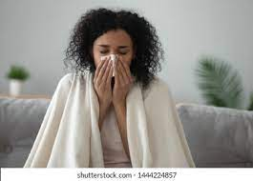
Last Monday
What did she do last Monday? Why?
She stayed at home.
She didn’t go to work because she had the flu.

Slide 13
Recap previous session- listen to questions and answer
https://esol.britishcouncil.org/content/learners/grammar-and-vocabulary/beginners/reading-letter-hospital

Slide 15
Video- aren’t for countables -isn’t for uncountables
https://www.youtube.com/watch?v=Srglu-yI9Ow
activity
https://www.liveworksheets.com/worksheets/en/English_as_a_Second_Language_(ESL)/Countable_and_uncountable_nouns/Countables_and_uncountables_fo857352pl
Video-a/an some/any
https://www.youtube.com/watch?v=MIDOnliWyew
HW-
https://www.liveworksheets.com/worksheets/en/English_as_a_Second_Language_(ESL)/There_is_-_there_are/There_is_-_There_are_%5E_a,_an,_some,_any_gy25424bs

