Slide 1
How to attract the right customers and clients
All rights Reserved: B Consultancy Ltd

Slide 2
Agenda
Cultivate quality business contacts and connections
Generate referrals
Master word-of-mouth marketing
Boost self-belief and self-confidence
Get and keep more customers, clients
How to research your customers and your market
Building rapport and gaining trust
How to follow up your contacts

Slide 3
Who will buy from you?

Slide 4
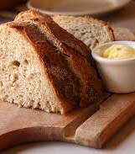
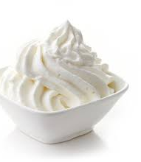
Who are you really targeting?

Slide 5
Where are you fishing?

Slide 6
Excercise

Slide 7
Networking – Events - Workshops

Slide 8
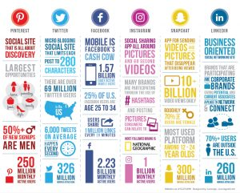
Social Media Insights
Analysing your content on the channels you are already using provide robust social media insights in identifying the right target audience.

Slide 9
m
Social Listening
Social listening is the process of monitoring social media channels for mentions of your brand, competitors, product, and more.
Source: www.blog.hootsuite.com
What are your customers talking about?

Slide 10
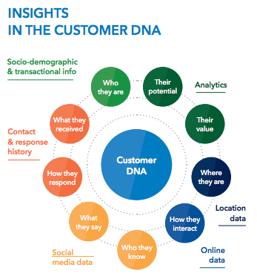
Data
Source: http://www.black.ninja/how-to-blow-away-your-customers-with-data-analytics/

Slide 11
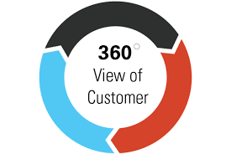
Build a bigger picture of your customer –
Preferences, needs and wants the full 360 degree
Aim - Build long term relationships
Building = improved loyalty
Anticipate - customer behaviour and listen to what customers are saying, they will leave hints, clues and footprints.

Slide 12
What are your customers really paying for?

Slide 13
What do your customers want?

Slide 14
Conversations
Interactions
Reviews
Testimonials

Slide 15
Communication
Send potential customers useful tips, updates
and resources at regular intervals
Freedom Tool
Face to Face
LinkedIn
Messaging tools
Do people endorse or recommend you, send them an email, thank you for connecting...

Slide 16
Attract
People who are likely to become leads, and, good customers
Relevant content attracts the right customers at the right time, when the want or need YOUR BUSINESS
Resources and Tools
Blogging
Content Strategy
Keywords, Long tail and intent
Social Media

Slide 17
Questionnaires and Surveys

Slide 18
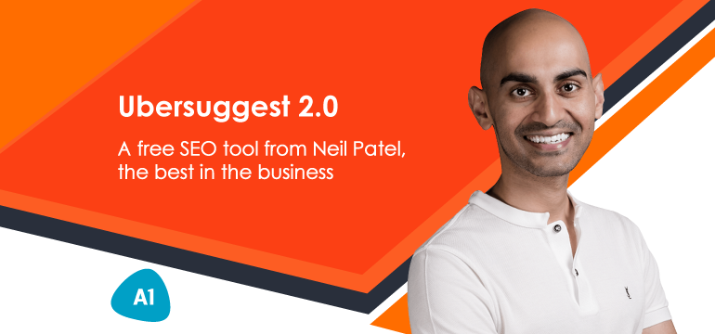
Social Media - Keywords
What’s trending on Instagram, Twitter

Slide 19
Resources to connect with clients

Slide 20
Feel, Felt, Found

Slide 21
“I understand how you feel.” “Initially, other …) felt that way.” “What they found, however, was that after doing ‘X’ was that ‘Y” happened.

Slide 23
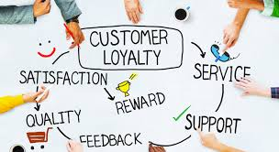
Go the Extra mile
Exceed their expectations
Be proactive
Improve the customer experience, this will lead to opportunities to upsell and cross-sell

Slide 24
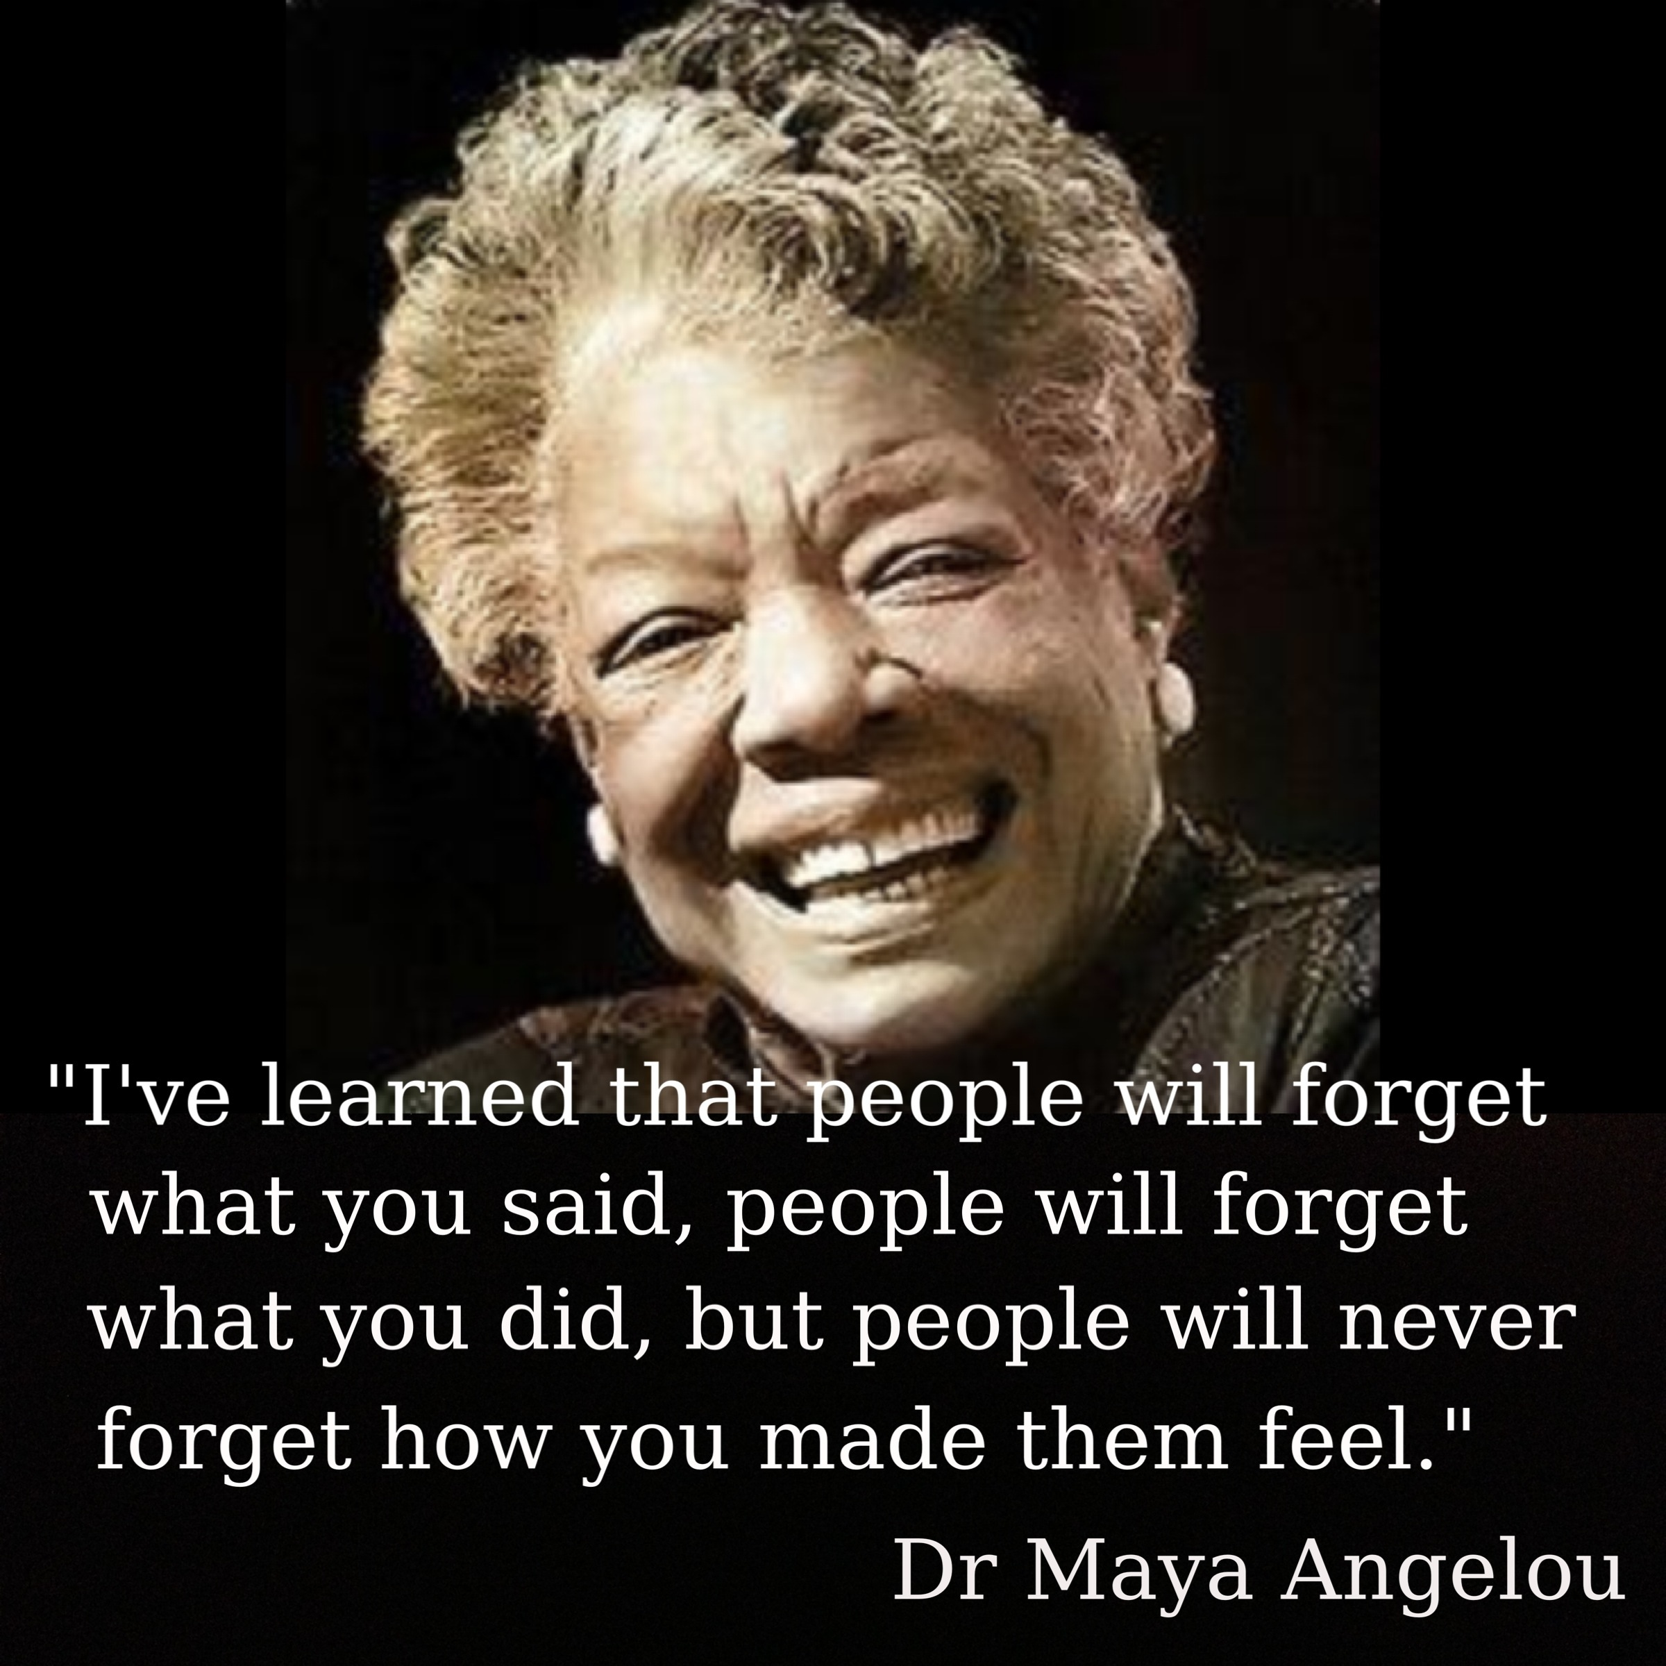
Make people feel special
Personalise their experience with you

Slide 25
Facts v Stories

Slide 26
Sell the benefits!

Slide 27
Excercise

Slide 28
Customer Needs
Write down five needs / reasons why your people will buy from you…

Slide 29
Networking
Know your outcome
Meet key people
Be seen
State it in the positive
Attendee list
Follow up
Build contact list

Slide 30
Integrity, Honesty Trust
Build and develop relationship
Be sincere the aim to offer value
B.A.M. F.A.M
Book a meeting from a meeting, networking event
Book an appointment to call
Don’t pitch, offer something of value

Slide 31
Follow Up

Slide 33
Build your credibility
Stories, testimonials the best tool for building creditability.
1 minute short video testimonials
LinkedIn is a useful site to get recommendations. Display these on your blogs, social outlets and websites. These provide potential customers a proof of your credibility

Slide 34
Give
Give and it will come back to you
You can get everything in life you want if you will just help enough other people get what they want.
Secrets of Closing the Sale (1984)

Slide 35
Crystal Knows

Slide 36
Social Media
Status updates
Pictures, video, infographics, updates
Blogs – the right content at the right time
Email – share a clean joke, interesting information

Slide 37
BIG HAIRY AUDACIOUS GOALS

Slide 38
Group Discussion
Action Plan
What will you:
Be
Do
Build
Know

Slide 39
Reflection & Evaluation

Slide 40
Questions, Learnings
& Discoveries

Slide 41
Thank you
www.bconsultancy.co.uk
Instagram: @bconsultancyltd
Facebook: @bconsultancyltd
Twitter: @bconsultancyltd
49-51 East Road
London
N1 6AH

