Slide 2
Welcome to your online lesson
Today we will:
Complete tasks about a winter scene
Learn useful adjectives to use in describing photos
Speak about our chosen pictures
Tell a story from pictures

Slide 3
https://www.liveworksheets.com/worksheets/en/English_as_a_Second_Language_(ESL)/Picture_description/Describing_pictures_ht12634oa
https://esol.britishcouncil.org/content/learners/skills/speaking/describing-winter-scene

Slide 4
Where the photograph was taken.
Describe the details, e.g. on the left/ at the back / near the ?

Slide 5
Tell us about your picture.
Why did you choose it? What is it? Where is it?
Did you take it?
What do you feel when you look at it.

Slide 6
Tell us about your picture.
Why did you choose it? What is it? Where is it?
Did you take it?
What do you feel when you look at it.

Slide 7
Tell us about your picture.
Why did you choose it? What is it? Where is it?
Did you take it?
What do you feel when you look at it.

Slide 9
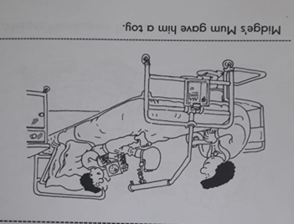
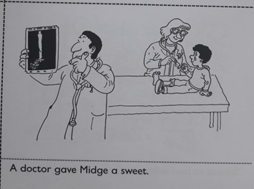
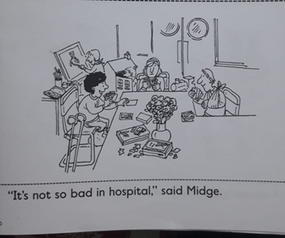
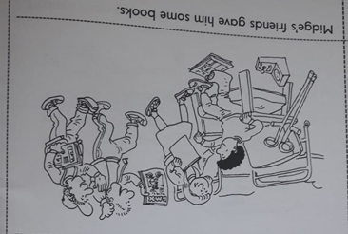
Put pictures in the correct order.
b
a
c
d
e
1

Slide 10
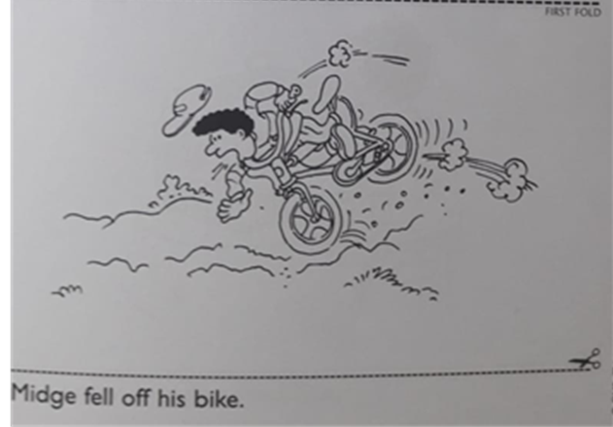
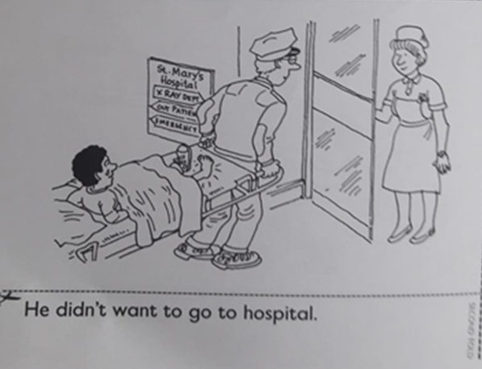
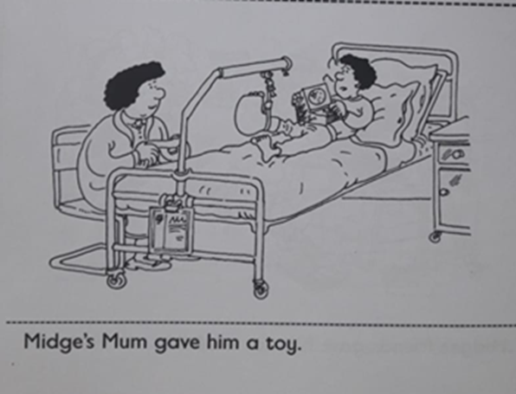
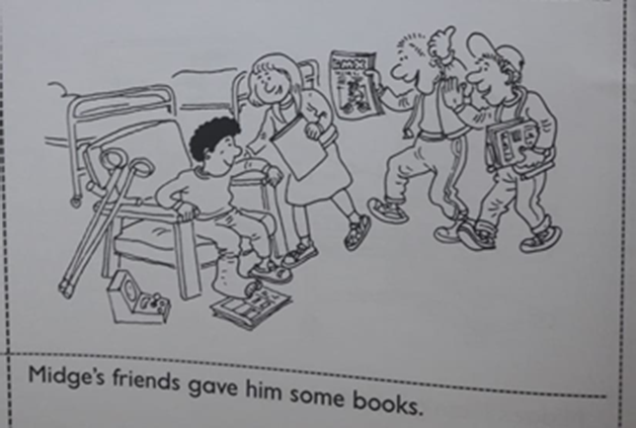
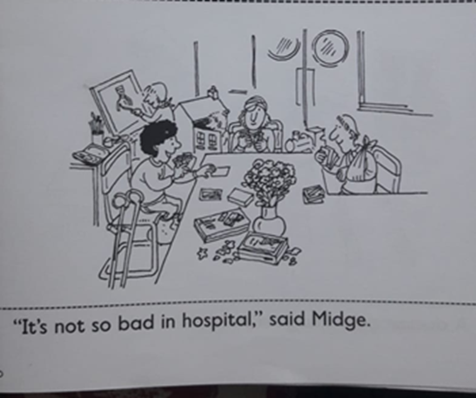

Slide 11
Look at the picture. Describe as many details as you can.

Slide 12
Look at the picture. Describe as many details as you can.

Slide 13
Look at the picture. Describe as many details as you can.

Slide 14
Look at the picture. Describe as many details as you can.

