Slide 1
Lesson One
Learning objectives:
To revisit and practise past simple, past continuous and ‘used to’ to describe past events and habits
To practise sentence rhythm and pronunciation of –ed endings

Slide 5
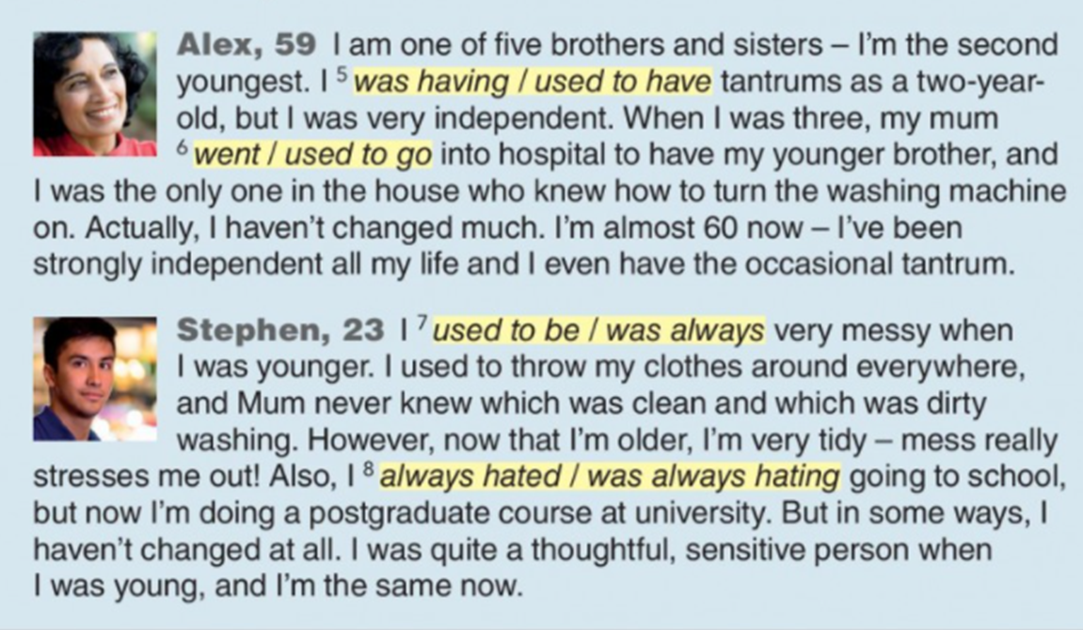

Slide 7
Grammar Bank

Slide 9
Kahoot
Go to kahoot.it and enter the game PIN

