Slide 1
Functional Skills Entry Level 3 English
You are working towards your Entry Level 3 English Qualification.
There are 3 exams:
Reading Paper
Writing Paper
Speaking and Listening Exam
We will be working on different topics each week until you are familiar with everything you need to know to pass this exam!

Slide 2
Writing
Week 13 – Entry 3 English
Paragraphs, Sentence Types and Email Writing

Slide 3
Lesson Intentions
Use the first, second and third place letters to sequence words in alphabetical order
Write in compound sentences and paragraphs where appropriate
Use language appropriate for purpose and audience
Use appropriate format and structure for an email when writing straightforward texts, including the appropriate use of headings and bullet points
Stretch:
Write consistently and accurately in complex sentences

Slide 4
Mark Scheme
Take a look at the mark scheme. It’s really important to know what you’re being marked against in the exam.
5 minutes

Slide 5
Alphabetical Order Starter
Complete the tasks on the worksheet
We use alphabetical order (A-Z) so that words or names can be found quickly.
We first look at the first letter to put in order
If the first letter is the same, we look at the second letter
If the second letter is the same, we look at the third letter
Amanda
Ben
Beth
Bevan
Clive
5 - 10 minutes

Slide 6
Try these
The following theatre tickets need to be put in alphabetical order by surnames:
L. Singh
M. Smith
J. Haji
K. Smithers
S. Sanderson
H. Holden
J. Hall
P. Haggerty
Top Tips!
Read the instructions carefully
Remember, if they start with the same letter, look to the letter to the right
3 - 5 minutes

Slide 7
Sentence types
There are three different types of sentences simple, compound and complex.
https://www.bbc.co.uk/bitesize/articles/zfxfwty
Notes:
Q and A from video. For example what length are simple sentences normally? What sentences include more than one verb? When might you use a simple sentence? Which sentence gives greater detail?

Slide 8
Simple Sentence
Verb = A ‘doing word’ which describes an action.
Jump
Walk
Sing
Clap
Laugh
One main verb
‘She ran quickly back to her friends house.’
Can you think of one?

Slide 9
Compound Sentences
Remember:
You need to include
at least one compound sentence in each writing task in the exam!
More than one verb. Usually using coordinating conjunctions e.g. ‘but’ ‘so’ ‘and’
Useful for connecting events and ideas
‘Dani realised she had forgot her phone so she ran quickly back to her friends house.’
Can you think of one?

Slide 10
Complex Sentences
Remember:
Complex sentences do not make complete sense when broken up.
Subordinate clause can go at the start, middle or end.
Contains a subordinate clause e.g. although, because, even though, despite, when…
‘Dani realised she had left her phone at her friends house when she went to call her Dad.’
Can you think of one?

Slide 11
Task- Add a conjunction to the following sentences
Compound Sentences
I went to bed early. I am still tired.
I like cycling. I don’t like running.
I wanted a good seat at the cinema. I booked a ticket in advance.
India was late. Lisa waited for her.
I don’t like coffee. I don’t like tea.
I can get the train home. I can get the bus home.
Watford are a good team. Chelsea are better.
I want to pass my exams. I need to attend every lesson.
Worksheet
5 – 10 minutes

Slide 12
Writing an Email
To box
Where you write the email of who you are sending it to.
CC box
Where you write the email of someone you want to receive a copy of the email.
Subject Heading
Where you write what subject the email discusses, e.g. ‘birthday party’.
Greeting
The opening of the email, greeting the person receiving it.
Content
The main part of your email, with details about why you are writing.
Sign off
Write a closing phrase and your name to end the email.
Attachments
Any documents, pictures or videos you want to send with your email.

Slide 13
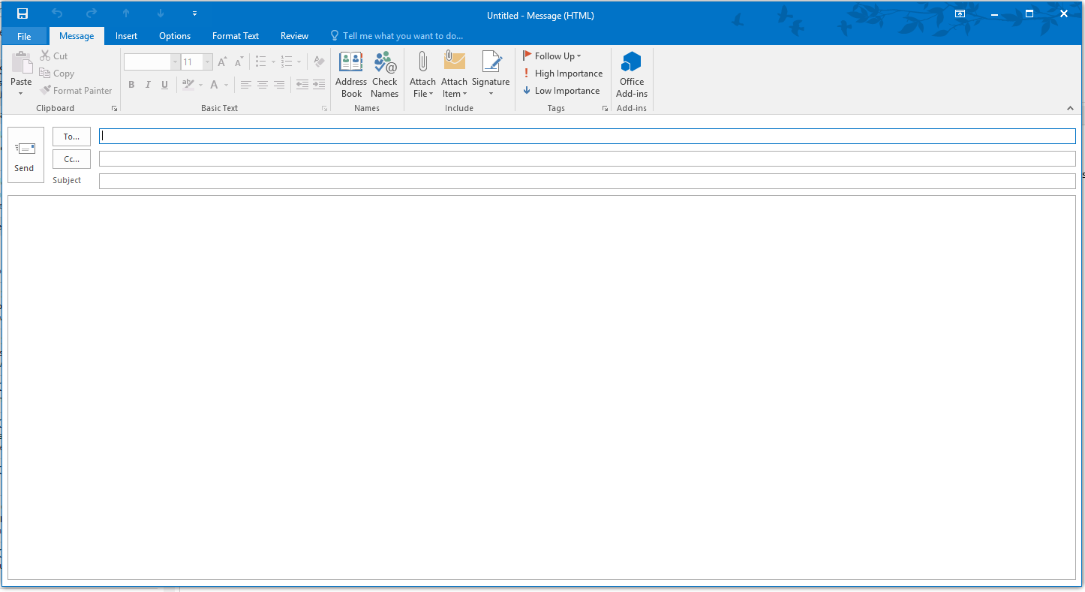
Email layout – where should everything go?
Task!
Draw out in your books where you think everything goes.
Greeting
Content
(Including Paragraphs)
Sign Off
5 minutes

Slide 14
Language
It’s important to understand when to use formal language, and when it’s ok to use informal language.
Watch the video and complete the tasks on the website.
https://www.bbc.co.uk/bitesize/topics/zvgg4qt/articles/zp42rwx

Slide 15
Greeting and Sign Off
Complete formal and informal task!
Greeting and Sign Off is how you open and close the email.
This will change depending on who you’re writing to.
If you are writing to someone you know…
If you are writing to someone you do not know…
‘Dear Sir or Madam’ or ‘Dear Mr …... / Mrs …...’
Greeting
‘Dear …….’ or ‘Hi …….’
‘See you soon’ or ‘Speak to you soon’
‘Kind regards’ or ‘Many thanks’ or ‘Yours Sincerely’
Sign Off
3 - 5 minutes

Slide 16
Writing Task
You see a poster for a local animal shelter asking for volunteers and you would like to help.
Write an email (Minimum of 2 paragraphs) to the manager asking to join the team.
Email: manager@brooksanimalshelter.com
You should include:
Why you are writing the email.
3 reasons why you would like to volunteer.
Relevant skills you have.
What days you are available to help.
Try to plan your answer first.
If you finish early, think have you written enough information?
Try to write another paragraph!
15 minutes

Slide 17
Plenary
Put the names of everyone in the class in alphabetical order.
Write down 3 reasons you may need to write a formal email.

Slide 18
Go to kahoot.it
Emails

