Slide 1
Today’s Menu
Gross and net profit
Start up costs
Direct and indirect costs
Costings
Pricing strategies

Slide 2
Start Up Costs
Take into account all start-up and operating costs for at
least 12 months ahead.
Remember, small expenses can mount up
Premises-related costs can provide a shock. First you have to find them, possibly refit and redecorate them, make them safe, secure or legally compliant.
A landlord will expect a deposit and rent upfront. You might also have to pay a service charge

Slide 3
Start Up Costs
Cost of sales: raw materials, manufacturing equipment, shipping, packaging, warehousing
Professional fees: Setting up legal structure, trademarks, copyrights, patents, drafting partnership or non-disclosure agreements, accountant, coach
Technology costs: Computer hardware and software, printers, mobiles, website development, internet access, security measures
Admin costs: Business insurance, office supplies, licenses and permits, postage, parking, rent, utilities, phone bills, copier, desks, chairs, filing cabinets, stationery – anything else you need to have on a daily basis to operate a business
Sales and marketing costs: designing and printing stationery, marketing materials, advertising, trade show attendance, networking fees, mailing or lead lists
Wages and benefits: Employee salaries, payroll taxes, benefits

Slide 4
Limiting Start Up Costs
The less you spend, the less you’ll have to
turnover to cover all of your costs
The more likely you’ll be able to afford any
unexpected costs
Every penny you spend must earn money for
your business – otherwise you're wasting
money

Slide 5
Limiting Start Up Costs
Look for no-cost or low-cost alternatives first
- Ask yourself “is this item essential?”
Borrow
Second hand
Share costs with other businesses (i.e. co-working)
Drive a hard bargain
Ask for help
Try Fiverr, Fivesquids and People Per Hour

Slide 6
Costs
Direct costs – to produce the product or service
Indirect costs (overheads) – incurred whether you make or sell anything or not

Slide 7
Homework
List your start up costs
List your direct and indirect costs
Research the actual cost of each item

Slide 8
Pricing your product or service
Pricing is based on three critical points:
What your product or service is worth to your customers - its value
What it costs you to produce your product or provide your service
The price your competitors charge

Slide 9
Production based business
Total Indirect (overhead) costs / no. of units
= (Indirect cost per unit)
Indirect cost per unit + direct costs
= total cost per item
(but remember you haven’t made any profit yet…)

Slide 10
Service based business
Calculate no. of productive (paid for) days (or hours) per year
Annual indirect (overhead) costs / no. productive days = daily cost
Daily cost + direct costs = cost per day
(but remember you haven’t made any profit yet…)

Slide 11
Cost Plus Pricing
Cost plus a mark up expressed as a %age
The mark up is what you need to add to make the desired profit
Examples of retail mark-ups:
Most retail : cost plus 50 per cent.
Restaurants: cost plus 60 per cent or more
Branded clothing: cost plus 135 per cent.
Jewellery: cost plus 250 per cent or more
Example: Item costs £20, mark up is 50%
£20 x 0.5 = £10; £10 plus £20 = £30.

Slide 12
Cost Plus Pricing
Does not take into account the price of competing products
Ignores what the product is worth to the buyer

Slide 13
Value Based Pricing
What’s it worth?
Ask your customers
Choose a competitor : How much is your product or service? How much is your competitor’s?
What are all of the differences?
Tweak this price up or down based on your judgement and experience

Slide 14
Value based pricing
Convenience - a late-night store can charge more than a supermarket for a pint of milk.
Brand – big spenders will buy the expensive product if the brand is well marketed even though there’s little to choose in quality between a branded and an unbranded product.
Fashion - some people will pay a premium for hot items (e.g. the latest trainers or cars).
Pure perceived value - fine art is a good example. A sculpture is priced at £20,000 or £60,000 based on its estimated value to the purchaser, rather than simply the cost of its creation.
Supply and demand - tickets for top-level sports/music events can be highly priced as there will be more committed potential customers than available seats

Slide 15
Setting prices

Slide 16
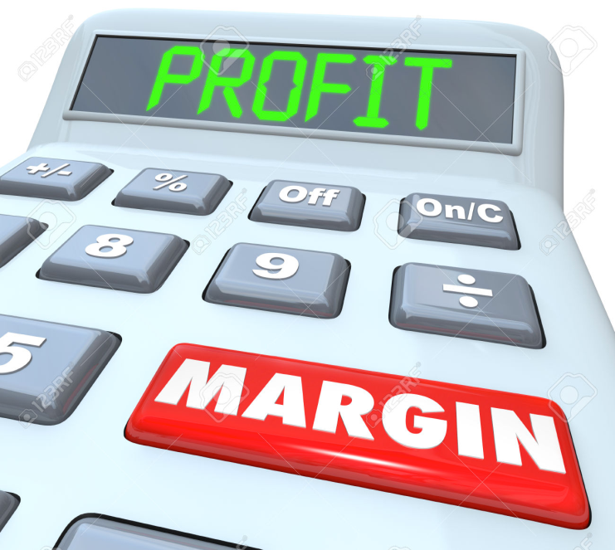
Gross and net profit
https://www.youtube.com/watch?v=cnA0INKCu00

Slide 17
Gross and net profit
Sales revenue £8,000
Less cost of sales
(direct costs) £5,000
Gross profit £3,000
Less other expenses £2,000
(overheads, tax)
Net profit £1,000

Slide 18
Protecting Your Business
Business Insurance
Public Liability
Employee Liability
Professional Indemnity
Business Interruption
Personal Interruption
Income protection and critical illness

