Slide 1
Planning a presentation

Slide 2
Short videos
Presentation Skills: Tips & Tricks – YouTube
https://www.youtube.com/watch?v=_QvguJJNilA
Take notes and write down the key features used to persuade the dragons.
What are the listeners doing? How do you know they are listening?
Let’s discuss what you feel are the main points to consider in order to present successfully

Slide 4
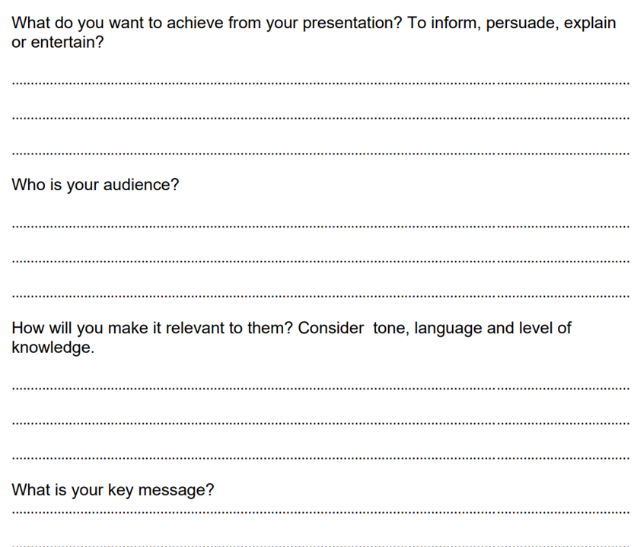
Group work

