Slide 1
Week 4 – reading skills - Methods of reading - Fact and opinion

Slide 2
Aims of the session
Know the different methods of reading a text
Be able to look at a text and identify facts/opinions
Be able to discuss an issue using information from a text

Slide 3
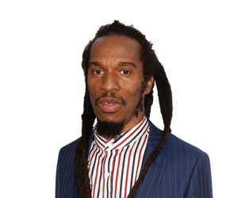
Black History Month

Slide 4
How would you read …
a dictionary?
a newspaper article?
the back cover of a book?
a menu?
a novel?
a college text book?

Slide 5
Ways of reading
Scanning
Skimming
Reading for detail
We skim read to quickly get the gist of a text

Slide 6
Skim reading
How do you skim read?
use layout features
read first and last paragraphs
read first sentence of each paragraph
look for key words (scanning)

Slide 10
Fact and opinion
Definition of fact?
Definition of opinion?
Areas where fact and opinion overlap or are difficult to identify/trust?
using statistics selectively to prove your point
ignoring facts that undermine your point
advertising

Slide 11
Examples of facts

Slide 12
Examples of opinions

Slide 13
An example of a tricky fact/opinion
98% of dentists choose Colgate toothpaste *
* in a survey of 27 dentists

Slide 14
Black History Month
Overall, which text has more facts and which has more opinion?

Slide 15
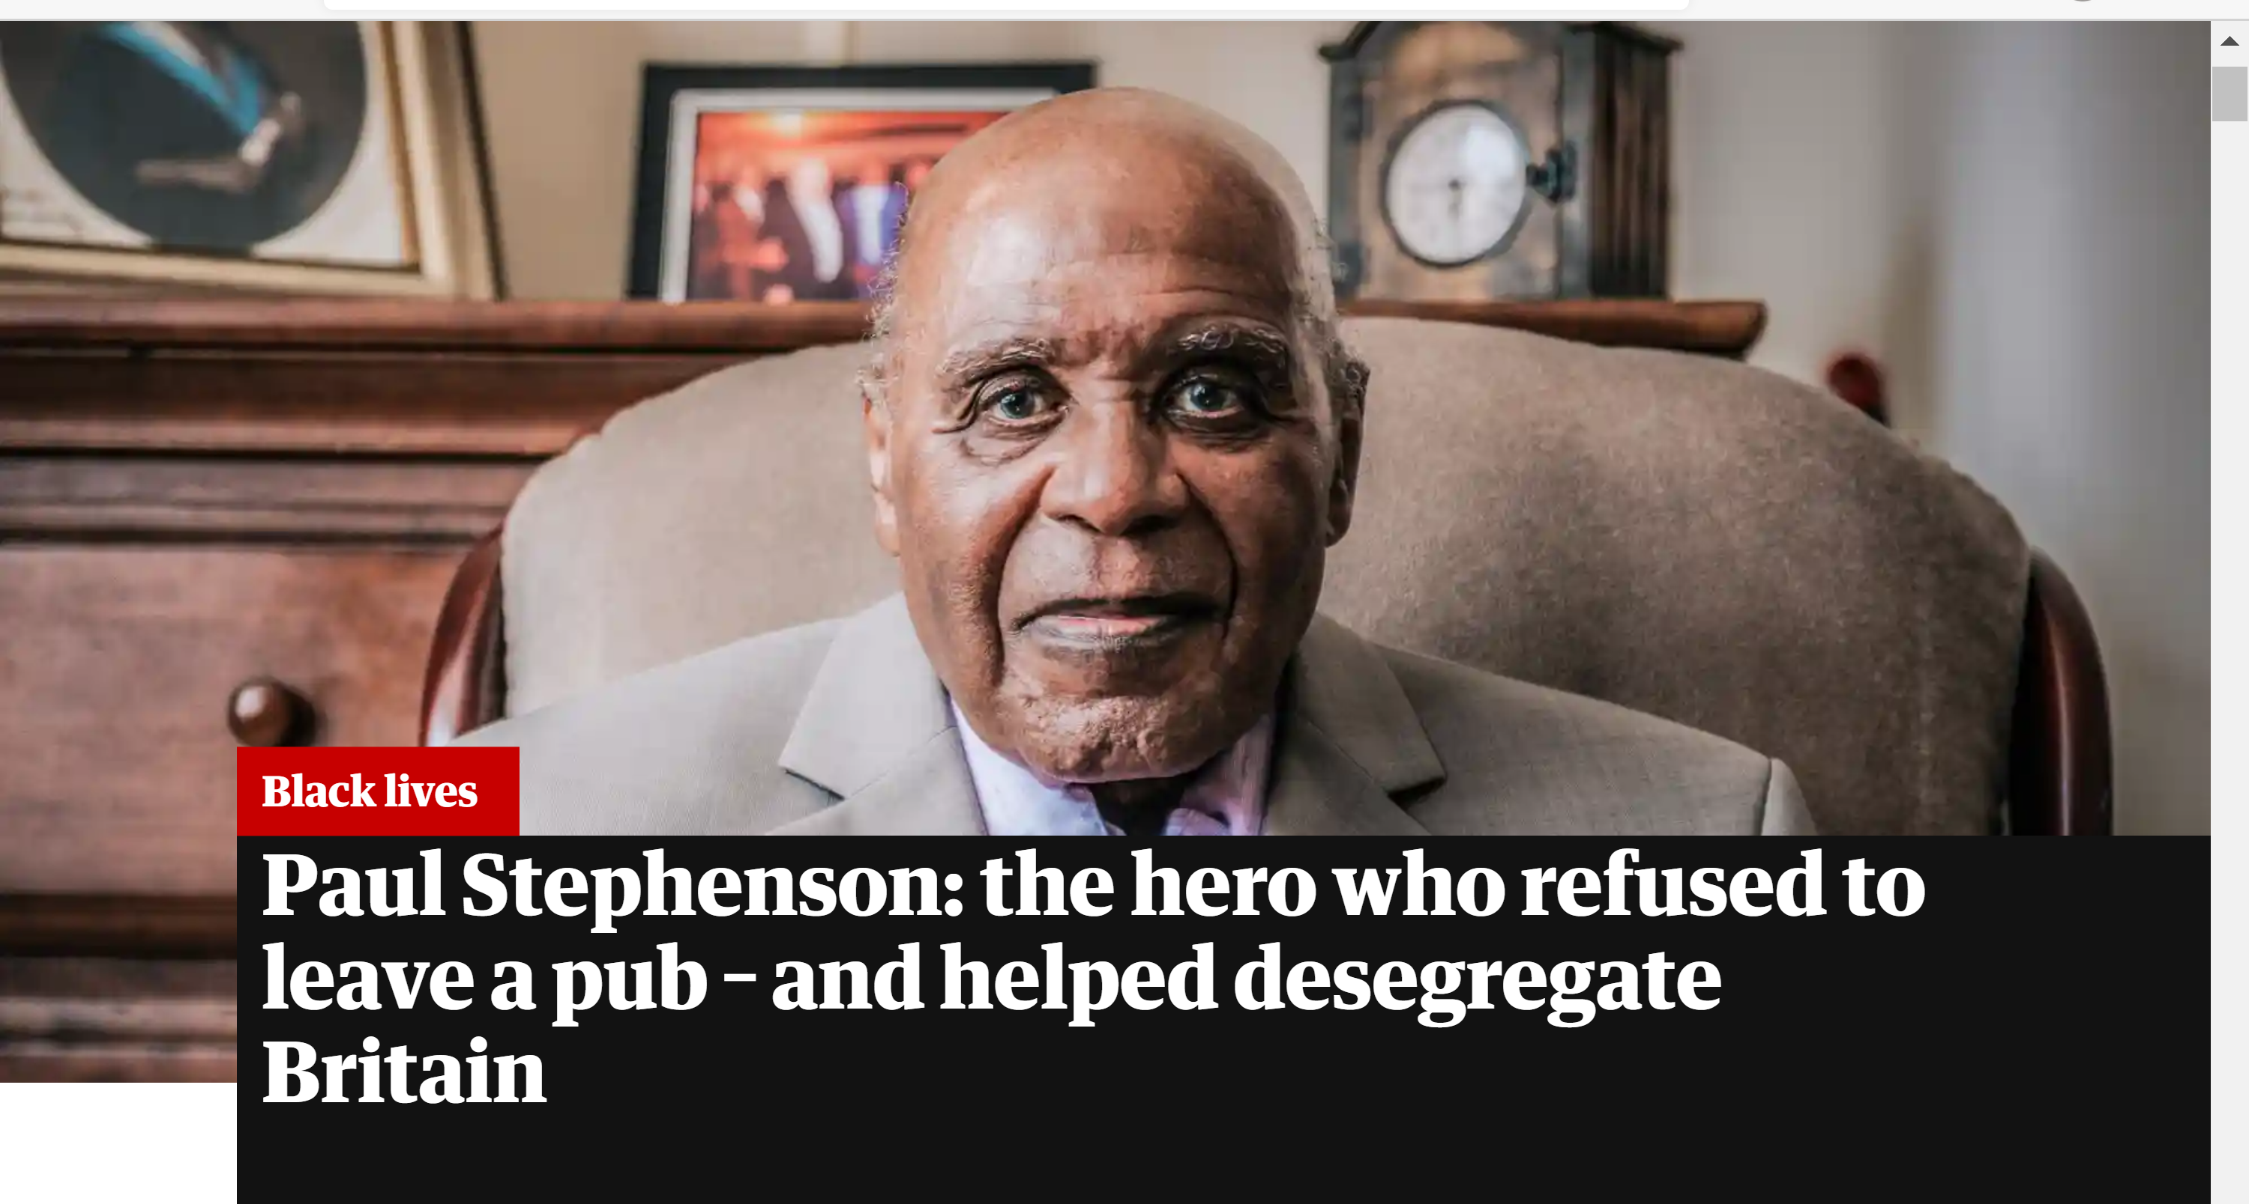
What did you find out about him and his life?

Slide 16
Vocabulary from the interview
Look at the following sentences and define the underlined word(s). Use your knowledge and the context of the sentence to work it out.

Slide 17
The Bay Horse pub may have been notorious for banning black people but it was not alone.
… fresh from leading a successful boycott of the city’s bus company.
While the activists had been triumphant, it was not without personal cost.
The charges against him were dismissed … “I was vindicated,” he says.

Slide 18
5. … it is clear the decades have not dimmed his satisfaction.
6. (He) was born … to a west African father (from whom he was estranged)
7. While caning him for a misdemeanour, Stephenson’s teacher asked him …
8. Yet not everyone admired his stance …

Slide 19
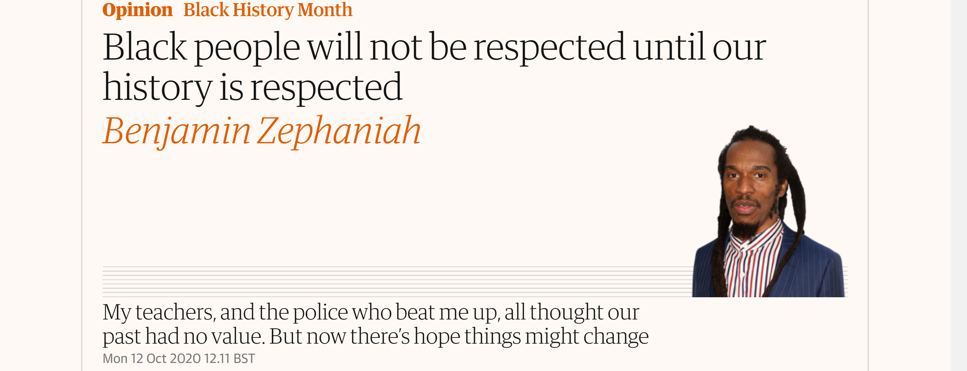

Slide 20
Opinion from the editorial
Why does he say we need a Black History Month?
What is his experience of racism?
What does he say about racists now?
Is the article balanced or one-sided?

Slide 21
Writing prompted by quotes from the texts
“You can’t have true racial harmony without racial justice. So, you need to be disruptive.”
Paul Stephenson
“The uprisings we see happening all over the world now are not happening in a vacuum. They are happening because history is being ignored – and ultimately, it’s all of our history.”
Benjamin Zephaniah

Slide 22
Developing your reading skills
www.readtheory.org

Slide 23
Aims of the session
Know the different methods of reading a text
Be able to look at a text and identify facts/opinions
Be able to discuss an issue using information from a text

