Slide 1
Online Interview Skills Pt 2
Online interview skills for a digital age

Slide 2
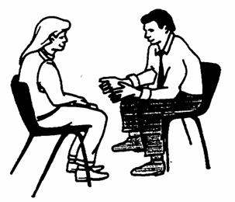
Safeguarding Please…
Respect other people
Speak to your teacher or the Centre Manager if you have a problem.
The Safeguarding Officer is David Coleman who can be contacted on 07525387549
Notes:
As well as being about comments and complaints this slide also offers the opportunity to raise SAFEGUARDING awareness. You can draw attention to the posters around the centre and offer an access point for people to come forward with abuse issues and be referred to the relevant support.

Slide 3
We actively promote British Values
Democracy
The Rule of Law
Individual Liberty
Mutual Respect
Tolerance of those of different faiths and beliefs
Safeguarding policy
Harassment and Bullying policy
Computer Use policy which includes e-safety

Slide 4
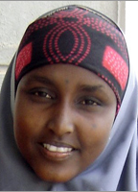
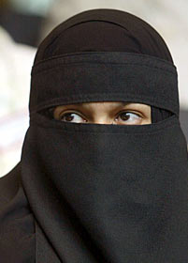
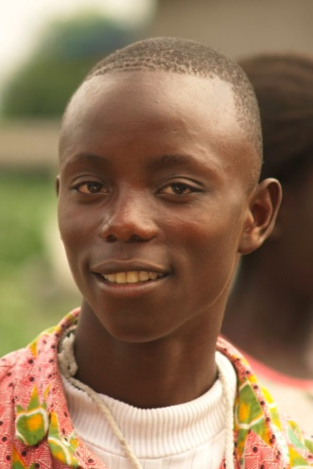
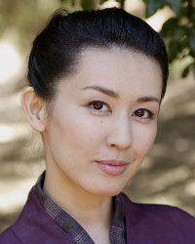
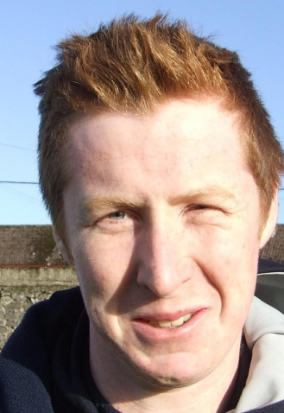
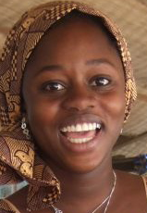

Slide 5
In today’s session we will
Review what we learned last week
Be able to understand how to answer the kinds of typical questions we may face
Have the opportunity to start to prepare our answers and to practice speaking them out.

Slide 6
Why do you want to work for this company?
You need to say what appeals to you about:
The company’s core business products or services
How many people work there? Are they local, regional, national or international?
Be willing to outline how your relevant skills and experience can make a difference to the company.
You may also mention these if it seems more is expected:
Company structure, finances, key staff, how old is the company?
Customers and competitors
Market trends and challenges

Slide 7
What are your strengths?
Highlight what you are good at and how this helps in a work situation.
Make sure your strengths are relevant to the job – ie a good teacher needs to be patient and resilient.
Give examples for each one showing how you have used your strength in a work situation. Use factual information to influence in a positive way – Who? What? Where? Why? And When?

Slide 8
What would you say are your weaker areas?
Keep your weaknesses technical not personal. No-one wants to hear you saying you like to gossip or you spend too much time playing computer games! Your weaknesses need to be solvable, manageable deficiencies that you are overcoming and learning to conquer.
The interviewer wants to see:
How you approach a difficult question.
Whether or not you recognise your weaknesses (we all have them)
What you’re doing about them and whether your individual strengths and weaknesses (they’re usually related) make you the right candidate for the job.

Slide 9
Choose one of the previous questions and prepare your answer

Slide 10
What do you think makes a good team?
In any role you will be expected to work as part of a team and the interviewer needs to assess how well you relate to other people, what role you take in a group and whether you are able to focus on goals and targets.
Wherever possible, give examples of situations where you have demonstrated teamwork.
Indicate the personal qualities you used and how this helped the team to succeed.

Slide 11
Tell me about a difficult scenario at work and how you dealt with it:
This question is to test how you cope under pressure as well as your problem solving and communication skills. Good examples are where you:
Helped resolve or improve a difficult situation.
Were resilient in adverse conditions.
Showed emotional intelligence and cool-headedness.
Avoid any examples which still feel sensitive, because in a high-pressure interview situation, old emotions can easily resurface and throw you off balance

Slide 12
Why do you want this job?
Your answer should reinforce why you are such a good fit for the job and then convey your enthusiasm for the role e.g.
Good match between your skills and their requirements
Interested in the product/market/sector
Company’s excellent reputation, exciting challenge etc.
It isn’t very complimentary to say (even if it’s true) that you just need a job, or you want it because it’s local!

Slide 13
What would you do to ensure you gave excellent customer service to all our customers?
Your answer to this question should demonstrate that you recognise how important it is to keep customers satisfied in any business:
Give actual past work-related examples of when you have delivered a good service or gone the extra mile wherever possible.
Explain what you did in a previous role which resulted in satisfied customers.

Slide 14
Now choose another question and take it in turns to give your answer.

