Slide 1
Welcome Functional Skills Maths Level 2

Slide 2
My name: Hasan Shah

Slide 3
Session 1:
Aims: Course Induction
Objectives: by the end of the session, you will be aware of:
Online session start time and term dates.
Online Learning Class Rules
Health and Safety guidance
Adult Community Learning (ACL) Courses

Slide 4
Introductions

Slide 5
Start/Finish Times:
Functional Skill Maths E3 Monday 1pm – 3pm
Functional Skill Maths L1 Tuesday 10am – 12pm
Functional Skill Maths L2 Tuesday 1pm – 3pm

Slide 6
Summer Term 2021
Maths E3, Mon; 26/04 – 12/07/21
Maths L1, Tue 10-12; 27/04 – 13/07/21
Maths L2. Tue 1-3; 27/04 – 13/07/21

Slide 7
ACL:
Autumn Term: 13/09/21 – 10/12/21
Half Term 25/10/21 to 29/10/21
Spring Term: 10/01/22– 01/04/22
Half Term 14/02/22 – 18/02/22
Summer Term: 25/04/22 – 15/07/22
May Day Bank Holiday 02/05/22
Half Term 30/05/22 - 03/06/22

Slide 8
What are: functional skills?
“Functional skills are practical skills in English, mathematics and information and communication technology (ICT) that allow individuals to operate confidently, effectively and independently in life and work.”
Department for Education and Skills

Slide 9
Maths Topics
Number: Whole number, Calculations, Fractions, Decimals, Percentages, Large Numbers, Positive & Negative Numbers, Ratios, Equivalences
Measure, Shape and Space: Money, Time, Length, Weight, Capacity & Temperature, Compound Measures, 2D & 3D Shapes, Positional Vocabulary, Perimeter, Area & Volume,
Statistics and Data: Recording Data, Discrete Data, probability, Averages, Mean & Range, Tree Diagrams & Tables, Frequency Tables

Slide 10
Online Learning Class Rules
Try to be somewhere quiet, away from noise where you can fully concentrate on your learning
Even if you are at home, wear appropriate clothes as you would in the classroom
Log in to the session 5-10 minutes before the start time to give yourself time to test your microphone and speakers, (and resolve any technical issues)
Be on time to every online session.
Respect everyone and do as the teacher asks.
Mute your microphone whenever you are not speaking to reduce background noise.
Be patient because sometimes the internet is slow or doesn’t work.
Do your homework.
Never record or screenshot any part of the lesson.
Keep your camera turned on (unless agreed otherwise with your tutor)
A tea/coffee is fine, but please avoid eating during the sessions
Be present, engaged and ready to contribute
Do not multitask (documents and presentations that are required for the session are the only things you should have up on your screen). Although it’s tempting to check emails or work on other things when you are not speaking please remain focused.
If you need to excuse yourself then please use the chat function to let the tutor know that you need to leave and when you will return.

Slide 12
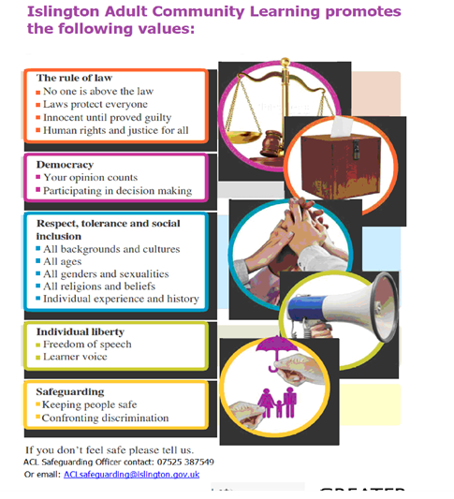

Slide 15
https://aclgateway.islington.gov.uk/pluginfile.php/25398/block_html/content/Safeguarding%20with%20subtitles.mp4

Slide 17
Information Advice and Guidance
IAG one-on-one sessions (by appointment only)
This term we are offering Information Advice and Guidance session online Monday afternoons from 1.00 – 4.00pm and Wednesday mornings from 9.30 – 12.30.
To book an appointment contact Alison Moore 07808879044 or email Alison.Moore@islington.gov.uk
At Islington Adult Community Learning we are committed to providing you with high quality information and advice about learning opportunities with us. We will also signpost you to other agencies like the National Careers Service, which offers free guidance to adults relating to learning and work.
The IAG service at Islington Adult Community Learning gives you the opportunity to have a confidential 1- 1 appointment with a qualified advisor absolutely free if you are an Islington resident in receipt of benefits. Sessions can last up to an hour and are designed to help you to give you the opportunity to move forward with your employment, education and training.

Slide 18
https://aclgateway.islington.gov.uk/pluginfile.php/3944/mod_page/content/38/Information%20Advice%20and%20Guidance%20BSL%20in%20vision.mp4

Slide 19
Homework:
Complete ILP &
Read Student Handbook

Slide 20
The end

