Slide 1
Welcome to your online lesson
Today we will:
Talk about health and wellbeing
Listen to a radio programme
Revise using past continuous

Slide 2
Let’s talk
Health and Medicine - Random wheel (wordwall.net)

Slide 3
Read the e-mail and notes below. Write one illness on each line. flu food poisoning a cold

Slide 5
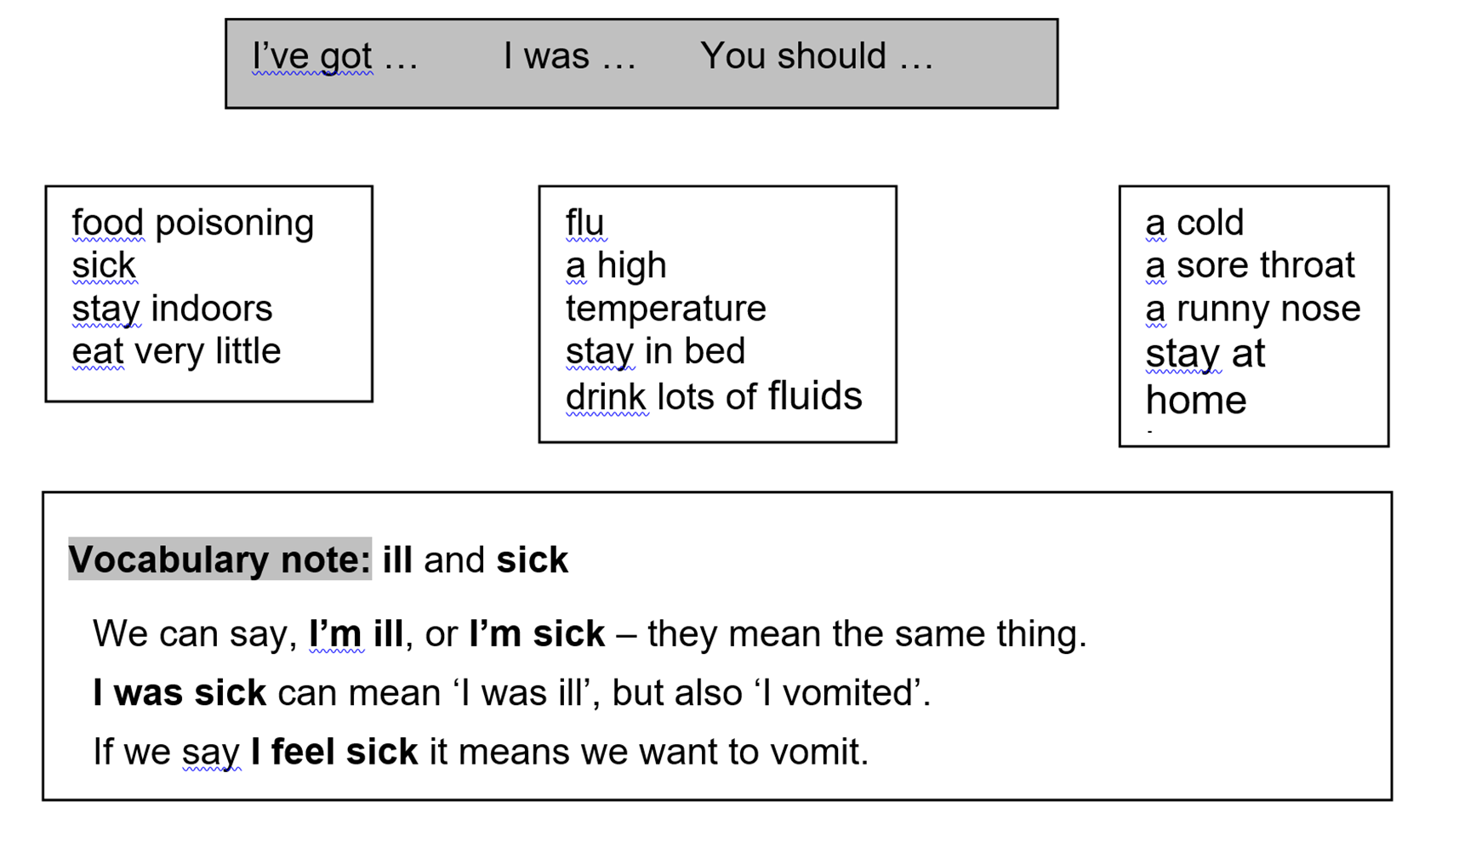
Now use the structures in the grey box and the words and phrases in the white boxes
You are ill. Telephone your teacher/boss. Say what the problem is.
You are the teacher/boss. Give advice.

Slide 7
Listen again

Slide 8
Welcome to your online class today

Slide 11
Past simple and past continuous
Look at this sentence:
I drove home when my scooter ran out of petrol.
This doesn’t work. You can’t drive a scooter without petrol. You want to say you ran out of petrol on the way home. You need to make drove longer so that ran out of petrol happens in the middle. You can do this with the past continuous, which makes shorter-time verbs longer:
I was driving home when my scooter ran out of petrol.
If the verb can’t get longer, it repeats:
He banged his head on the door. → He was banging his head on the door.

Slide 12
Online grammar practice (2b)

Slide 13
Complete each sentence using past simple and past continuous.

Slide 14
Look at the sentences below. Some of the tenses are wrong. Change the wrong ones to the correct tense – either past simple or past continuous.
1 I woke up with toothache so I phoned the dentist.
2 When I was finishing the letter I took it to the post box.
3 When I was cleaning the car, my mobile rang.
4 I was cutting my hand so I went to the hospital.
5 I ran along the street when the policeman stopped me.
6 I was sending a text to my girlfriend when I dropped the phone.
7 When the dentist gave me an injection the needle was breaking.
8 They put him inside the ambulance and it drove away.
9 When I was losing my passport I phoned the consulate.

Slide 15
Now write answers to these questions:
What were you doing:
at eight o’clock this morning? __________________________
at ten o’clock last night? __________________________
at one o’clock yesterday? __________________________
at nine o’clock on Sunday evening? __________________________
at this time last week? __________________________
on the 1st of January this year? __________________________
on the afternoon of your last birthday? __________________________
Work with a partner. Ask and answer the questions. Do you have the same answers?

Slide 19
Poor diet can have bad effect on your health
Do you agree?
Can you give examples?

Slide 20
Poor diet brings back historical disease
BBC News Review: Poor diet brings back historical disease – YouTube
BBC Learning English - Course: English You Need / Unit 9 / Session 2 / Activity 1
Watch the video and write 3 new words explained in the video

Slide 21
Come back
Resurgent
Archaic

Slide 22
Put these words into pairs with similar meanings. attractive beautiful fat good-looking handsome not very tall overweight plain short slim thin ugly
beautiful
attractive

