Slide 1
ESOL L1 Spring Term
1st Mar 2021

Slide 2
Session aims/objs
Aim: exploring health and safety online and at home
Objs: by the end of this session, you will be able to
Watch a video and discuss the contents
Express your thoughts and ideas
Explore safeguarding

Slide 3
Online Learning Class Rules
Try to be somewhere quiet.
Even if you’re at home wear appropriate clothes.
Be on time.
Respect everyone and do as the teacher asks.
Wait until you’re asked to speak.
Turn your microphone off when others are talking.
Be patient because sometimes the systems don’t work.
Do your homework.
Never record or screenshot any part of the lesson.
Have fun and learn!

Slide 4
Our ACL 1-1 IAG offer
A confidential service for learners
Up to 3 one hour sessions with a qualified adviser
Adherence to the Guidance Council’s Code of Principles (impartial, current, confidential, in accordance with equality and diversity legislation, accessible, individual ownership, transparency)
and the Career Development Institute’s Code of Practice (as above, also duty of care, accountability and CPD)
Notes:
Any organisation which manages, administers and delivers an IAG service to support individuals in their career, learning, work or life goals has the chance to achieve matrix accreditation.
This is regardless of whether the service or services are delivered face-to-face, through training, learning, remotely, or through a website.

Slide 5
How can learners book an appointment?
For the summer term we are offering IAG sessions via telephone and/or via MS Teams
For general appointments:
Contact Alison on 07808 879044
Email Alison.moore@islington.gov.uk
Appointments available:
Tuesdays and Thursdays
9.30am - 12.30pm and 1 – 4pm
To find out about all or our courses on offer visit: www.adultlearning.islington.gov.uk

Slide 7
Privacy online

Slide 8
Discussion on safeguarding
What do you understand about the term safeguarding?
What do you understand by the terms below:
Abuse
Responsibility
Threaten
Can you name different types of abuse?
verbal abuse
physical abuse
sexual abuse
psychological abuse (mental/emotional)
financial abuse

Slide 9
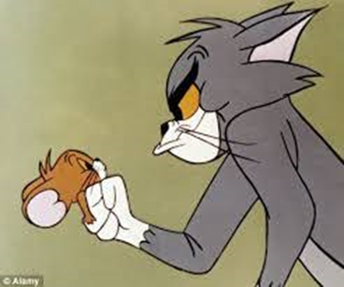
What is safeguarding?
Safeguarding is about making people feel safe.
abuse = to make someone feel bad or to hurt someone
What does abuse mean?

Slide 10
What does safer learning mean?
Feeling safe to learn
Your rights
Your responsibilities
Tel 020 7527 3343

Slide 11
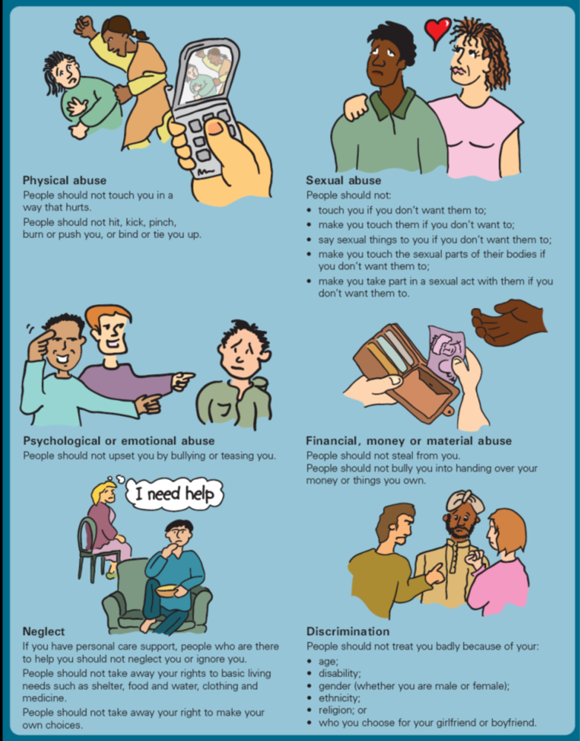
Psychological abuse
Physical abuse
Sexual abuse
discrimination
neglect
Financial abuse

Slide 12
Safeguarding
David Coleman
Safeguarding Lead
Tel 020 7527 3343
ACLSafeguarding@islington.ac.uk

Slide 13
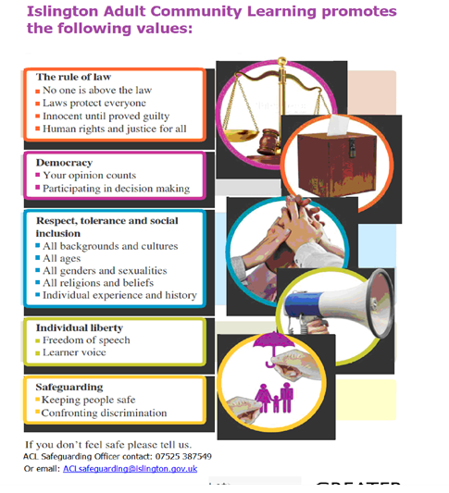

Slide 14
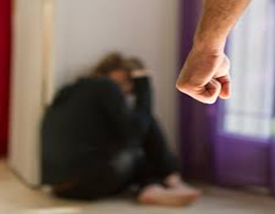
Now, decide if these scenarios are
examples of abuse. If so, what type of abuse.
Amy pinches her colleague’s bottom in the office party, and when her colleague asked her to stop, she said that he must have enjoyed it and was just being too sensitive.
Adam gets incredibly annoyed at having to wait on hold during telephone calls. He shouts at the automated voicemail and hangs up.
Betty works full time but has to transfer her monthly salary to her husband’s account who says that she is silly, absent minded and cannot be trusted with money.
Samina is often ignored by her mother at home. She is not given dinner often, or a wash. Reminder letters asking for her mum to book her for an oral check up at the dentist go ignored.

Slide 15
Modal verbs (grammar focus)
For advice – “I think you/he/she should” + infinitive
“I would advise that you/he/she” + infinitive
For suggestions – I suggest that you/he/she should + infinitive
E.g.
I think you should report it to your manager
I advise that you report it to your manager

Slide 16
Now, offer a solution for each of these examples?
Use modal verb (should/suggest/advise) in your phrases.
Amy pinches her colleague’s bottom in the office party, and when her colleague asked her to stop, she said that he must have enjoyed it and was just being too sensitive.
Adam gets incredibly annoyed at having to wait on hold during telephone calls. He shouts at the automated voicemail and hangs up.
Betty works full time but has to transfer her monthly salary to her husband’s account who says that she is silly, absent minded and cannot be trusted with money.
Samina is often ignored by her mother at home. She is not given dinner often, or a wash. Reminder letters asking for her mum to book her for an oral check up at the dentist go ignored.

Slide 17
Lesson summary
In the lesson, you…
Watched a video and discuss the contents
Expressed your thoughts and ideas
Explored safeguarding
Developed confidence in using language effectively
Practised grammar/pronunciation

Slide 18
Discussion of the video
Extra resource on My Digital Rights
Privacy online: an introduction
https://www.bl.uk/my-digital-rights/videos/privacy

Slide 19
References:
Extra resource on My Digital Rights
Privacy online: an introduction
https://www.bl.uk/my-digital-rights/videos/privacy

