Slide 1
Essential Digital Skills for ESOL
Entry 2 & Entry 3
Vocabulary & Zoom

Slide 2
Today we will:
Learn computer and internet vocabulary
Talk about what to do when you get ‘lost’ on your phone or computer
Practise turning your microphone and video on and off
Send a message in Zoom chat

Slide 3









Do you know what these pictures mean?
1
2
3
4
5
6
7
8
9

Slide 4

icon – (noun) a small picture on a computer screen or a phone that you press to do different things (for example open your WhatsApp or use your camera)
How many icons can you see on this phone?

Slide 5

What’s this?

Slide 6

What is a device?

Slide 7
device – (noun) a piece of computer technology, for example a smartphone
Do you know any other devices?

Slide 8


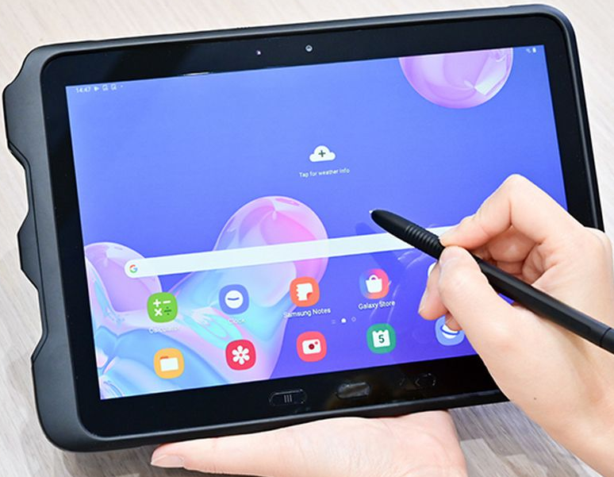
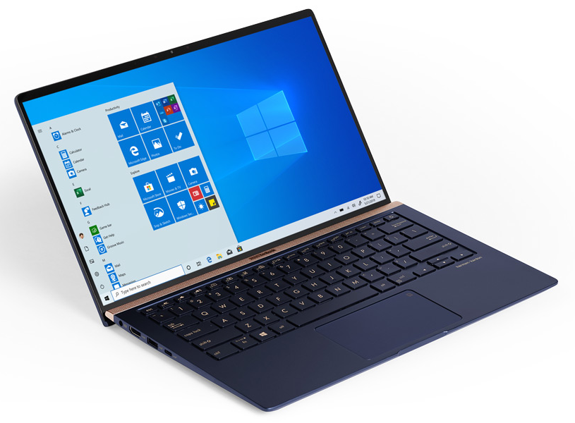

Match the pictures and the words in the box.
smartphone laptop tablet iPhone desktop computer
B
C
D
A
A large computer that sits on top of your desk
E
What device are you using?
A small computer you can take with you

Slide 9

What’s this?

Slide 10
Can you think of other things that have a screen?

Slide 11




Slide 12


Match the words and the meaning.
A
Use it for people to hear you speak
Write text on a phone or computer
A small arrow icon on a computer screen that shows you where you are working
To press on a part of a computer to make the computer do something
to type
to click
microphone
cursor
B
C
D

Slide 13
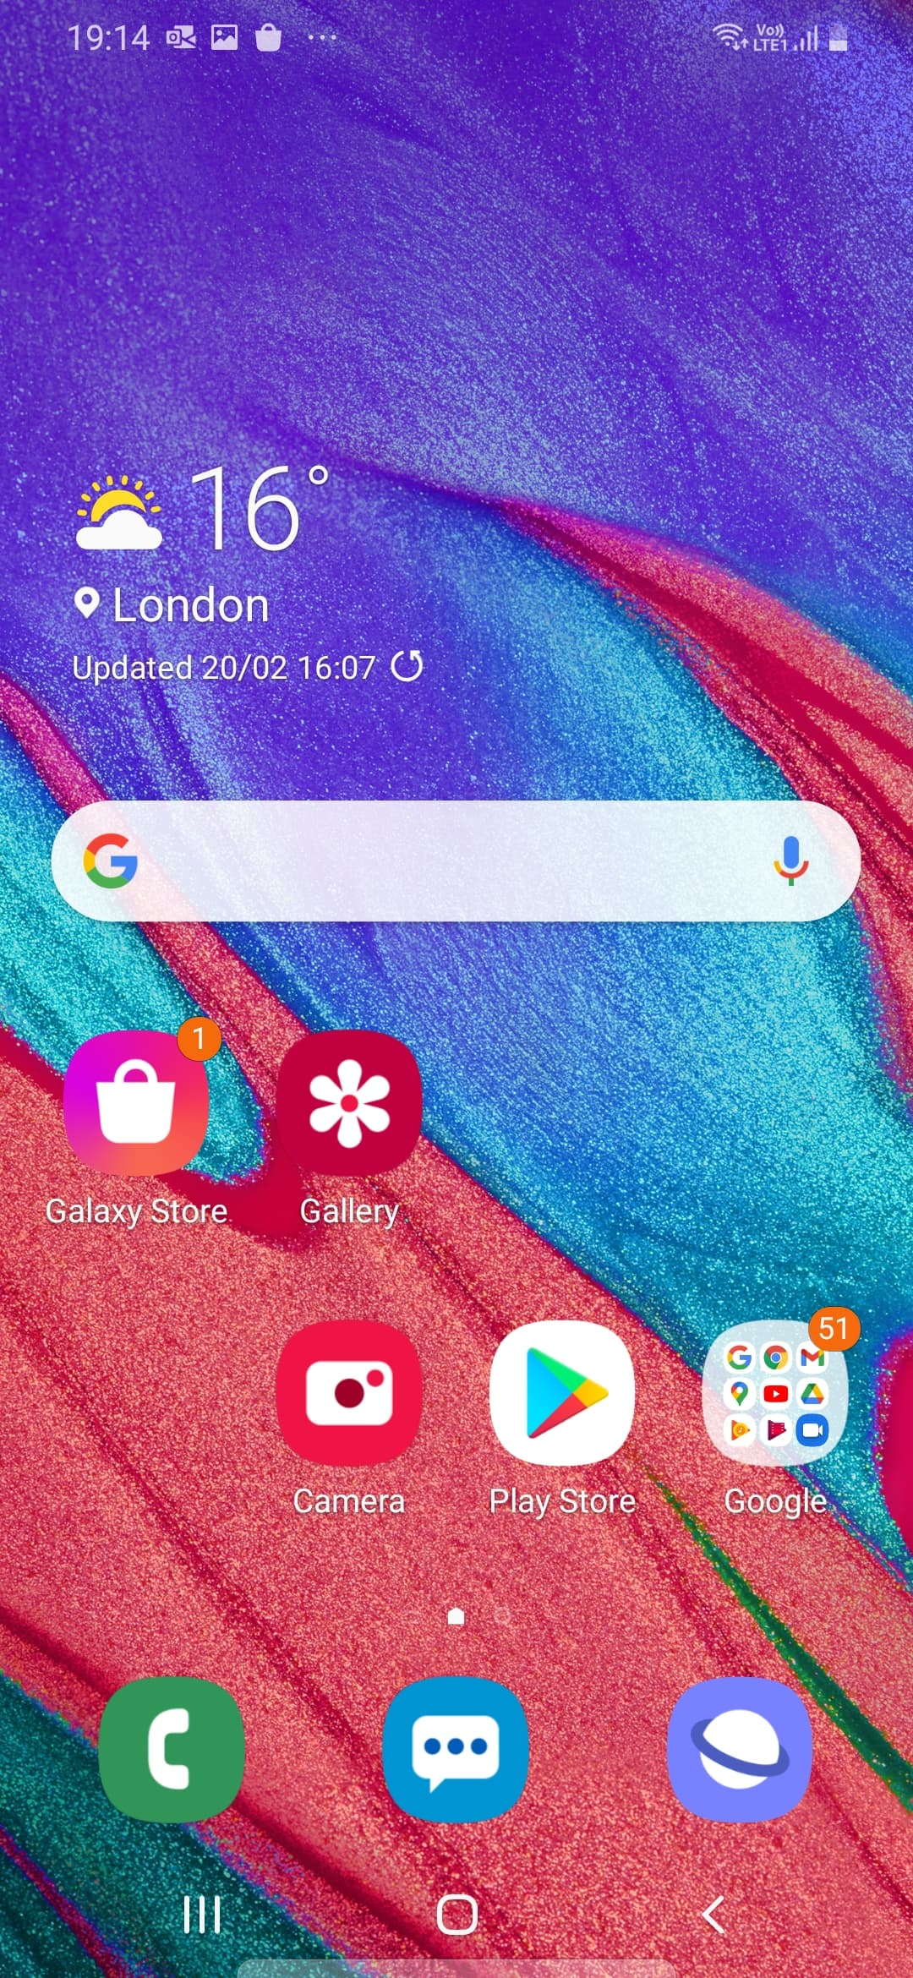
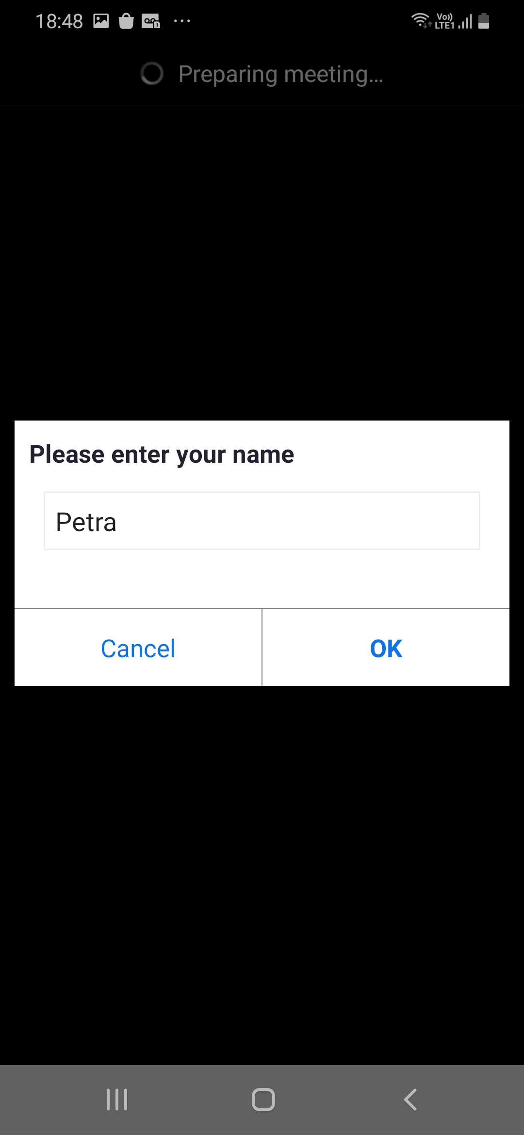
If you get lost on your phone
home screen
Press the home button at the bottom of your screen
You will return to your home screen
and you can start again

Slide 14

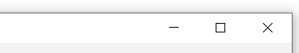

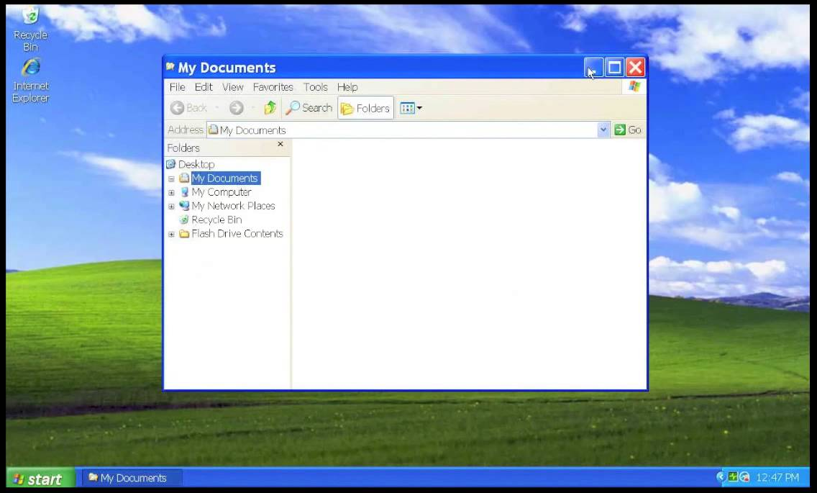
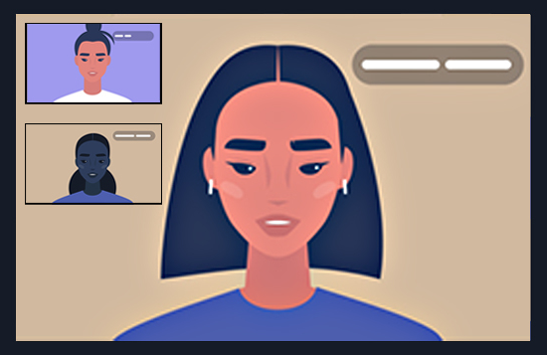
If you get lost on your computer/laptop
Icons in the top right corner of your screen:
hide the page (make it go away)
Make the page smaller (so you can see other things on your screen)
Close the page
If you get lost, you can close the page and start again

Slide 15

How to join a Zoom meeting
join = connect
Your teacher will send you a link. The link is always underlined. It looks like this:
https://weareislington.zoom.us/j/91029085478?pwd=cElyWEQ1bmNGSkFZL21XTklIQmRBdz09
You press/click on the link to join the meeting and follow the instructions

Slide 16
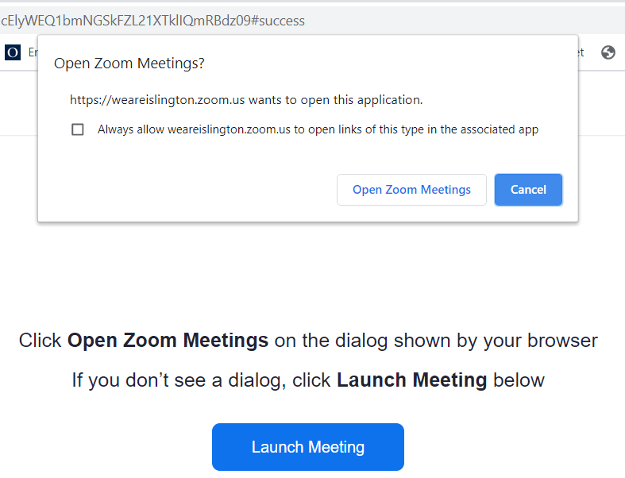
Joining a meeting on your computer or laptop
You will see this message. Click open Zoom Meetings

Slide 17
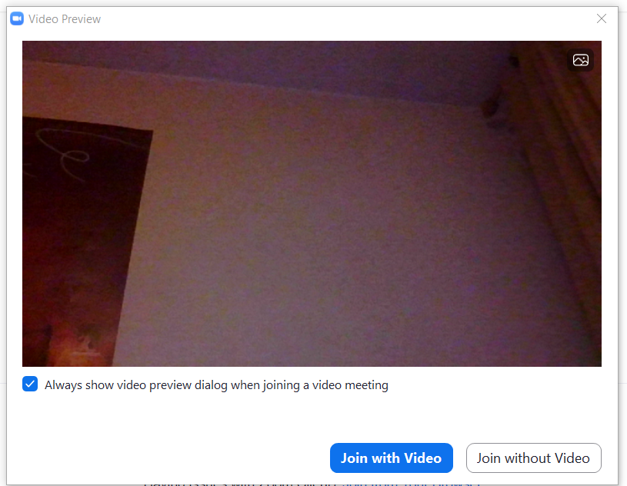
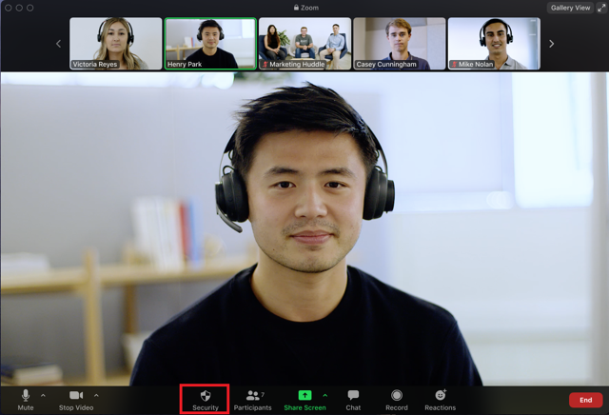
Click join with video

Slide 18

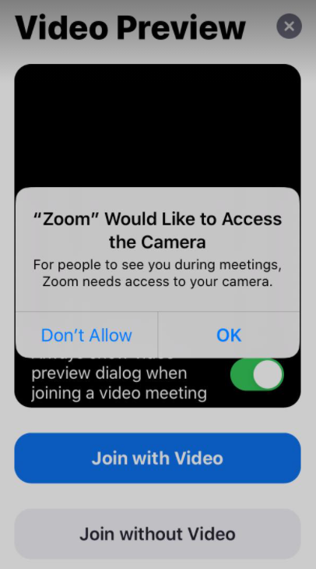

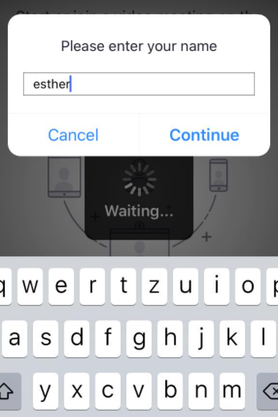
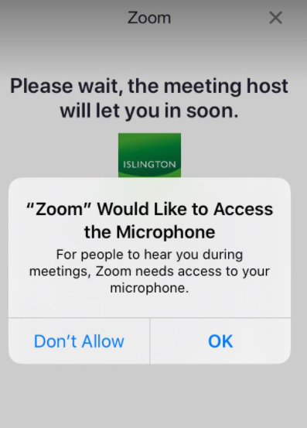
Joining a meeting on an iPhone
1 Type your name and press continue
2 Press ok
3 press Join with Video
4 press ok

Slide 19
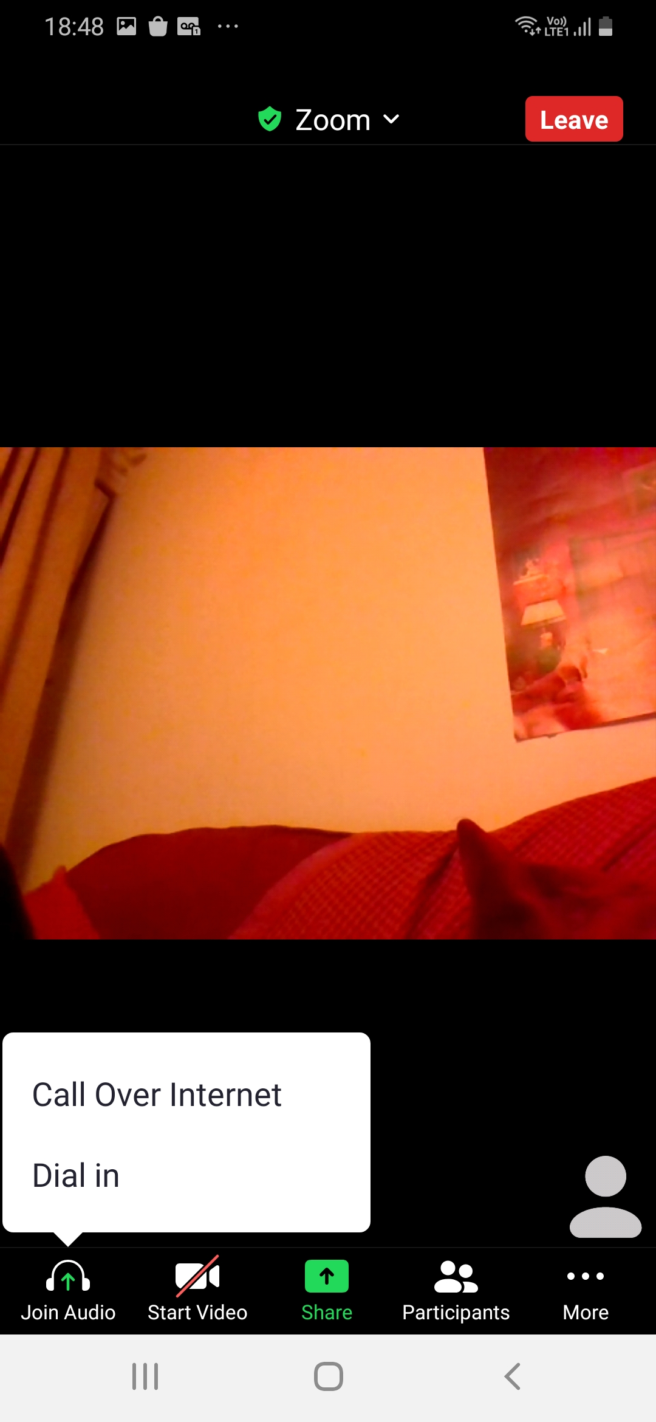
Joining a meeting on a different phone (not iPhone)
1 Type your name and press ok
2. Press call Over Internet

Slide 20
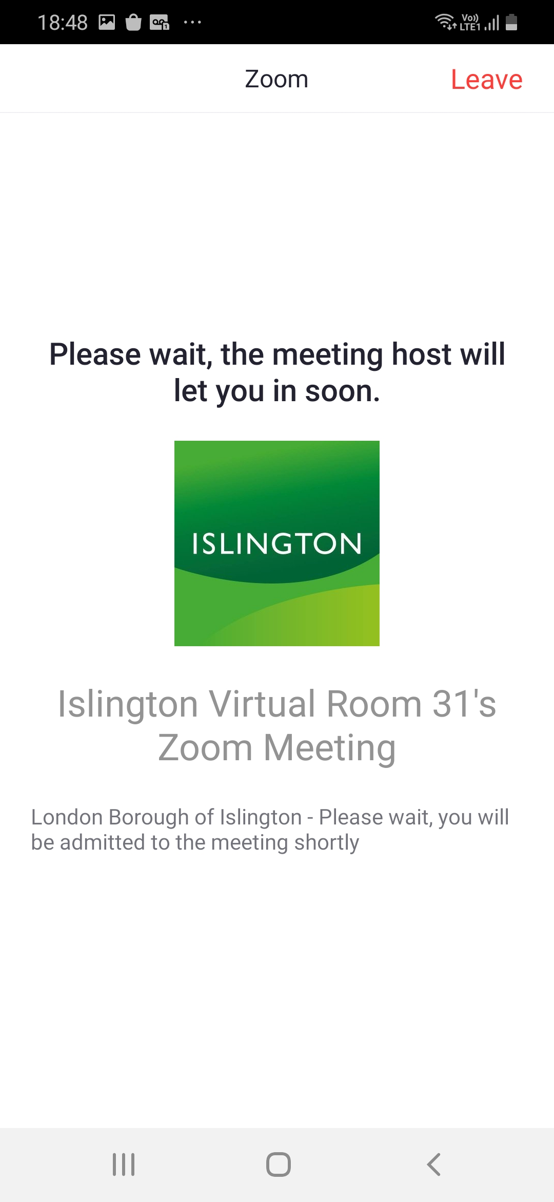
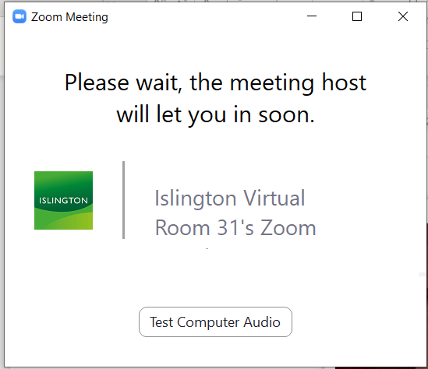
Now wait, your teacher will let you in
to the meeting.

Slide 21
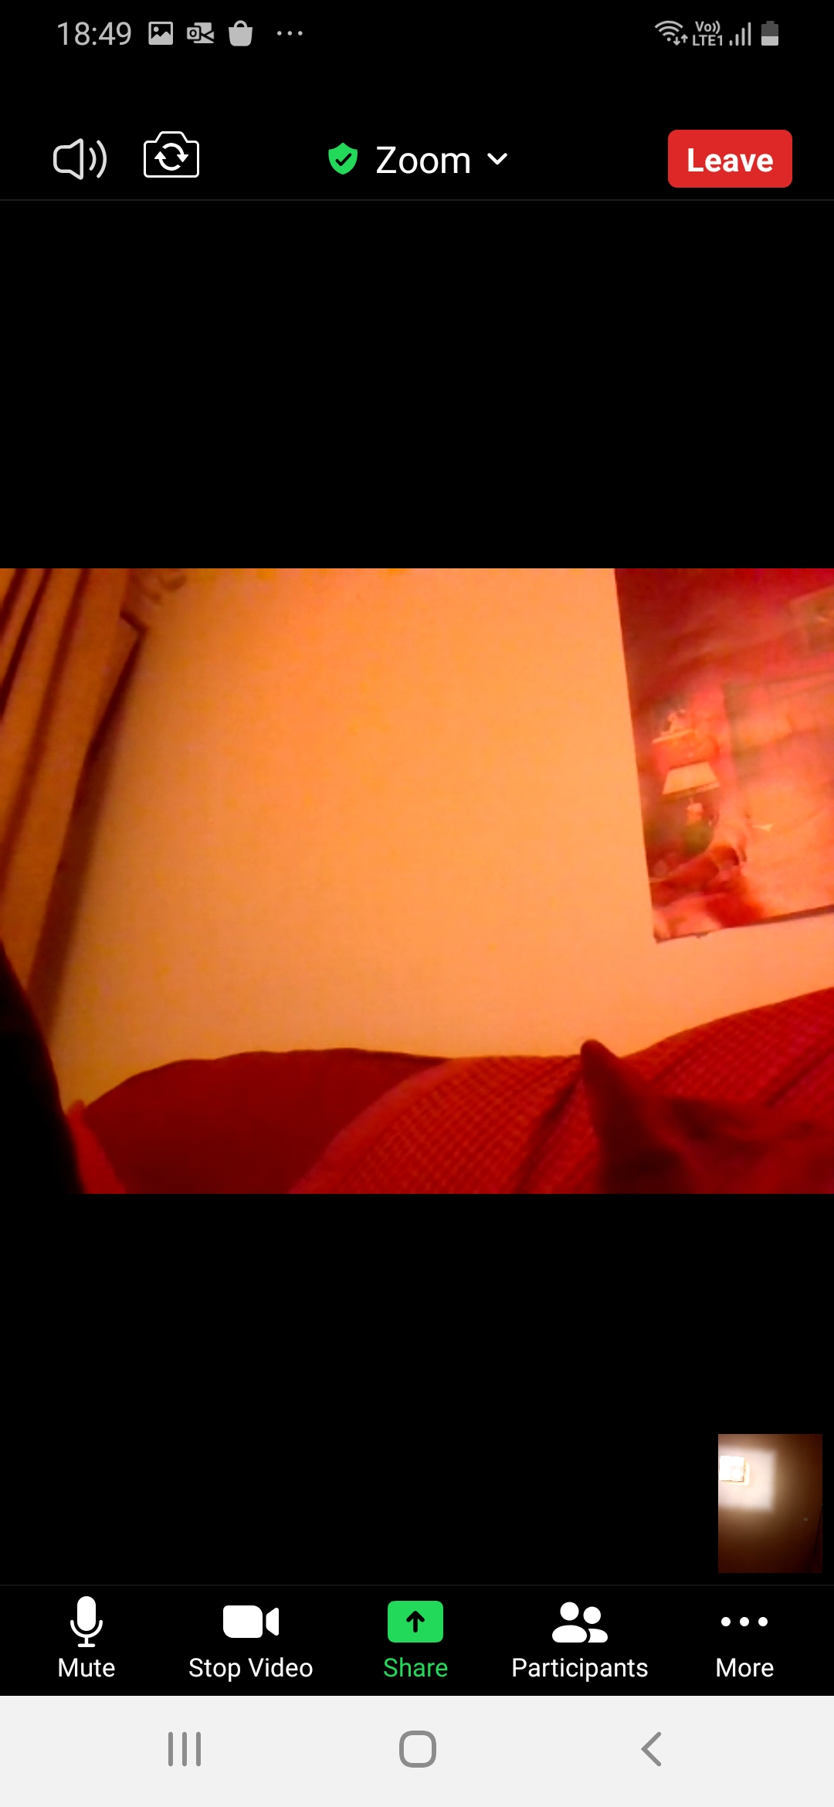

Using Zoom on your phone
After a few seconds, all the icons go away.
Press anywhere on the screen to see the pictures again
Press on screen

Slide 22
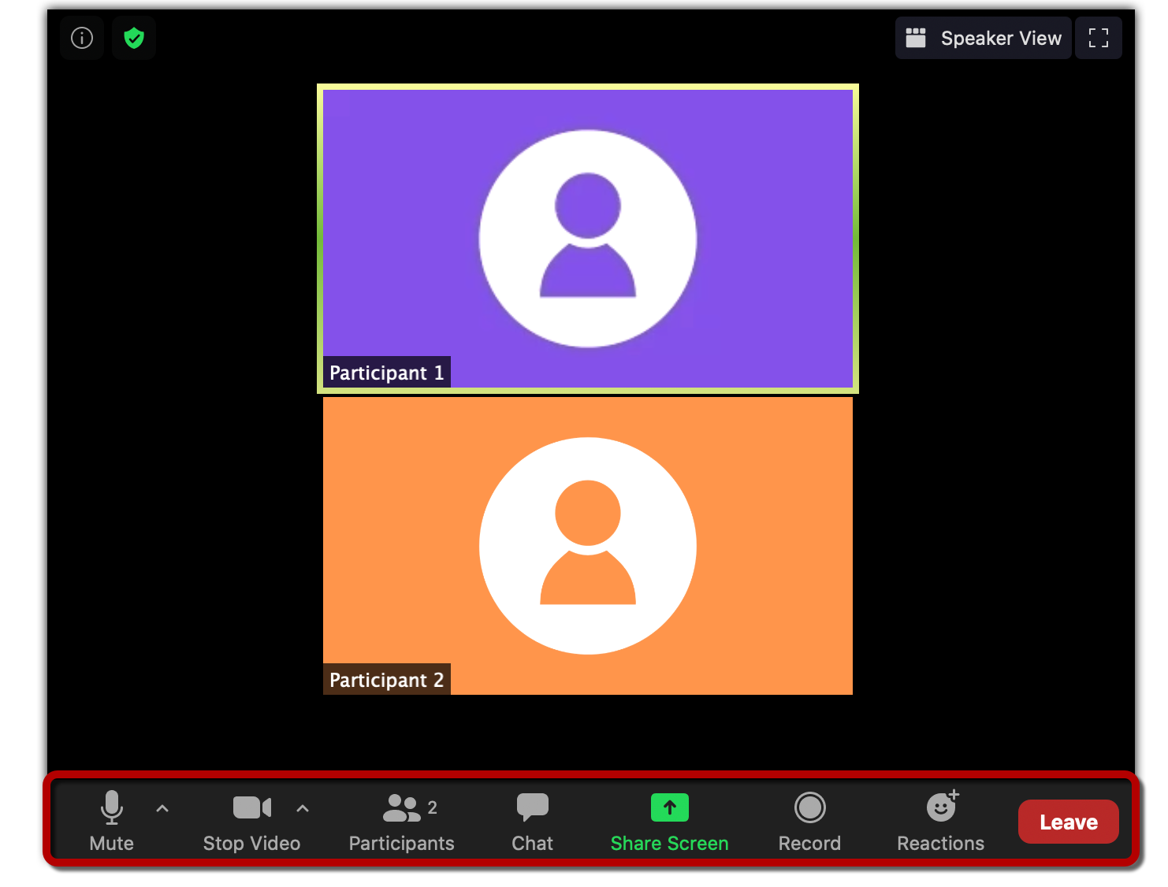
menu

Slide 23
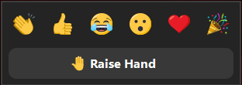
Zoom menu – press/ click on each picture to do different things
turn your camera on or off
write a message in the chat
send pictures
leave the meeting
turn your microphone/sound on or off
see the people in the meeting

Slide 24
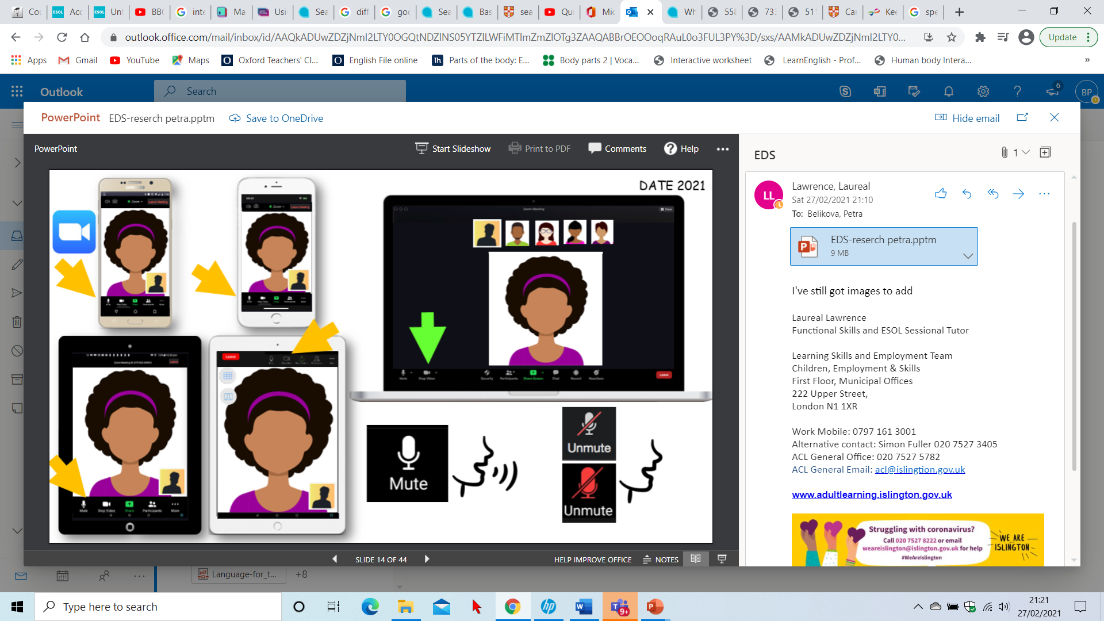
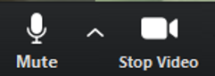

Microphone: you can turn your sound off (= mute) or on (= unmute)
Video: you can turn your camera on or off
microphone and camera are on
microphone and camera are off
Let’s practise!
1. Turn your microphone off. Turn it back on.
2. Turn your video off. Turn it back on.

Slide 25


To leave the meeting press
Let’s practice!
Everyone leave the meeting now, then find the Zoom link from your teacher and join the meeting again.

Slide 26
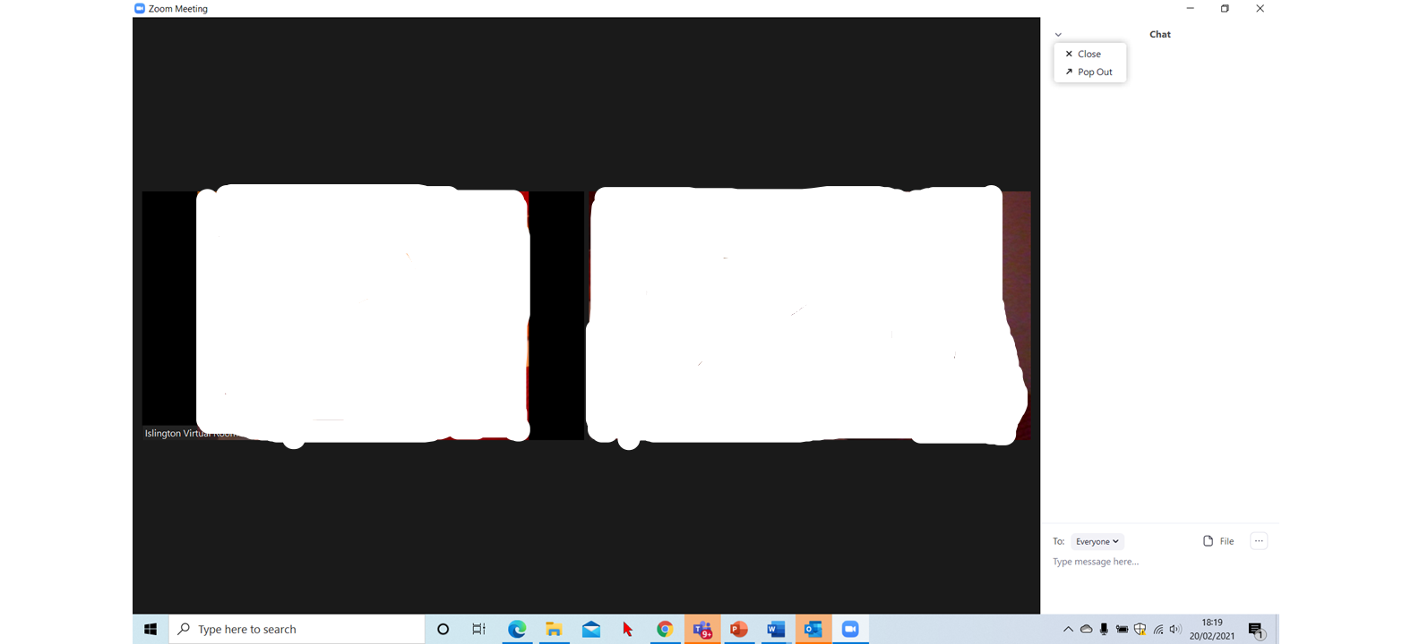
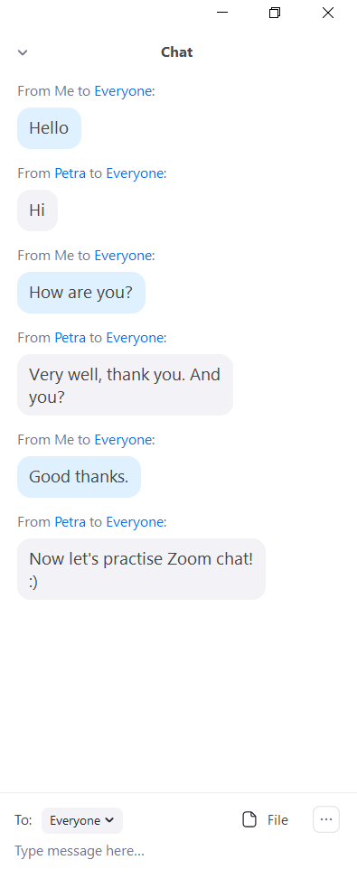


Using chat on your computer/laptop
Type your message here and press the Enter key
press chat

Slide 27
To close the chat press here

Slide 28
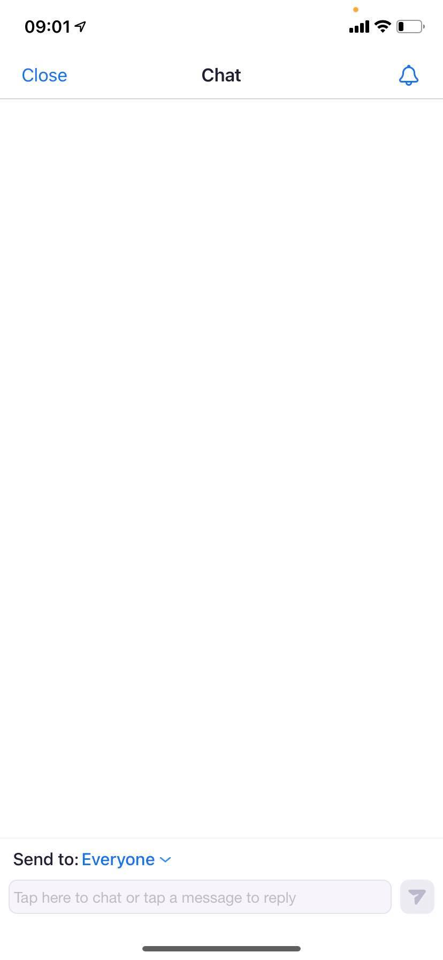
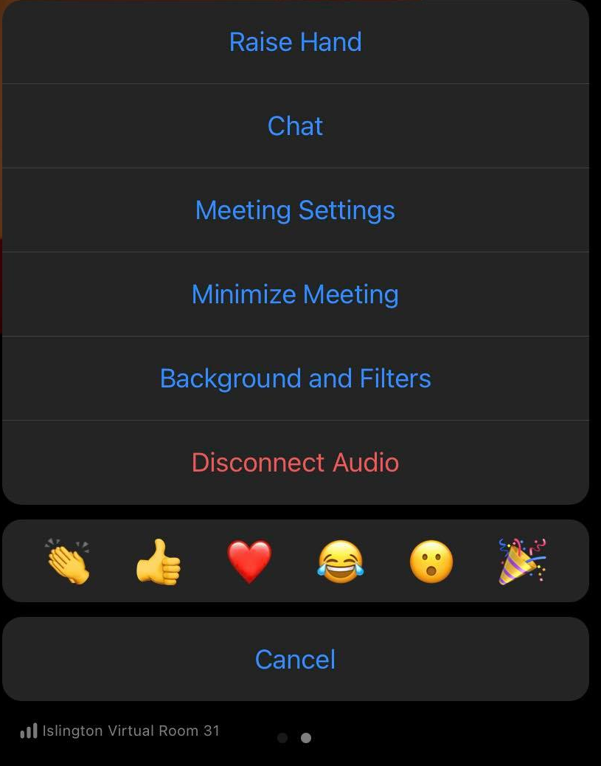
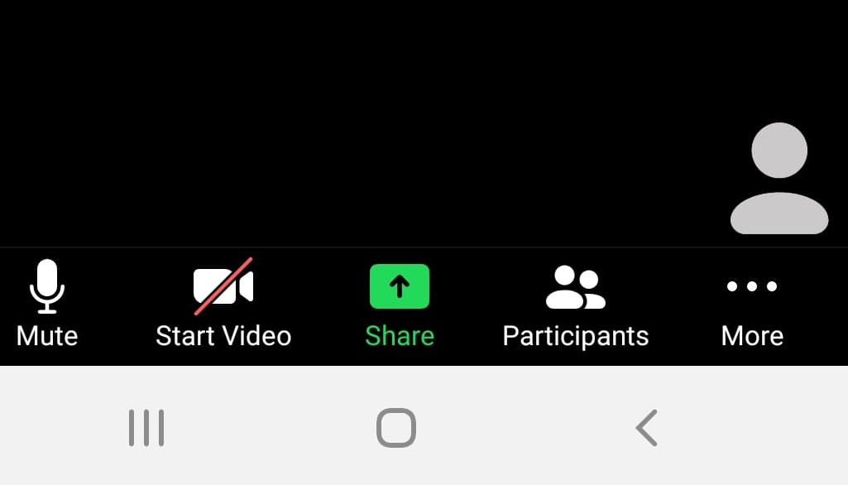
Using chat on an iPhone
To leave the chat press close
2 press chat
1 at the bottom of your screen, press more . . .
3 type your message here
4 press send

Slide 29
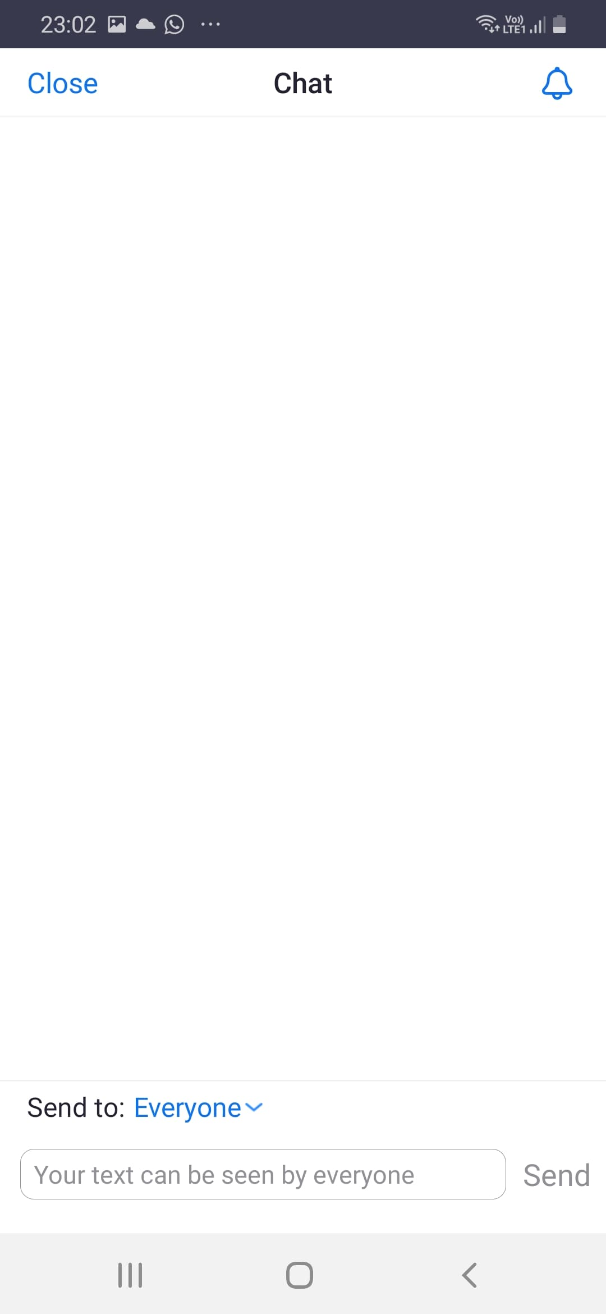
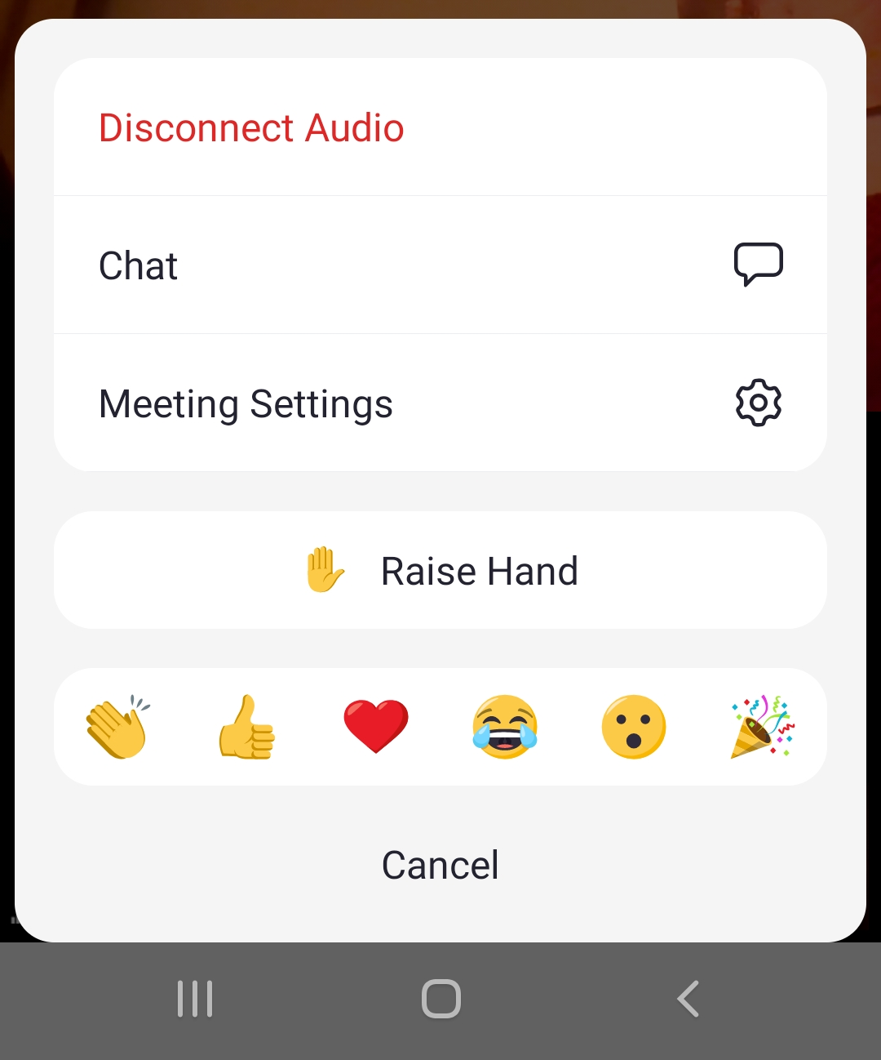
Using chat on a different phone (not iPhone)
To leave the chat press close
2 press chat
1 at the bottom of your screen, press more . . .
3 type your message here
4 press send

Slide 30
Let’s use Zoom chat!
Say hello in the chat

Slide 31
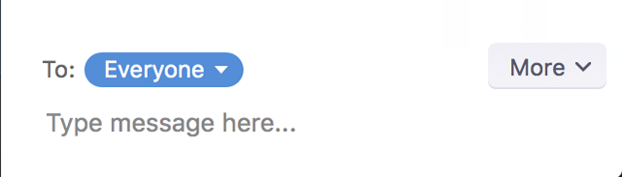
You can send your message to everyone or send a private message to one person, for example to your teacher.
Press/click on the small arrow, you will see all the people in the meeting. Choose the person you want to message
Let’s practise
1. Say hello in the chat, send the message to everyone.
2. Say hello in the chat, send the message only to your teacher.

Slide 32
Homework: Revise vocabulary from today’s lesson:
icon - a small picture on a computer screen or a phone that you press to do different things
arrow -
device - a piece of computer technology, for example a smartphone
screen -
to type - to write text on a phone or computer
to click - to press on a part of a computer to make the computer do something
to mute - to turn microphone/sound off
to unmute - to turn microphone on

