Slide 1
Essential Digital Skills for ESOL
ESOL Entry 2 & Entry 3
Online search

Slide 2
Today we will:
Talk about the internet
Learn about different search engines
Learn how to search for things online
Use an online dictionary

Slide 3
What can you remember from the last lesson?
What is an icon?
What is a device? Can you give examples?
What does it mean to mute your microphone?

Slide 4
What is the internet?
Watch the video to find out.
https://youtu.be/VBKa9Ay8ebs

Slide 5
The internet, also called the web, is a big library of information. You can use it to read the news, shop, watch TV and videos, pay bills and more. You can use it to stay in contact with family and friends.
It’s also great for learning English!
To go online = go on the internet

Slide 6
How often do you use the internet?
What do you use it for?

Slide 7
What does it mean to search for something?

Slide 8
to search – (verb) to try to find something, to look for something
I searched my pockets but I can’t find my keys.

Slide 9
What is a website?

Slide 10
website – (noun) a page on the internet where you can find information about something
Do you visit any websites? Which ones?

Slide 11
Do you know what these icons mean?
1
2
3
4
5
6

Slide 12
Answers
1
2
3
4
5
6
Google
Internet
wifi
Facebook
close
search

Slide 13
You can access the internet from any computer or smartphone that has an internet connection, for example a broadband or wifi.
You use a browser to go to websites and pages on the internet.

Slide 14
Browsers help you get go pages on the internet.
Do you know any of these browsers? Try to match the pictures and the names.
1
Microsoft Edge
Safari
Google Chrome
2
3

Slide 15
When you don’t know the website, or you want to find some information, use the browser’s search engine to help you find it

Slide 16
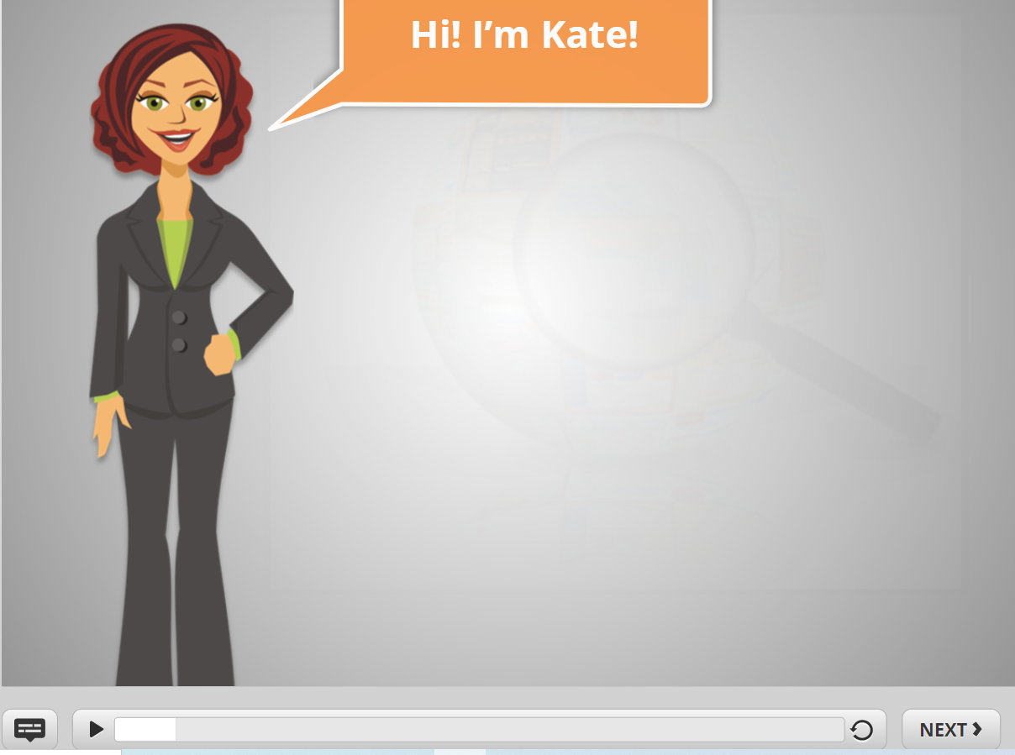
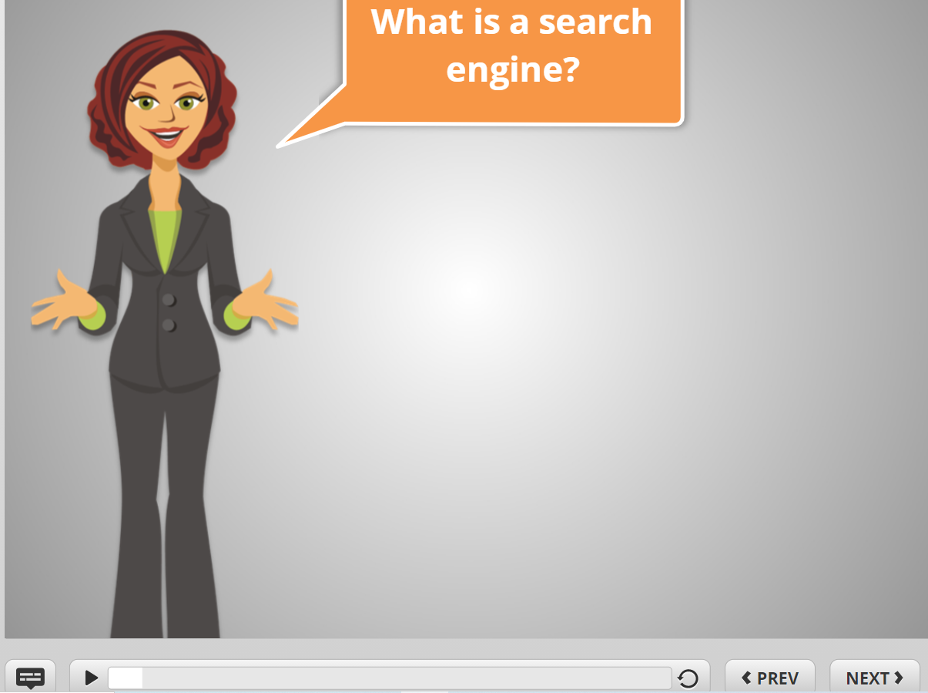
Instructions for teacher: to play video on the next slide
1. Open link:
https://www.digitallearn.org/courses/basic-search/lessons/what-is-a-search-engine
2. Click No
3. Click Next
Play from here: What is a search engine
Play until the end of examples of things to find online
Turn on captions

Slide 17
What is a search engine?
Watch the video and answer the questions.
1. What are some of the most popular search engines?
2. What kind of things can you search for?
https://www.digitallearn.org/courses/basic-search/lessons/what-is-a-search-engine

Slide 18
Answers
What are the most popular search engines?
Bing, Yahoo, Google
2. What kind of things can you search for?
the weather
the news
recipes
movie times
find words

Slide 19
How to search for things on the internet using Google
Press/click on the Google icon. It will open and you can start searching

Slide 20
How to search on the internet using Google
Click/press on the Google icon to open it
Type what you are looking for in the search box
Type your word in the search box

Slide 21
Let’s check the weather!

Slide 22
Type weather in the search box

Slide 23
1. Type weather in the search box
2. Click/press the search icon

Slide 24
You can also do it this way:
Type weather in the search box
Google will suggest ideas. Choose the one you want and click/press on it

Slide 25
What’s the weather like on Sunday?

Slide 26
You want to find a recipe for a curry
Type curry recipe in the search box
Click/press the search icon

Slide 27
You will see lots of links for websites and videos = these are your search results
Choose the one you want and click/press on the blue link
to open it

Slide 28
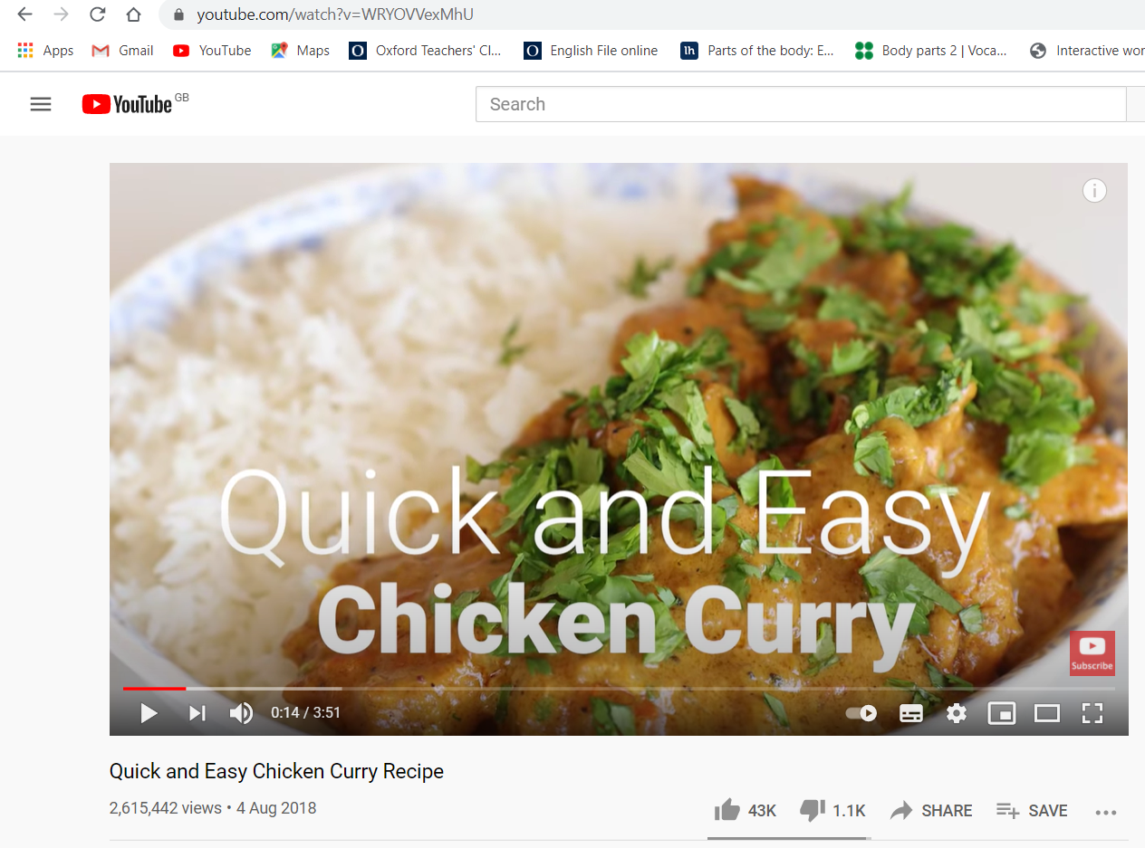
To go back to the search results, click/press the back button
go back

Slide 29
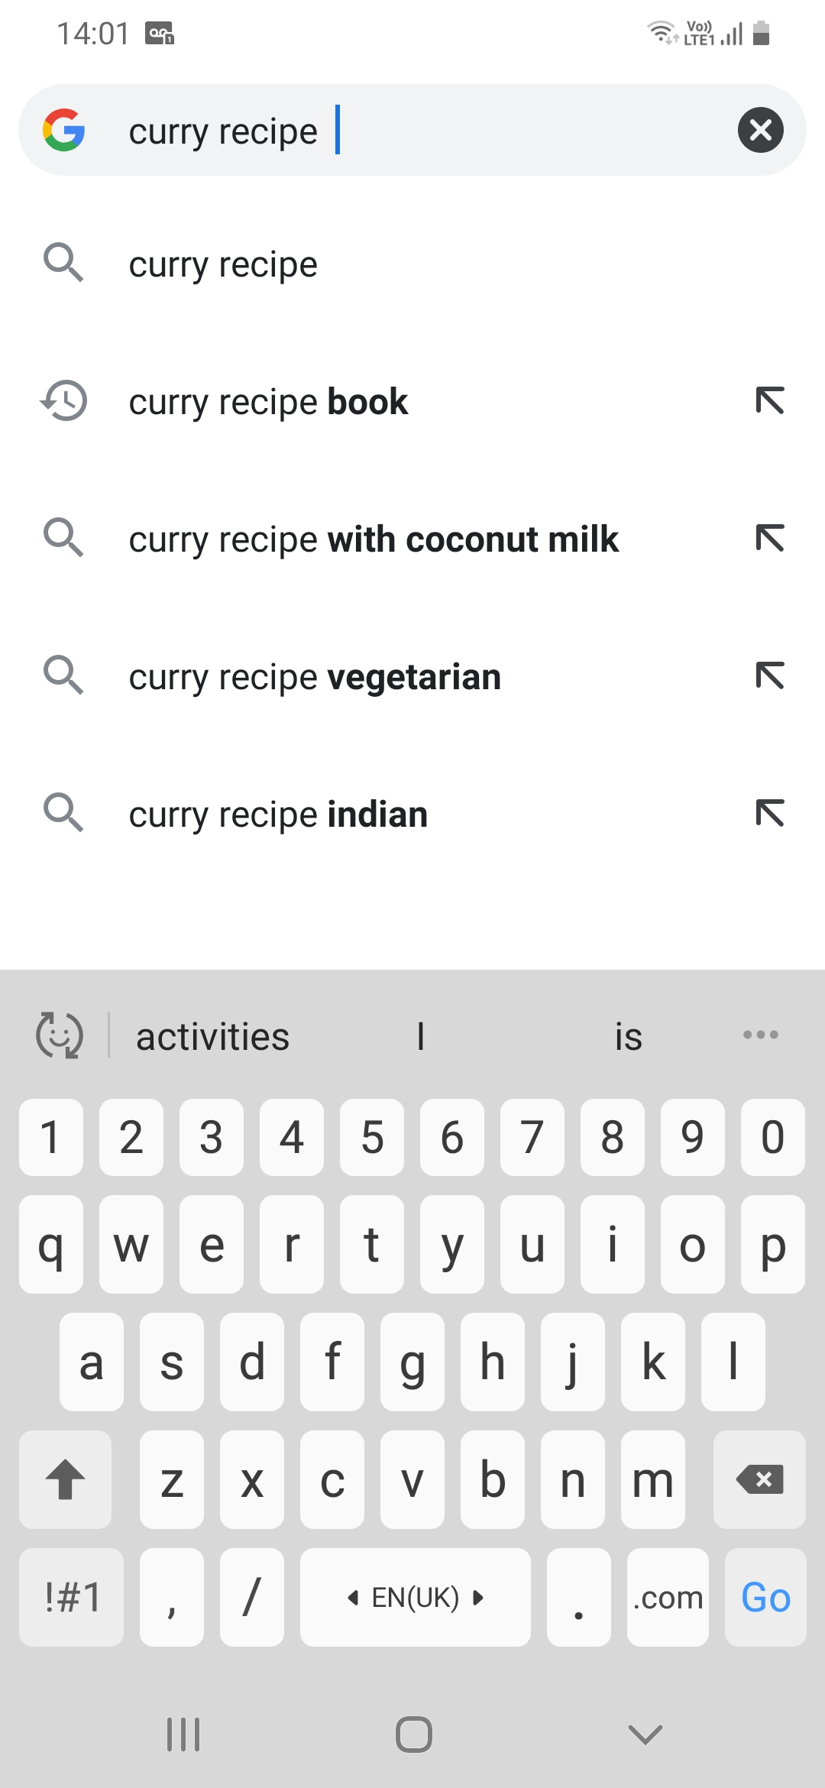
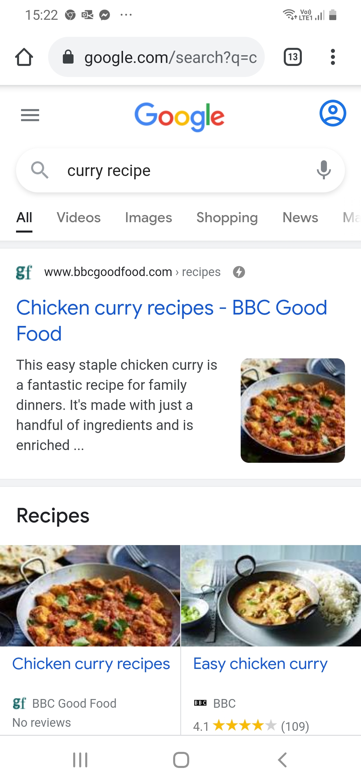
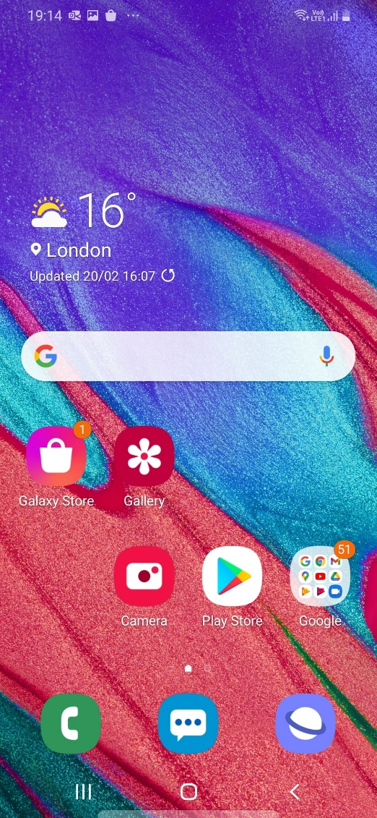
home screen
type here
Searching
on your phone
To go back to your home screen, press the home button
press go
on an iPhone press:
To go back to the last page

Slide 30
Using an online dictionary, for example the Cambridge learner’s dictionary
Type in the search box
To find the dictionary:

Slide 31
1 Type in the search box
2 Click/press search
3 Click/press on the link to open it

Slide 32
You can now search in the dictionary
Click/press search
Type your word in the search box

Slide 33
Let’s check the meaning and pronunciation of the word “search”
https://dictionary.cambridge.org/dictionary/learner-english/

Slide 34
Open page in browser with audio to play sound
https://dictionary.cambridge.org/dictionary/learner-english/search_1
click/press here to listen to the word
meaning
examples

Slide 35
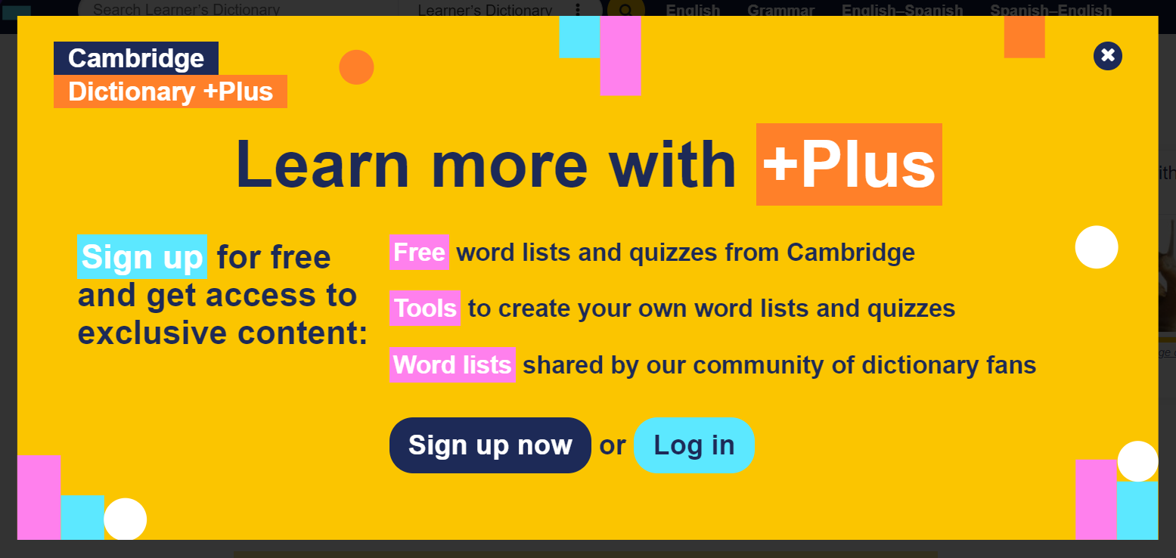
If you see this page, click the close button to close it

Slide 36
VOCABULARY QUIZ
Match the words and their meaning.
1. to search
2. website
3. search engine
A You use it to find information on the internet
B to try to find something, to look for something
C a page on the internet where you can find information about something

Slide 37
Homework
Go to the Cambridge learner’s dictionary online.
Here is the link:
https://dictionary.cambridge.org/dictionary/learner-english/
Find the meaning of the word “attach”.
Next week, explain the meaning to the class.

