Slide 1
Essential Digital Skills for ESOL
ESOL Entry 2 & Entry 3
Moodle

Slide 2
Today we will:
Learn about Moodle and how it can help you learn
Learn how to log in to Moodle
Learn how to find your course on Moodle
Learn how to find course information and lesson materials on Moodle

Slide 3
Homework from last week.
What is the meaning of the word “attach”?
How do we say it?
Let’s check:
https://dictionary.cambridge.org/dictionary/learner-english/

Slide 4
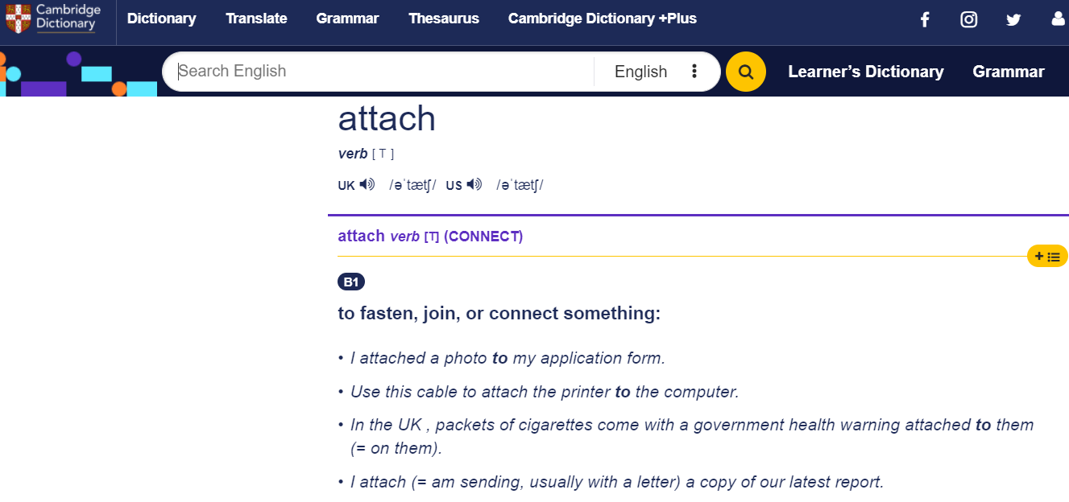

Slide 5
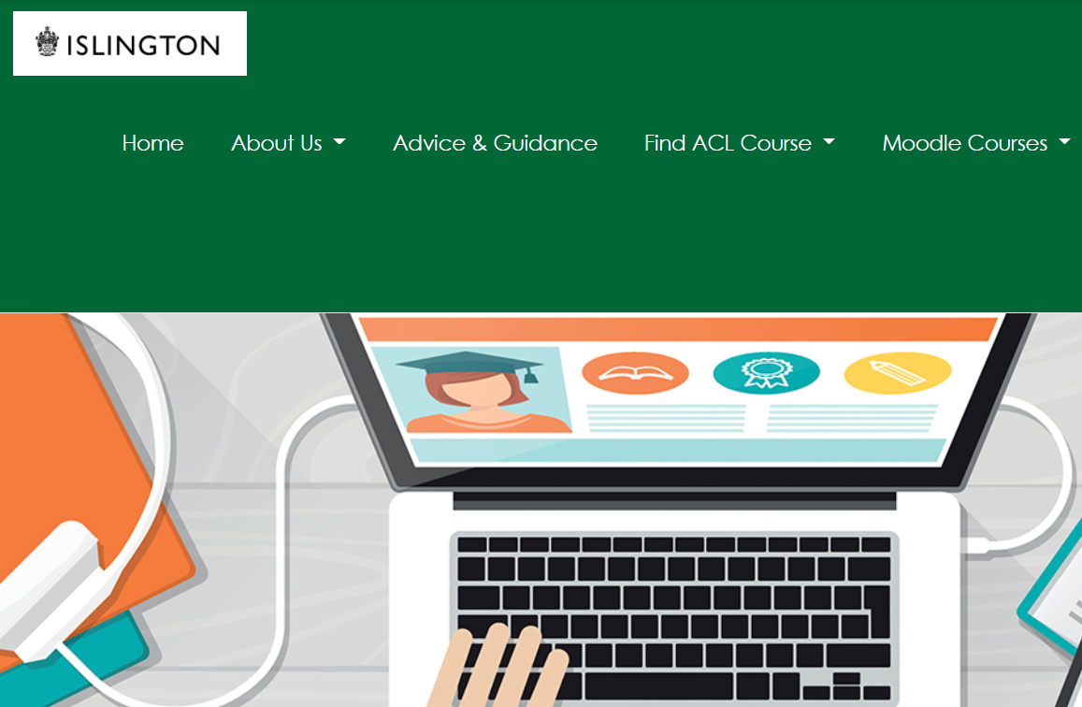
What is Moodle?
Has anyone used it before?
If yes, can you try to explain to the class what it is? What can you do on Moodle?

Slide 6
Moodle is a computer system for online learning
It’s a little bit like a website where you can find all your course information and learning materials.
You can access your Moodle courses on the Islington Adult Community Learning Gateway (ACL Gateway).
https://aclgateway.islington.gov.uk/

Slide 7



How can you find your Moodle course?
Use your browser’s search engine

Slide 8
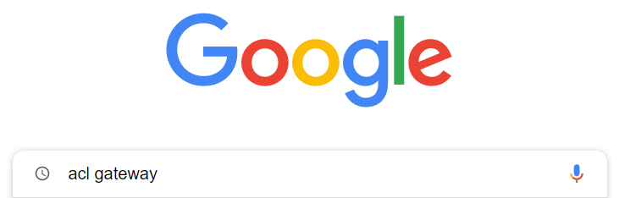
Open Google and type acl gateway in the search box

Slide 9
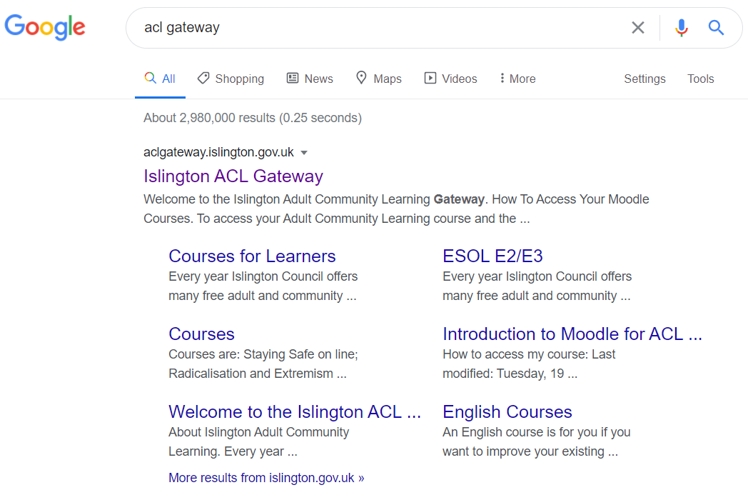
Click on the link

Slide 10
You can also click on the link from your teacher:
https://aclgateway.islington.gov.uk/

Slide 11
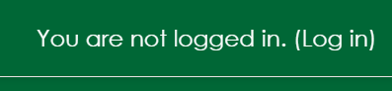
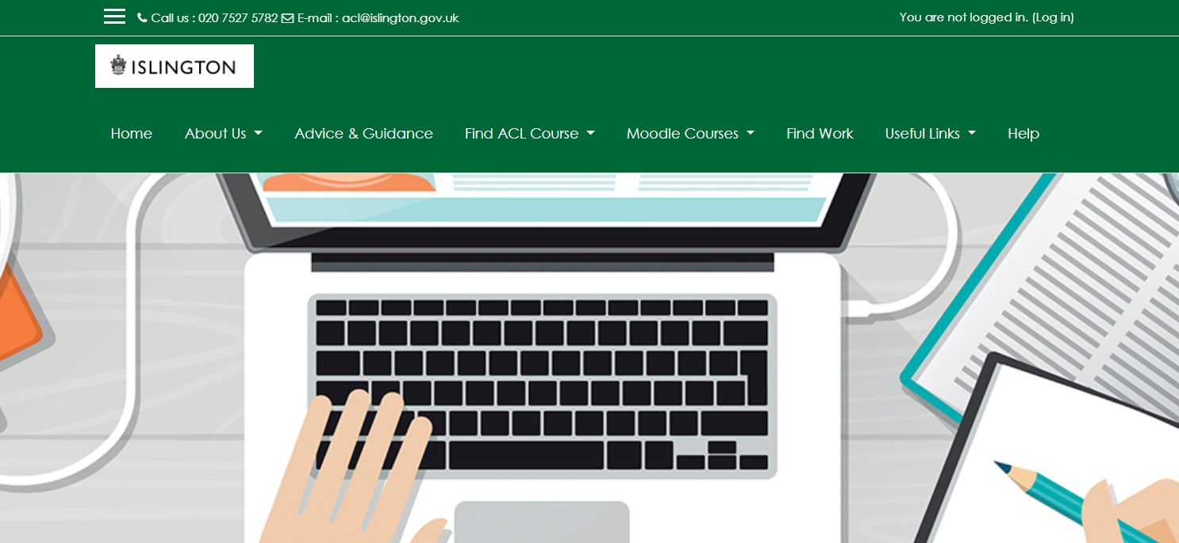
click/press Log in

Slide 12
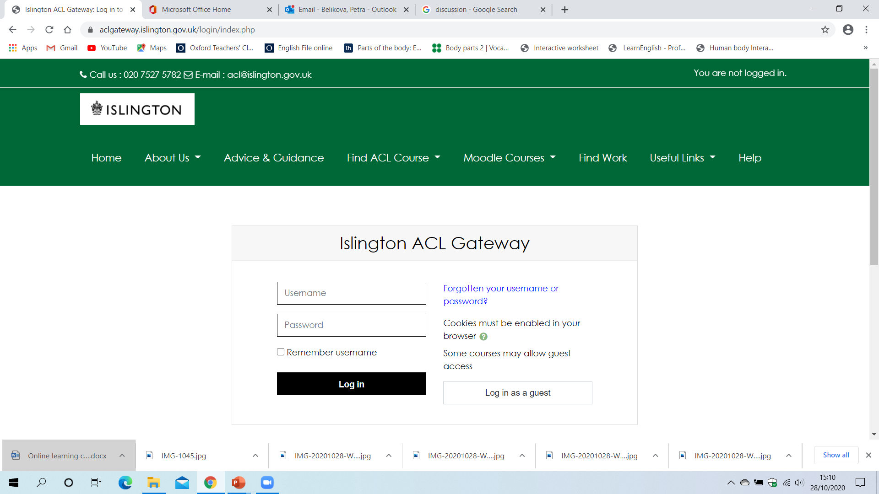

Slide 13
YOUR LOGIN DETAILS FOR ACL GATEWAY/ MOODLE
Username:
21firstnamesurname
21firstnamemiddlenamesurname
for example: 21johnsmith
21ahmedsaidmohamed
Password:
Welcome#1

Slide 14

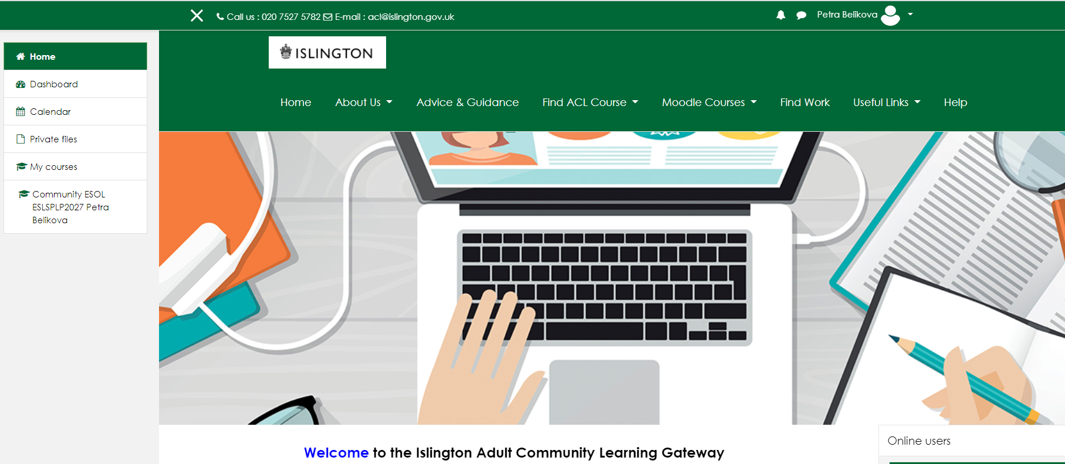
Moodle Home page

Slide 15
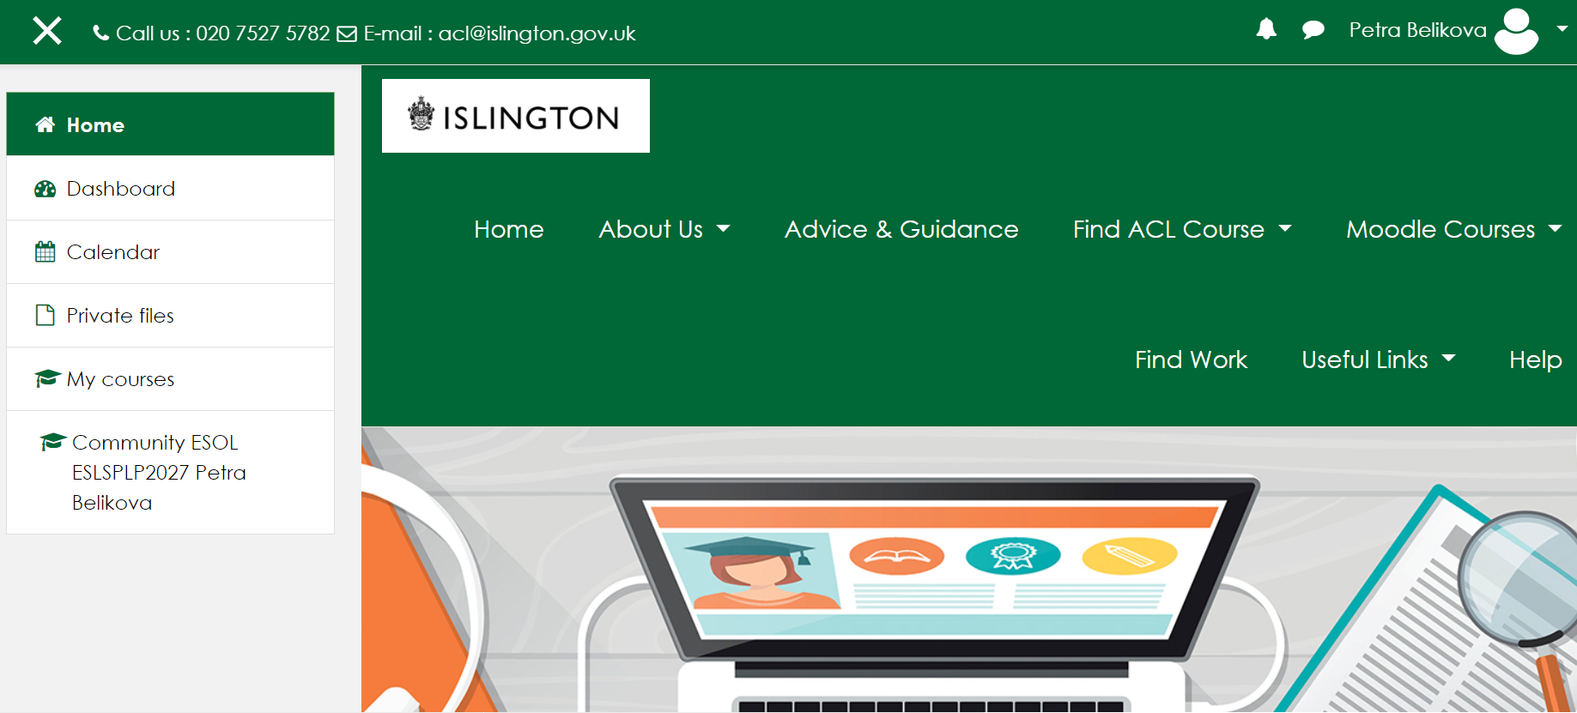
Moodle Home page
your course

Slide 16
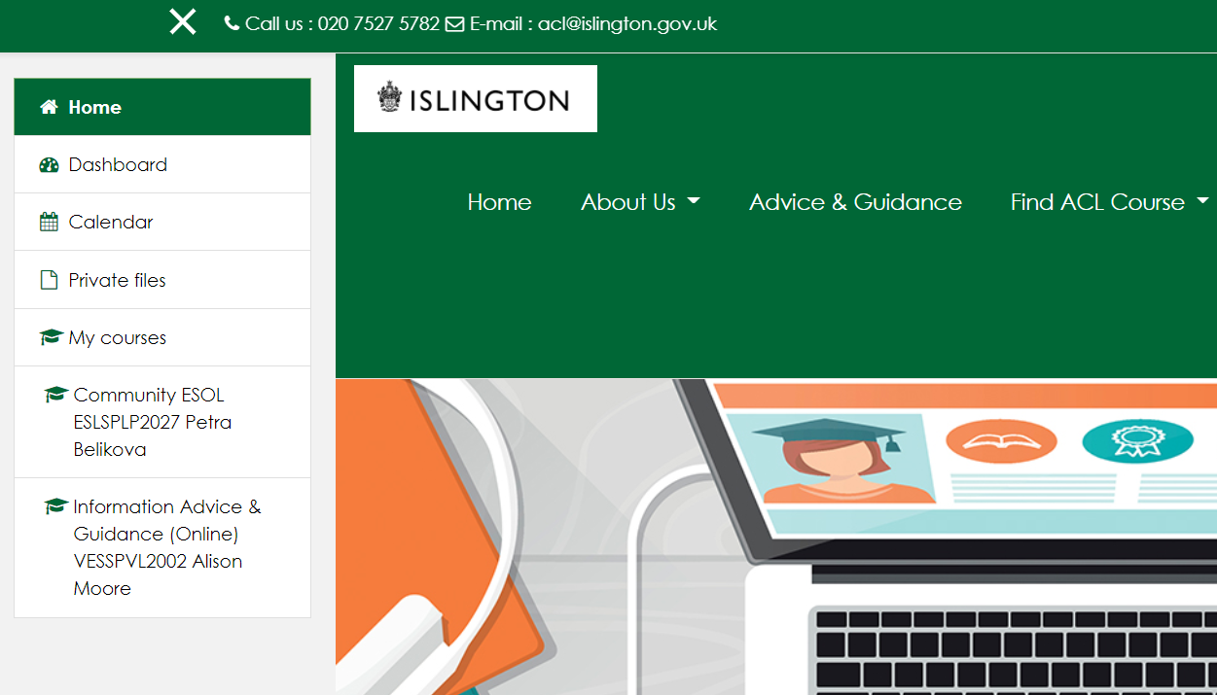
After you log in, find your course and click/ press to open
Your teacher will tell you your course code

Slide 17

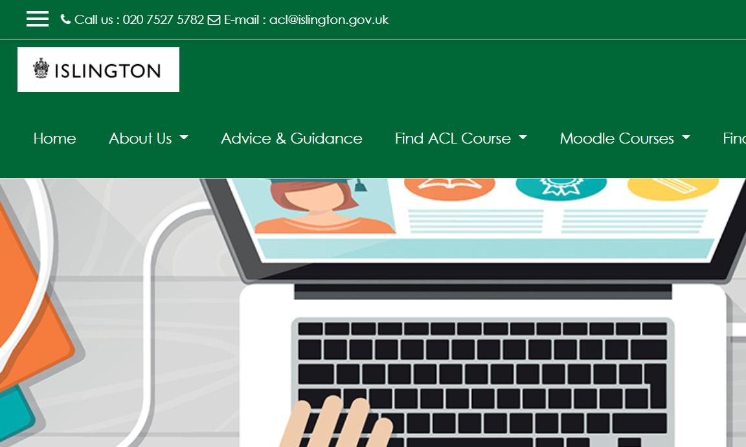
If you can’t see your course on the left,
click on the menu icon

Slide 18
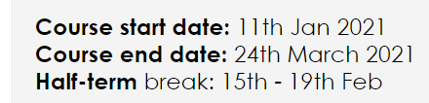
You can find important information, for example:
The start and end date of your course
Your teacher’s name and contact
Your Learner Handbook (with more information about your course and about Islington Community Learning)
Information about Safeguarding and who to contact if you don’t feel safe

Slide 19
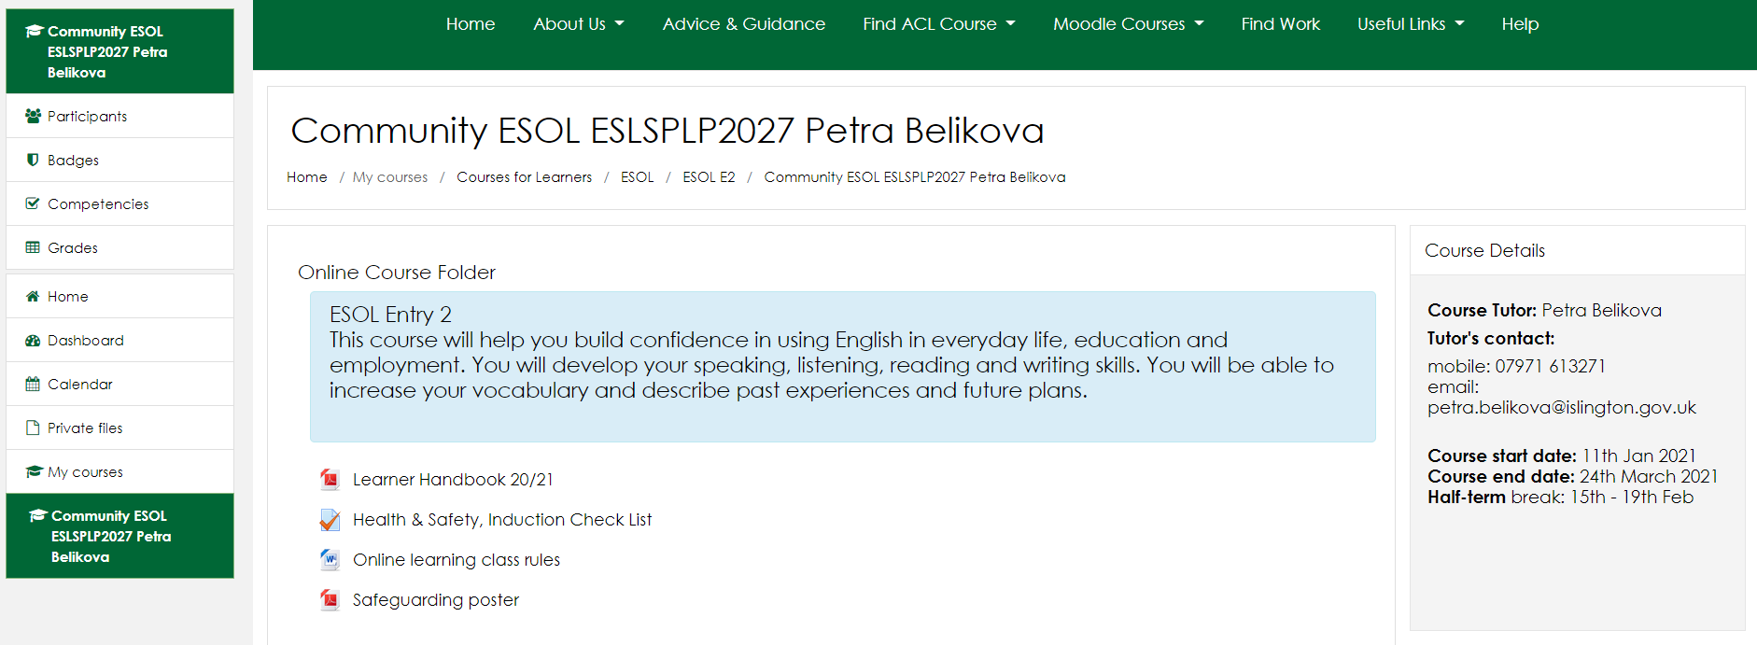
Your online course folder
Teacher’s name & contact and course dates
course introduction
important course documents

Slide 20
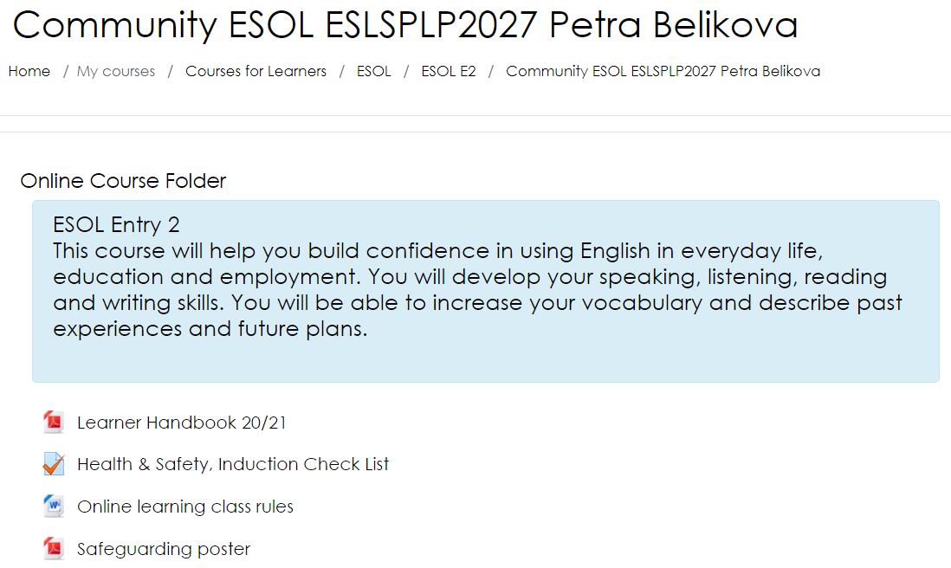
Online course folder
Click on a document or file to open it

Slide 21
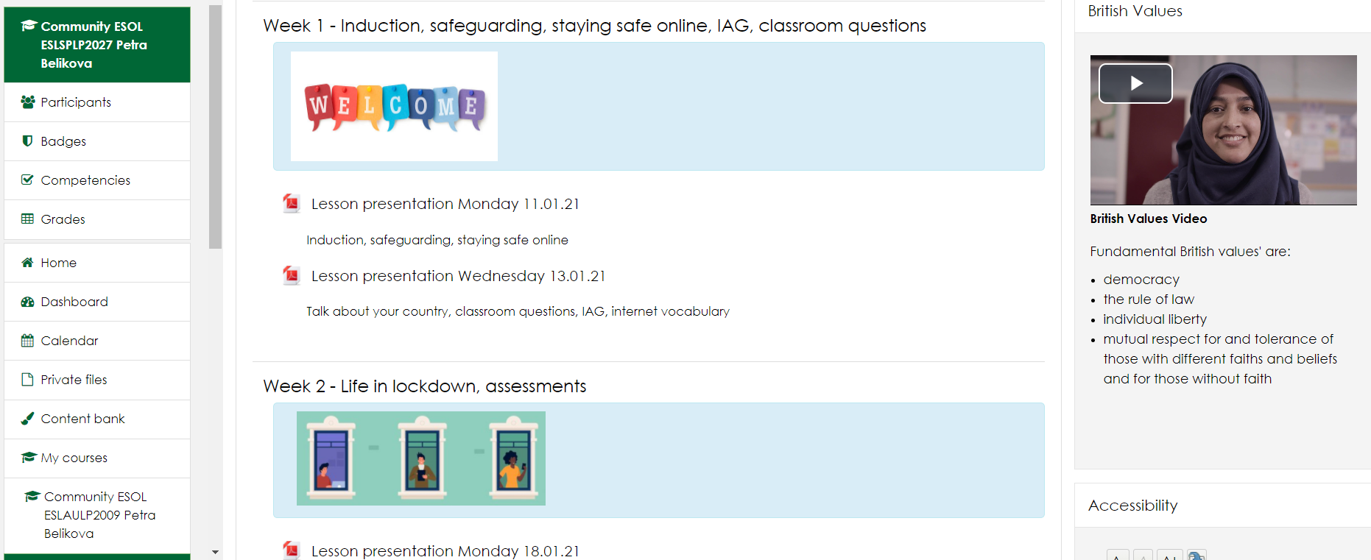
You can find all the materials from your lessons. Lesson materials are organised by weeks.

Slide 22
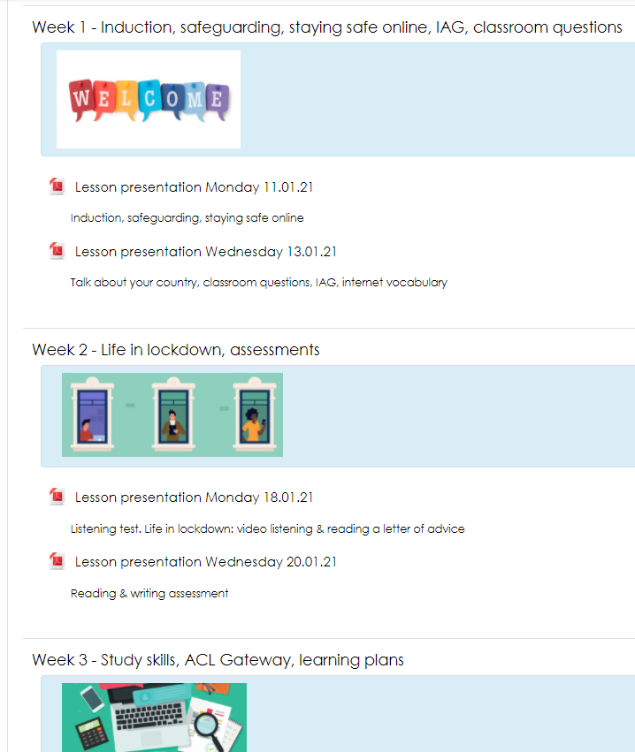



You can go to each week of the course to look at the lessons from that week
Scroll up and down to see all the lessons
to scroll = to go up and down

Slide 23
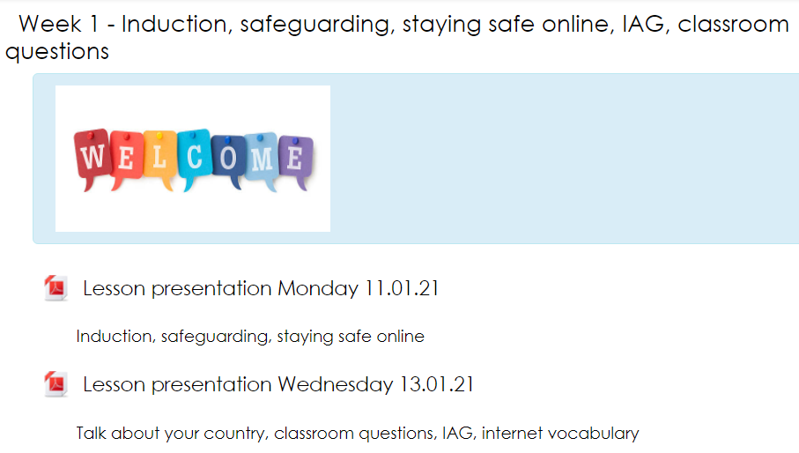
You can go to each week of your course and revise what you learnt that week.
What can you revise in the lesson from Wednesday 13.01.21?

Slide 24
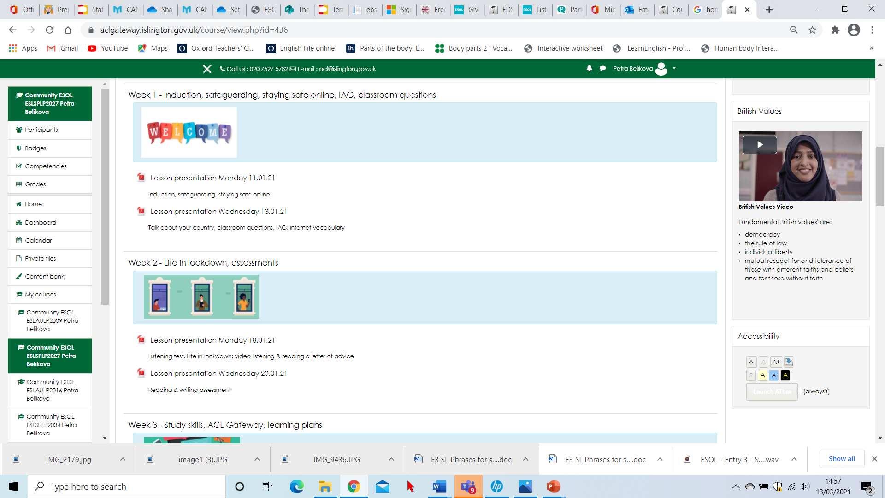
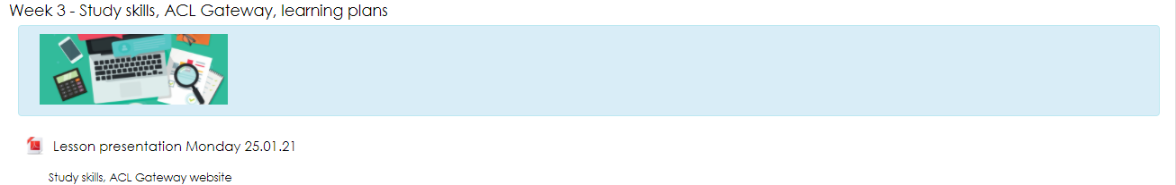

Slide 25
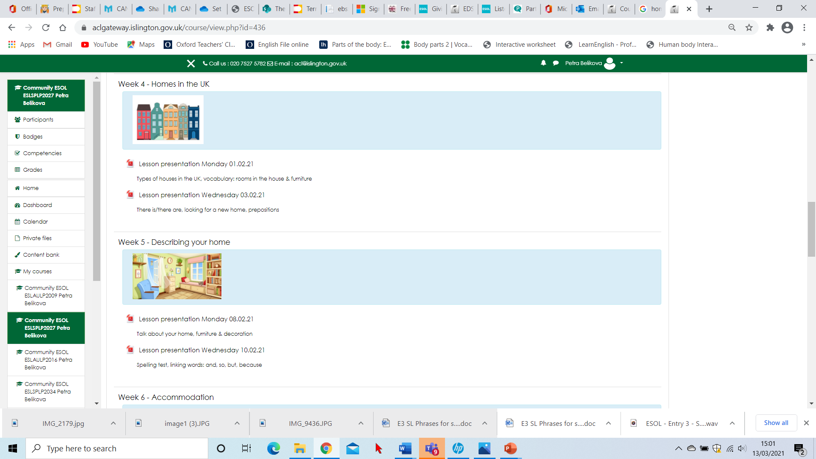
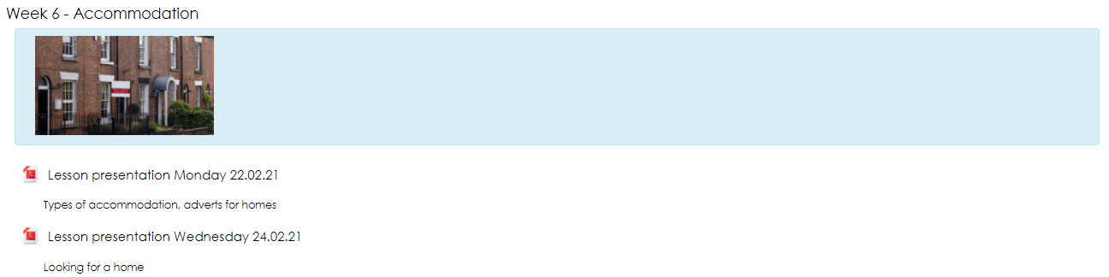

Slide 26
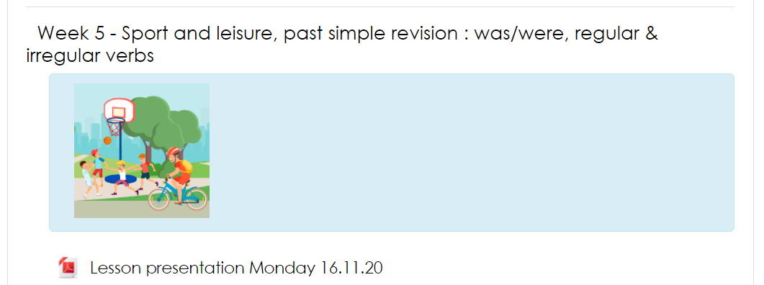
You can look at the lessons and do many things. For example, you can write down new vocabulary from the lesson, check the spelling of words or read grammar notes. You can do grammar exercises again to practise more.
You can also listen to recordings and watch videos from the lessons.

Slide 27
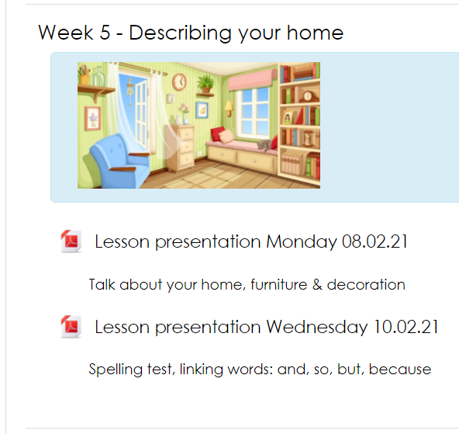
For example, if you want to revise furniture vocabulary, you can look at this lesson about homes

Slide 28

This means you can always catch up if you miss a class and it makes revising much easier.
Great!

Slide 29
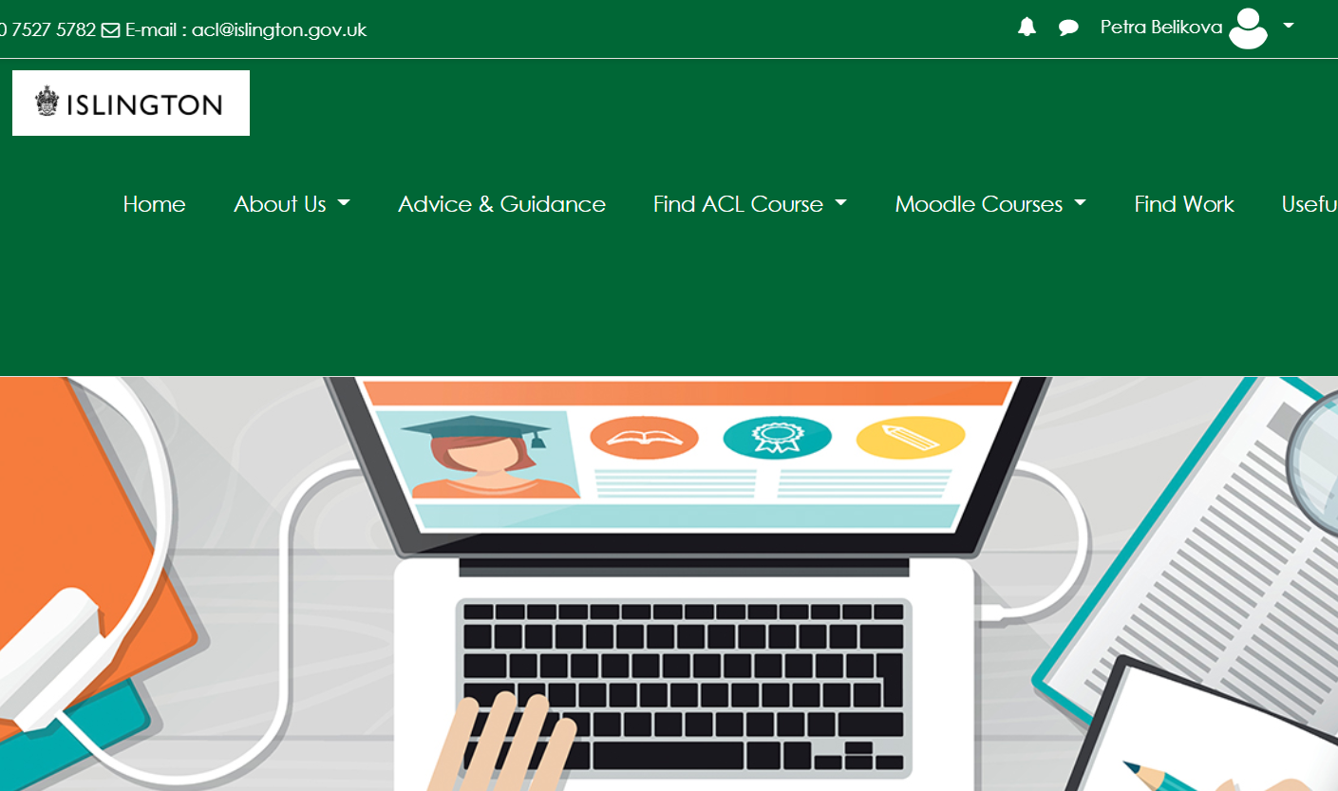
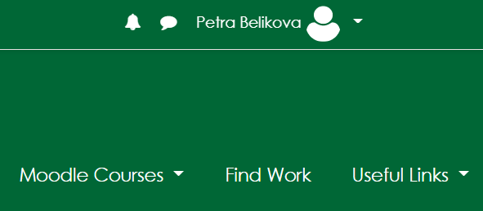
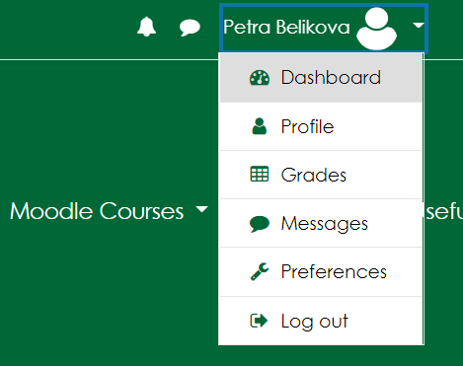
To log out (= leave/close)
Click/press on the arrow in the top right corner
Click/press log out

Slide 30
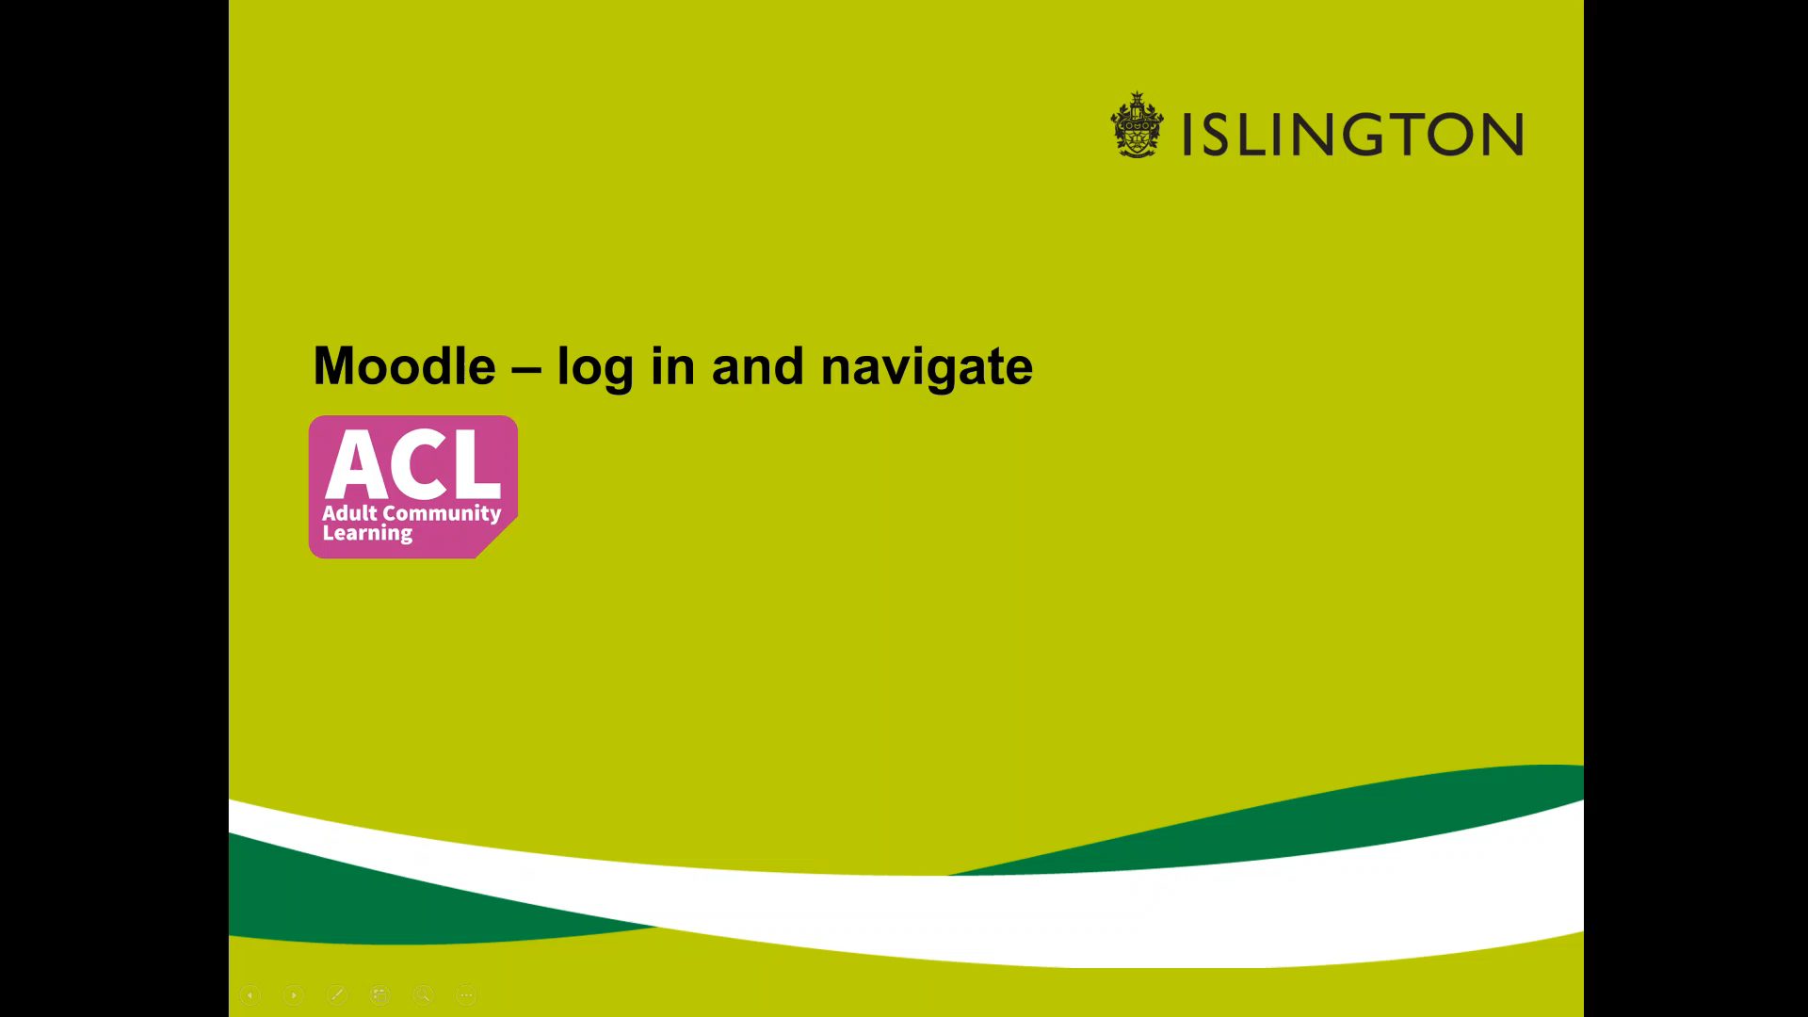
Watch the video about accessing Moodle and answer the question.
What is the first thing you have to do to access Moodle?
to access - (verb) to enter, to find and see information

Slide 31
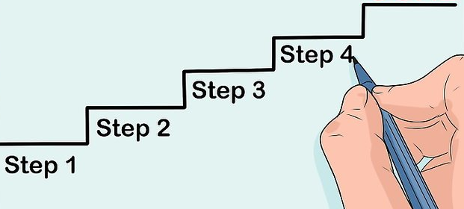
Watch the video again.
What else do you have to do to get to your course? Take notes and complete steps 3 – 6.
Search for ACL Gateway online
Click on the link to open_____
_________________________
_________________________
_________________________
_________________________

Slide 33
Answers
Search for ACL Gateway online
Click on the link
Click log in
Enter username and password
Click/press log in
Choose your course

Slide 34

Homework: Revise vocabulary from today’s lesson:
Moodle - a computer system for online learning
log in - to get in, for example to your bank account or email
log out - to get out from your account, to leave when you finish using it
to access - to enter (to be able to get somewhere) or to find and see information
You can access the hotel by road.
You can access your course on the ACL Gateway website.
to scroll - to go up and down

