Slide 1
Welcome
Islington Adult Community Learning - ACL
Islington Adult Community Learning - ACL

Slide 2
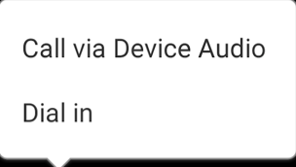
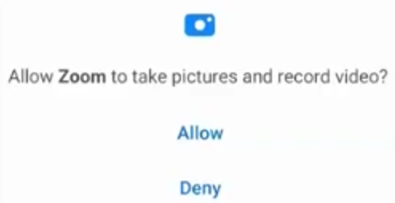
android
iOS
DATE 2021
1
2
1
3
2

Slide 3
1st February 2021
Session 1
Laurie Lawrence
ACL ESOL teacher
Islington Adult Community Learning - ACL
Islington Adult Community Learning - ACL

Slide 4
DATE 2021
Session 1:
device, apps 1, Zoom 1
Listen:
key words
Speak:
ask questions – say ‘yes’ or ‘no’
Practise together
Islington Adult Community Learning - ACL
Islington Adult Community Learning - ACL

Slide 5
DATE 2021
devices

Slide 6
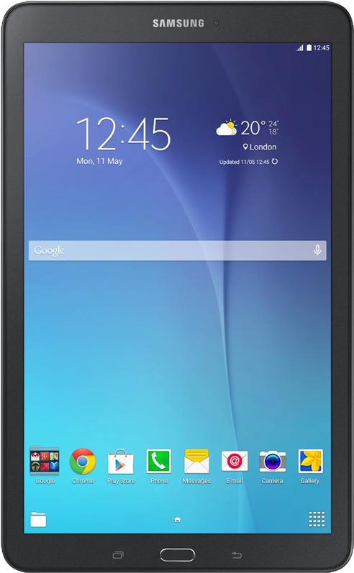
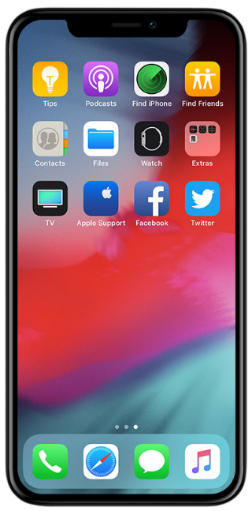
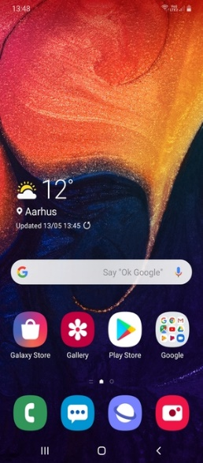
device
android
iOS
DATE 2021
phone
tablet
iPhone
iPad
Alcatel
Galaxy
Huawei
LG
Motorola
Nokia
Samsung
Sony
laptop

Slide 7
connect
DATE 2021
satellite
cable TV
internet
mobile data
telephone

Slide 8
DATE 2021
applications

Slide 9
apps
DATE 2021
Zoom
message app
email app
WhatsApp

Slide 10
DATE 2021
Zoom
teacher
you

Slide 11
1
3
5
DATE 2021
2
4
1 android phone
2 tablet
3 iPhone
4 iPad
5 laptop/computer

Slide 12
orientation
DATE 2021

Slide 13
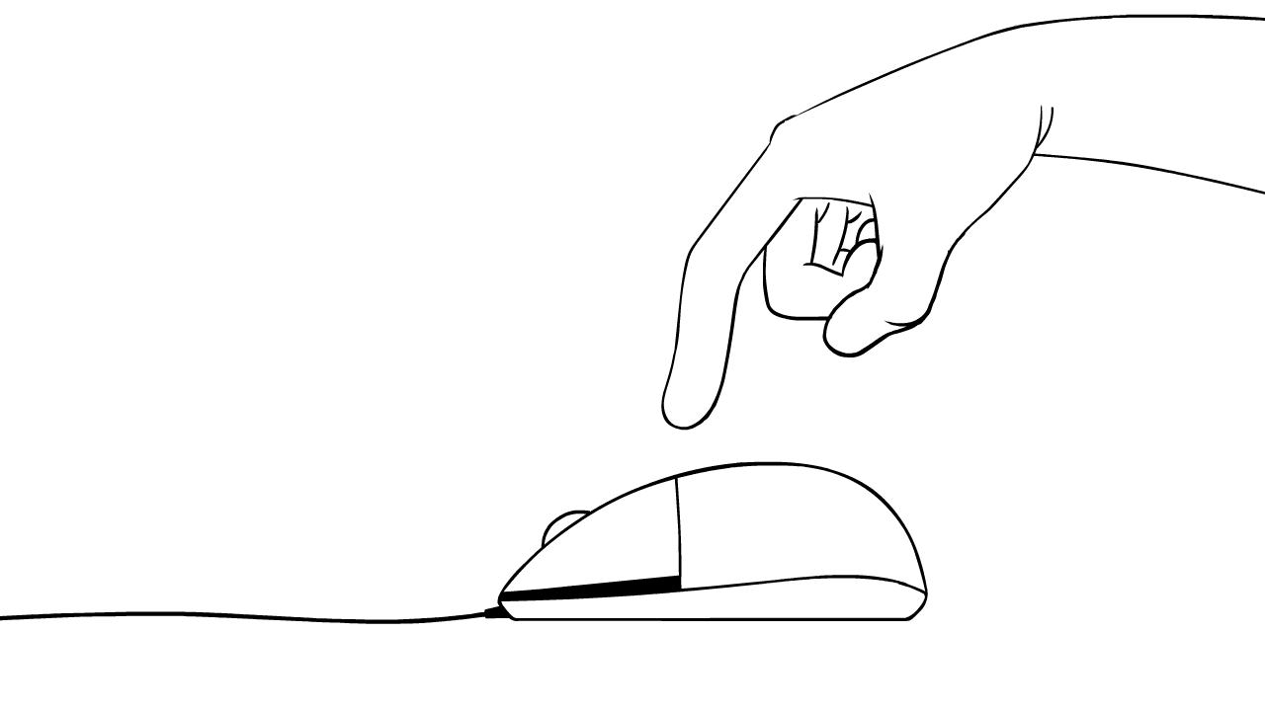
DATE 2021
tap
click

Slide 14
DATE 2021
tap
click

Slide 15
DATE 2021

Slide 16
DATE 2021

Slide 17
DATE 2021

Slide 18
DATE 2021
Mute your microphone.

Slide 19
DATE 2021
Unmute your microphone.

Slide 20
DATE 2021
Turn off your camera.

Slide 21
DATE 2021
Zoom
apps
device
connection
internet

Slide 22
DATE 2021
Any questions?
sorusu olan?
اي اسئلة؟

Slide 23
DATE 2021
Session 1:
device, apps 1, Zoom 1
Listen:
key words
Speak:
ask questions – say ‘yes’ or ‘no’
Practise together
Islington Adult Community Learning - ACL
Islington Adult Community Learning - ACL

Slide 24
DATE 2021
Today I learnt ….
The class was …
1
2
3
4
5
6
7
8
9
10
Islington Adult Community Learning - ACL
Islington Adult Community Learning - ACL

Slide 25
DATE 2021
Leave
Leave meeting
Leave

Slide 26
DATE 2021
Session 1 observations
learner
Can troubleshoot Zoom audio connection
Can name/recognise own device
Can name/recognise own OS
Can name/recognise own connection
Can name /recognise some of own apps
Can orient device to suit self
Can tap/click device correctly to access Zoom controls
Can mute/unmute in Zoom
Can start/stop video in Zoom
Can locate and leave Zoom
Can give feedback

Slide 27
Welcome
Islington Adult Community Learning - ACL
Islington Adult Community Learning - ACL

Slide 28
android
iOS
DATE 2021
1
2
1
3
2

Slide 29
1st February 2021
Session 2
Laurie Lawrence
ACL ESOL teacher
Islington Adult Community Learning - ACL
Islington Adult Community Learning - ACL

Slide 30
DATE 2021
Session 2:
Zoom 2
Listen:
key words
Speak:
ask questions – say ‘yes’ or ‘no’
Practise together
Islington Adult Community Learning - ACL
Islington Adult Community Learning - ACL

Slide 31
DATE 2021
Zoom
apps
device
connection
internet

Slide 32
DATE 2021
Mute your microphone.

Slide 33
DATE 2021
Unmute your microphone.

Slide 34
DATE 2021
Turn off your camera.

Slide 35
DATE 2021
tap
click

Slide 36
DATE 2021
tap
click

Slide 37
DATE 2021
tap
click

Slide 38
DATE 2021
home
tap

Slide 39
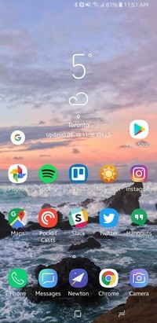
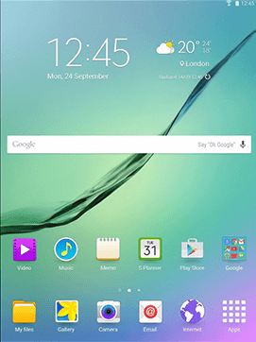
DATE 2021
home
swipe
look
Zoom app
tap

Slide 40
DATE 2021

Slide 41
DATE 2021
home
swipe
look
Zoom app
tap

Slide 42
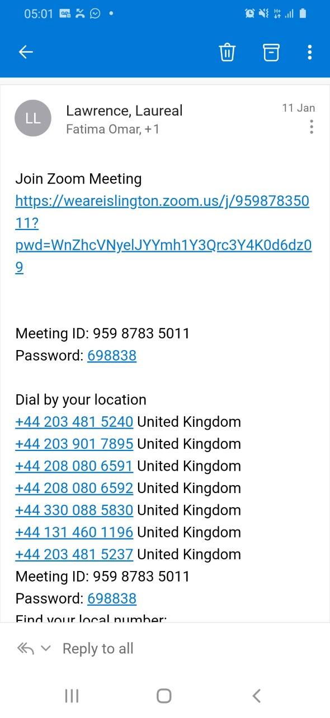
DATE 2021
email app
message app
Zoom
email
message
link
tap
click

Slide 43
DATE 2021
tap
click
leave
home
swipe
look
Leave
Leave

Slide 44
DATE 2021
Leave this class and return.
tap
click
leave
home
swipe
look
Leave
Leave

Slide 45
DATE 2021
Welcome back

Slide 46
DATE 2021

Slide 47
DATE 2021

Slide 48
DATE 2021

Slide 49
DATE 2021

Slide 50
DATE 2021

Slide 51
DATE 2021

Slide 52
DATE 2021

Slide 53
DATE 2021

Slide 54
DATE 2021

Slide 55
DATE 2021

Slide 56
DATE 2021
Any questions?
sorusu olan?
اي اسئلة؟

Slide 57
DATE 2021
Session 2:
Zoom 2
Listen:
key words
Speak:
ask questions – say ‘yes’ or ‘no’
Practise together
Islington Adult Community Learning - ACL
Islington Adult Community Learning - ACL

Slide 58
DATE 2021
Today I learnt ….
The class was …
1
2
3
4
5
6
7
8
9
10
Islington Adult Community Learning - ACL
Islington Adult Community Learning - ACL

Slide 59
DATE 2021
Leave
Leave meeting
Leave

Slide 60
DATE 2021
Session 2 observations
learner
Can troubleshoot Zoom audio connection
Can locate device home button
Can navigate from Zoom to device home screen and return
Can locate Zoom app and re-enter from device home screen
Can name /recognise how they access ACL Zoom invitation
Can locate ACL Zoom invitation
Can leave Zoom session and re-enter
Can locate participant thumbnails

Slide 61
Welcome
Islington Adult Community Learning - ACL
Islington Adult Community Learning - ACL

Slide 62
android
iOS
DATE 2021
1
2
1
3
2

Slide 63
1st February 2021
Session 3
Laurie Lawrence
ACL ESOL teacher
Islington Adult Community Learning - ACL
Islington Adult Community Learning - ACL

Slide 64
DATE 2021
Session 3:
WhatsApp
Listen:
key words
Speak:
ask questions – say ‘yes’ or ‘no’
Practise together
Islington Adult Community Learning - ACL
Islington Adult Community Learning - ACL

Slide 65
DATE 2021
message
email
Zoom
apps
device
connection
internet

Slide 66
DATE 2021
Mute your microphone.

Slide 67
DATE 2021
Unmute your microphone.

Slide 68
DATE 2021
Turn off your camera.

Slide 69
apps
DATE 2021
Zoom
message app
email app
WhatsApp

Slide 70
DATE 2021
internet
messaging app
voice
video
text

Slide 71
DATE 2021
home

Slide 72
DATE 2021
home
swipe
look
WhatsApp
tap

Slide 73
DATE 2021
home
finished?

Slide 74
DATE 2021
home
swipe
look
Zoom app
tap

Slide 75
DATE 2021

Slide 76
DATE 2021
open WhatsApp
what can you see?
return Zoom
home
swipe
look
WhatsApp
tap

Slide 77
DATE 2021
go to WhatsApp
what can you see?
return to Zoom
home
swipe
look
Zoom
tap

Slide 78
DATE 2021
Welcome back

Slide 79
DATE 2021
CONTACTS
My sister
My brother
Hana Fazio
Bella Boutella
cv
cv
My teacher
Steve Smith
Amina Ahmed

Slide 80
text message
cv
1
Tap the chat box.
Enter chat text
2
Your one-to-one is at 2pm.
OK teacher
cv
cv
3
send

Slide 81
emoji message
cv
1
Tap the chat box
2
Tap the emoji icon
Your one-to-one is at 2pm.
Choose an emoji
3
4
send

Slide 82
DATE 2021
open WhatsApp
send a message
send an emoji
home
swipe
look
WhatsApp
tap

Slide 83
DATE 2021
go to WhatsApp
what can you see?
return to Zoom
home
swipe
look
Zoom
tap

Slide 84
DATE 2021
Any questions?
sorusu olan?
اي اسئلة؟

Slide 85
DATE 2021
Session 3:
WhatsApp
Listen:
key words
Speak:
ask questions – say ‘yes’ or ‘no’
Practise together
Islington Adult Community Learning - ACL
Islington Adult Community Learning - ACL

Slide 86
DATE 2021
Today I learnt ….
The class was …
1
2
3
4
5
6
7
8
9
10
Islington Adult Community Learning - ACL
Islington Adult Community Learning - ACL

Slide 87
DATE 2021
Leave
Leave meeting
Leave

Slide 88
DATE 2021
Session 3 observations
learner
Can troubleshoot Zoom audio connection
Can locate device home button
Can navigate from Zoom to device home screen
Can locate WhatsApp and open app from device home screen
Can navigate fro WhatsApp to device home screen
Can open WhatsApp messages
Can locate Zoom app and re-join session from device home screen
Can send WhatsApp text message
Can send WhatsApp emoji message

Slide 89
Welcome
Islington Adult Community Learning - ACL
Islington Adult Community Learning - ACL

Slide 90
android
iOS
DATE 2021
1
2
1
3
2

Slide 91
1st February 2021
Session 4
Laurie Lawrence
ACL ESOL teacher
Islington Adult Community Learning - ACL
Islington Adult Community Learning - ACL

Slide 92
DATE 2021
Session 4:
WhatsApp (pictures, voice)
Listen:
key words
Speak:
ask questions – say ‘yes’ or ‘no’
Practise together
Islington Adult Community Learning - ACL
Islington Adult Community Learning - ACL

Slide 93
DATE 2021
message
email
Zoom
WhatsApp
apps
device
connection
internet

Slide 94
DATE 2021
Mute your microphone.

Slide 95
DATE 2021
Unmute your microphone.

Slide 96
DATE 2021
Turn off your camera.

Slide 97
DATE 2021
open WhatsApp
1. what can you see?
2. send me a message
home
swipe
look
WhatsApp
tap

Slide 98
DATE 2021
go to WhatsApp
what can you see?
return to Zoom
home
swipe
look
Zoom
tap

Slide 99
DATE 2021
Welcome back

Slide 100
DATE 2021
Your one-to-one is at 2pm.
Describe your friend.
class work
home work
listening
speaking
reading
writing

Slide 101
voice message
cv
1
Press and hold microphone
2
Speak
v

Slide 102
DATE 2021
open WhatsApp
leave a message
return Zoom
home
swipe
look
WhatsApp
tap

Slide 103
DATE 2021
go to WhatsApp
what can you see?
return to Zoom
home
swipe
look
Zoom
tap

Slide 104
photo
cv
DATE 2021
1
Tap camera
2
Please, write about your day.
3
Tap button

Slide 105
DATE 2021
open WhatsApp
take a picture
return to Zoom

Slide 106
video
DATE 2021
cv
1
Tap to open camera
2
Please, take a 1 minute video.
3
Press and hold button

Slide 107
DATE 2021
open WhatsApp
take a (5s) video
return to Zoom

Slide 108
DATE 2021
tap
press and hold

Slide 109
DATE 2021
Any questions?
sorusu olan?
اي اسئلة؟

Slide 110
2
1
3
5
4

Slide 111
DATE 2021
Today I learnt ….
The class was …
1
2
3
4
5
6
7
8
9
10
Islington Adult Community Learning - ACL
Islington Adult Community Learning - ACL

Slide 112
DATE 2021

Slide 113
DATE 2021
Leave
Leave meeting
Leave

Slide 114
DATE 2021
Session 4 observations
learner
Can troubleshoot Zoom audio connection
Can recognise the place of WhatsApp in ACL teaching and learning
Can take a photograph within WhatsApp and send directly to teacher contact
Can take a video within WhatsApp and send directly to teacher contact
Can make an audio recording within WhatsApp and send directly to teacher contact
Can use relevant device gestures to create messages

