Slide 1
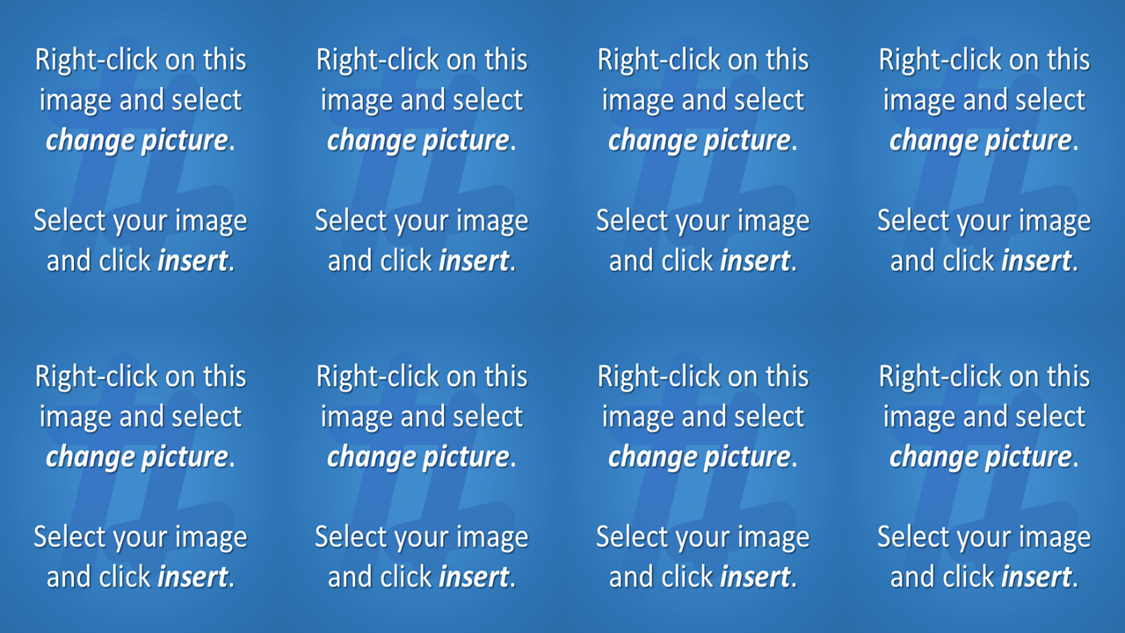
1
2
3
4
5
6
7
8
9
Notes:
Click on a numbered square to make the square disappear.
Click on the image to reveal it. All the squares will disappear.

Slide 2
1
2
3
4
5
6
7
8
9
10
11
12
13
14
15
16
17
18
Notes:
Click on a numbered square to make the square disappear.
Click on the image to reveal it. All the squares will disappear.

Slide 3
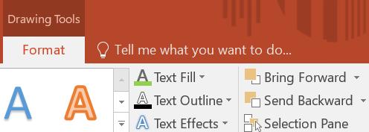
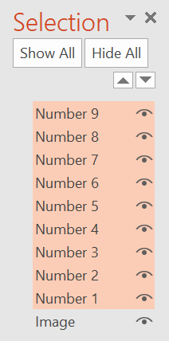
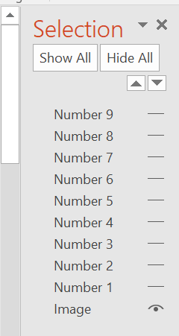
EDITING INFORMATION
TO HIDE THE SQUARES WHILE YOU CHANGE THE HIDDEN IMAGE
Hold shift and click to select all of the visible squares
Click on Drawing Tools from the menu
Click on Selection Pane from the ribbon
Selection Pane will open on the right hand side
Now click the eye icons on the far right to hide the squares

Slide 4
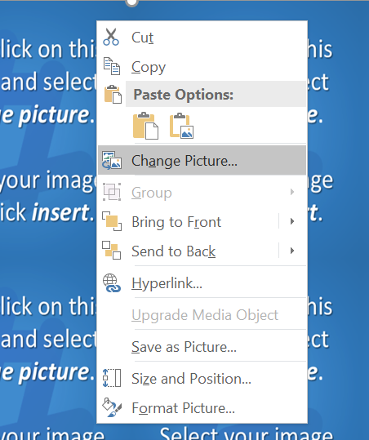
EDITING INFORMATION
TO CHANGE THE HIDDEN IMAGE
Right click rear picture and in th drop-down menu select change picture
PowerPoint will open the Bing Online Image Search window
Search, select, resize and copy your image to suit
Now return to the selection Pane on the right hand side to and click Show all
for the upper level squares to return

