Slide 1

NCFE Level 1
Working with Children
Adult and community learning

Slide 2
Group Agreement
How do we wish to work as a group so everyone can successfully complete the course in this environment
Example:
Everyone listening to each other with out interrupting
Respect our differences and different opinions
Treat everyone equally and fairly
Feel able to ask questions even if seem bit basic
Acknowledge each other’s contribution – body language
Not to be in a noisy environment
Accept comments and ideas in spirit of learning and improvement
Be open to new ideas
To pay attention and not multitask –limit distraction
Feeling comfortable
Supportive environment
Have fun
Confidentiality
Safeguard self and others
Punctuality
Everyone has a voice

Slide 3
Learning Outcomes
Session 5
By the end of the session you will be able to:
Recap session 4
Unit 5 Providing for play
Use a planning sheet for play – unit 5
Deliver a play activity for a children
Introduction to Unit 4

Slide 4
Planning of Play

Slide 5
Unit 5
Providing for play
For unit 5 you will have to:
1. plan three different types play activities e.g creative, language, maths, physical
2. Engage with children and clear away 3 play activities for children.
You will complete :
planning sheet x3
Explain how you worked/interacted with the children
Explain how you involved the children in clearing away the activity

Slide 6
Adult led play
Adult initiated play
Child initiated play

Slide 7
Why do we need to plan for children’s play?

Slide 8
Ensures all round development
Enables various experiences
Challenges learning
Encourages greater opportunities
Provide targeted activities

Slide 9
What type of activities can you plan and provide for children?
Explore – try and put them in categories
Construction –
Messy Play –
Outdoor and gross motor –
Role play –
Creative –
Table top –
Baby –

Slide 10
Why Observe children?

Slide 11
Why Observe children?
By observing children as they explore, play and learn, practitioners can: ensure that a child’s development is at the expected stage,
whether the environment and resources (toys or equipment) are stimulating their development,
and what future support the child will need in order to gain new interests, skills and knowledge.

Slide 12
Observation for Planning
Effective Practice: Observation, Assessment and Planning
Key messages
Observation, assessment and planning all support a child’s development and learning. Planning starts with observing children in order to understand and consider their current interests, development and learning.
Observation
Observation describes the process of watching the children in our care, listening to them and taking note of what we see and hear.
Assessment
We assess children’s progress by analysing our observations and deciding what they tell us. We also need to find out about children’s care and learning needs from their parents and from these we can identify the children’s requirements, interests, current development and learning.
Planning
We plan for the next steps in children’s development and learning. Much of this needs to be done on the basis of what we have found out from our own observations and assessments as well as information from parents

Slide 13
The Planning Cycle
The principles of the process to adhere to include:
Observation: The starting point (look, listen and note), describing what the child is doing
Assessment: Analysing observations and deciding what they tell us about children
Planning: What’s next? Experiences and opportunities, learning environment, resources, routines and the practitioner’s role.
Return to step 1 and so on.

Slide 14
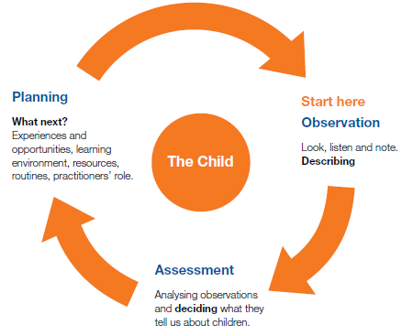

Slide 15
Planning Sheets x3
Assessment 1.2, 1.3, 1.4

Slide 16
Assessment 2.1
Carry out three separate activities with your child/ren and explain how you encouraged them to take part - think about how you showed/ or explained to them what they will be doing
What made you provide this activity and therefore met their individual interests
Assessment 2.2
What safety issues did you consider during the three activities and ensure you carried them out

Slide 17
Assessment 2.3
How did you communicate with your child during the three activities - what did you say and how did you say it – both verbally and non verbally -think about praise, positive comments and any questions you may have used. Were you using open ended questions? Did you get involved or observed?
Assessment 3.1,3.2, 3.3,
Complete these generally for all the activities
Assessment 3.4
Your tutor will ask you questions on how you carried out your activity

