Slide 1
NCFE Level 1 Working with Children
Adult and community learning

Slide 2
Group Agreement
How do we wish to work as a group so everyone can successfully complete the course in this environment
Example:
Everyone listening to each other with out interrupting
Respect our differences and different opinions
Treat everyone equally and fairly
Feel able to ask questions even if seem bit basic
Acknowledge each other’s contribution – body language
Not to be in a noisy environment
Accept comments and ideas in spirit of learning and improvement
Be open to new ideas
To pay attention and not multitask –limit distraction
Feeling comfortable
Supportive environment
Have fun
Confidentiality
Safeguard self and others
Punctuality
Everyone has a voice

Slide 3
Learning Outcomes
Session 5
By the end of the session you will be able to:
Discuss definitions within equality issues – Unit 4
Recognise the importance of equal opportunities in childcare
Identify 10 declarations for rights of children
Discuss how equality works in practice

Slide 4
Unit 4
Contribute to equality of opportunity in support
of young children’s development

Slide 5
What does Equality mean to YOU?

Slide 6
Opportunity
Treated fairly
Same opportunities
Equal treatment
Making reasonable adjustments
Sexuality
Colour
Race
Gender
Access
Poverty
Stereotypes
Positive discrimination
Equality
Positive Images
Background
Multicultural society
Black lives matter
Disabilities
feminism
LBGTQ+
Bias
Inequalities training
inclusion
Respect for each other
Awareness of differences
Allowing everyone a voice
Calling out sexism, racism, islamophobia
Age(older people)

Slide 7
Where do our ideas, opinions about the world around us come from?

Slide 8
Values
Values are the basis for our behaviour and motivation and closely linked with our beliefs.
It is a measure of the importance we attach to something; our values are often reflected in the way we live our lives.
eg I value my family.
Both values and beliefs shape the way we view ourselves and the world around us.
Our values may be similar or different to others. There are no right or wrong values
The problem with differing values is that not
everyone agrees with them.

Slide 9
Key words/Terminology
Equality is about fair treatment
What about these:
Inequality
Diversity
Inclusion

Slide 10
Key words/Terminology
Equality is about fair treatment
Inequality is about treatment that is unfair and not giving equal rights
Diversity is about valuing and respecting difference
Inclusion is about removing barriers to participation

Slide 11
Key words/Terminology
What about these:
Prejudice Stereotyping
Sexism Racism
Ethnicity Discrimination
Homophobic LGBTQ+

Slide 12
Definitions
Prejudice – judging someone the basis of what you think they are like
Stereotyping – associated with the above, that people behave the same, are alike in the same way and have the same thought and feelings.
Discriminate – when you treat people less favourable because of your prejudices
Sexism – discrimination based on someone's sex and may include the belief that a person of one sex is naturally superior to a person of the other.
Racism –in general terms consists of conduct or words or practices which disadvantage or advantage people because of their colour, culture, or ethnic
Homophobic – when you have negative feelings and behaviour towards others in same sex relationships

Slide 13
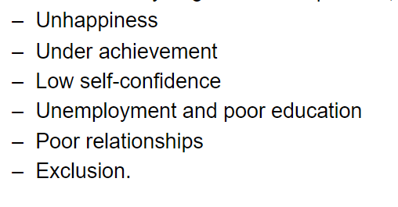
When people are treated unfairly and discriminated it can lead to negative consequences
.
School – prison - pipeline

Slide 14
Equal Opportunities

Slide 15
Life is not always fair.
Sometimes groups of people are treated more favourably than others.

Slide 16
Can you think of groups of people who might be discriminated against?

Slide 17
Sometimes people are discriminated against because of their:
Age
Ethnic group
Class
Disability
Gender
Religion
Appearance
Sexual preference

Slide 18
Sometimes they take an attitude to people simply because they are different in some way.
This is because humans, like other animals, have an instinct to protect their own group and keep out outsiders.

Slide 19
When people assume that all people belonging to a certain group have the same characteristics we call this stereotyping.
In reality, every individual is different. That is why it is interesting to meet new people.

Slide 20
Each individual should be treated fairly and with respect.
Everybody wins when people are able to contribute their talents and skills for the benefit of our society.
When we are respectful of each other, people from different groups can live side by side without conflict.

Slide 21
Discrimination is harmful when it stops people from flourishing – when it affects their job opportunities, housing, education etc.
When groups of people are treated badly, they get angry, and may become aggressive and start to cause trouble.
This can make everybody’s lives unhappy, and possibly unsafe.

Slide 22
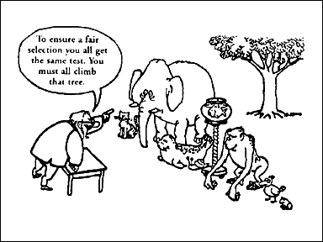
Discrimination can take many forms!

Slide 23
Children’s Rights

Slide 24
In 1989, world leaders decided that children needed a special convention just for them because people under 18 years old often need special care and protection that adults do not. The leaders also wanted to make sure that the world recognised that children have human rights too.
The Convention sets out these rights in 54 articles. It spells out the basic human rights that children everywhere have: the right to survival; to develop to the fullest; to protection from harmful influences, abuse and exploitation; and to participate fully in family, cultural and social life.
By agreeing to undertake the obligations of the Convention national governments have committed themselves to protecting and ensuring children's rights and they have agreed to hold themselves accountable for this commitment before the international community.
1989 United Nations Convention on Children’s Rights

Slide 25
Task PC 1.1
Complete this learning outcome using UN articles- in own words
Choose 10 of the articles on the handout – it is up to you which ones you choose (do the ones you understand best)
Read, then summarise in your own words
Put the number of the article on top of the box and write your summary in the box.

Slide 26
Task PC 1.6
Relating UN articles to everyday practices
Understanding how to support children’s rights
Calling child/children by their name
Which article relates to this?
Any other way you can support this article in the setting?
Allowing children to choose what they want to play with
Which article relates to this?
Any other way you can support this article in the setting?

Slide 27
Task PC 1.6
Use UN articles to complete case study
Write the title of the article/s and its number you think matches this case study
State clearly how you will support Niniola within the articles you have chosen -

Slide 28
Why is Equality Important in the
childcare setting?
Jot down three ways we can
promote equal opportunities
in the nursery

Slide 29
PC (1.4) List resources and materials which support equality
Collage or list of activities which support equality issues
With this task you can either make a written list or cut out pictures and stick on/ internet picture
You need to think of a range of resources /images you can provide children in the early years setting that promote equality- so think of cultural, special needs and disability, race, religion, different family make up’s etc –
Example- A welcome poster with hello in different languages, or dolls of both sexes for children to play with.

Slide 30
WEBSITES
https://www.hope-education.co.uk/help-and-advice/about/brands/nes-arnold/
https://www.earlyyearsresources.co.uk/
https://www.letterboxlibrary.com/
https://www.glsed.co.uk/?gclid=EAIaIQobChMIzM3q7bvX6gIVV-DtCh3OWgEOEAAYASAAEgLYnvD_BwE

Slide 31
P.C 1.7 Identify the needs of children at key transition
Answer the question- What is transition- in your own words of a dictionary definition
Decide what a child would need from you in at the different stages listed. Consider two aspects
Physically what you may provide
2. Emotionally what you may provide
E.g- Learning to walk…
Physically ……..walker, hand, soft footwear, safety, space
Emotionally………praise, comfort, confidence, encouragement
You will need to include at least 2 needs for each physical and emotional for each on the list.

