Slide 1
NCFE Level 1 Working with Children
Adult and community learning

Slide 2
Learning Outcomes
Session 3
By the end of the session you will be able to:
Check understanding for week 2 – recap
Identify if you can work with children quiz
Discuss the Early Years Curriculum Aspects
Unit 1 Encourage children to eat healthily
Explain the healthy eating plate -Unit 1

Slide 3
Can you work with children?

Slide 4
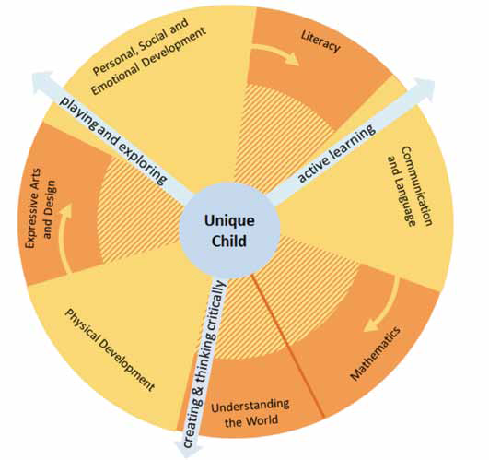
Early Years Foundation Stages
The Unique Child reaches out to
relate to people and things through the Characteristics of Effective Learning, which move through all areas of learning.
• playing and exploring
• active learning
• creating and thinking critically
Prime areas are fundamental,
• Personal, Social and Emotional Development
• Communication and Language
• Physical Development
Specific areas include essential
• Literacy
• Mathematics
• Understanding the World
• Expressive Arts and Design
Children develop in the context of relationships and the environment
around them. This is unique to each
family, and reflects individual communities
and culture

Slide 5
Complete the EYFS task worksheet

Slide 6
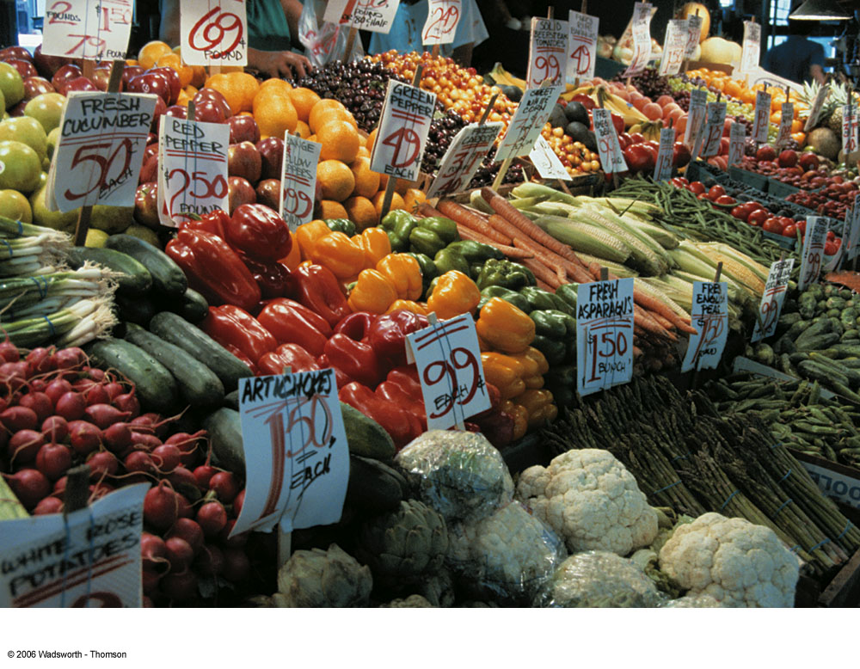
Unit 1
All foods once looked like this...

Slide 7
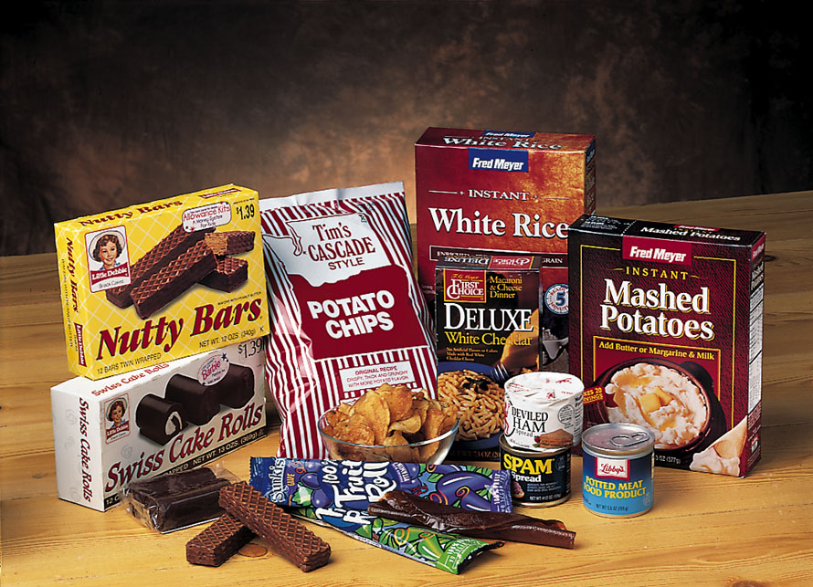
but now many foods look like this………………..

Slide 8
Why is it important to eat healthy?

Slide 9
Why is it important to eat healthy?
Give you energy for life
Help you stay at a weight that's right for you
Boost your immune system
Improve sports performance
Delay the effects of aging
Keep you active and fit into old age
Help beat tiredness and fatigue
Protect teeth and keep gums healthy
Enhance your concentration and possible alter mood
Ward off serious illnesses like heart disease, certain cancers, mature-age onset diabetes, and gallbladder disease

Slide 10
EAT WELL GUIDE
As part of our diet, what groups of food do we eat
1. Cereals, breads, pasta rice
2. Fruit and veg
3.fish, meat, pulses, beans, chicken
4. milk, yoghurt, cheese
5 oil, butter
6. crisps, choc, sweets
Task: Which foods go in which section of how much you should be eating a day?

Slide 11
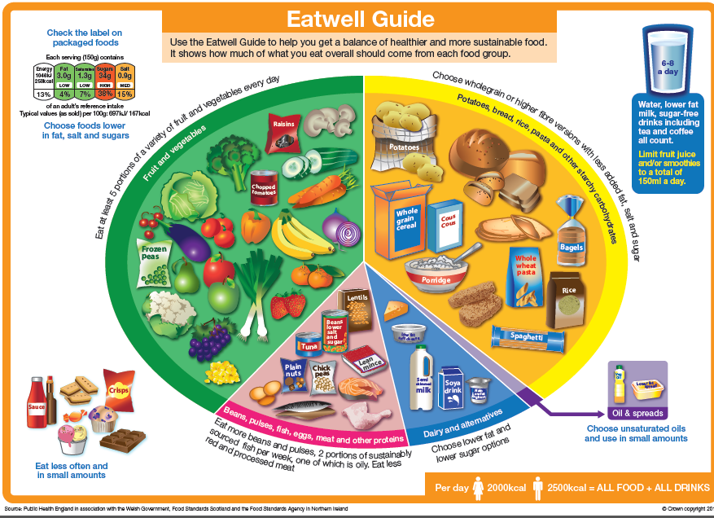

Slide 12
How food affects your health

Slide 13
What is the function of carbohydrate?
Carbohydrate provides an important source of energy for the body.
The two main types of carbohydrate are:
1) sugars;
2) starch.

Slide 14
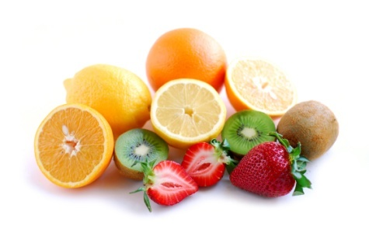
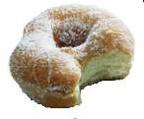
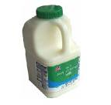
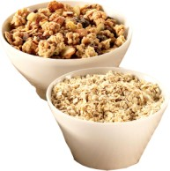
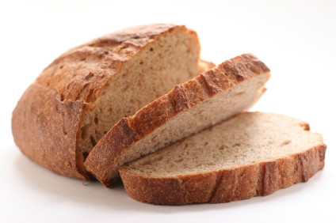
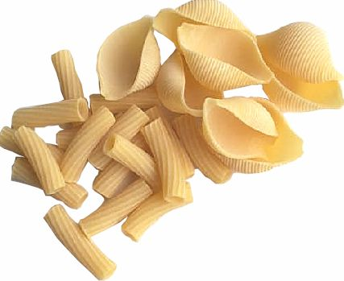
Where is carbohydrate found?
Some examples of sugar sources (carbohydrate) are sucrose (found in table sugar), lactose (found in milk), and fructose (found in fruit).
Some examples of food sources for starchy carbohydrates are bread, pasta, and cereal.

Slide 15
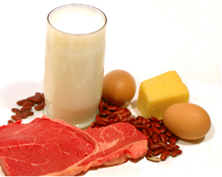
What is the function of protein?
Protein is needed by the body for growth, development and repair.
Protein can also provide energy.
Babies, children and adolescents need protein for growth.
Vegans and strict vegetarians need to eat a wide variety of foods to meet their protein needs

Slide 16
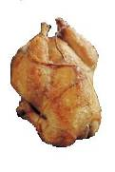
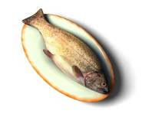
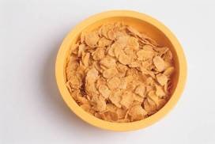
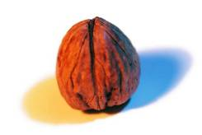
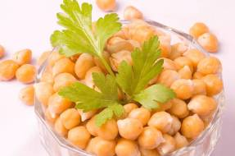
Where is protein found?
Protein is found in meat, fish, eggs, and dairy foods.
Protein is also found in non-animal sources, e.g. cereal products, nuts and pulses.

Slide 17
What is the function of fat?
Fat provides a store of energy for the body.
Fat also provides protection for the major organs in the body.
Types of fats include:
• saturated;
• unsaturated;
- monounsaturated;
- polyunsaturated.
Fat is needed for health, but only in moderate amounts.

Slide 18
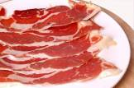
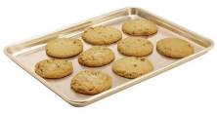
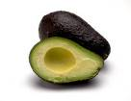
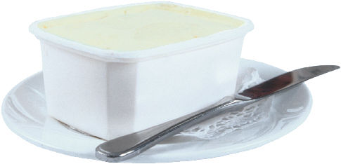
Where is fat found?
Saturated fat can be found in meat, coconut oil, palm oil, cakes, biscuits, and lard.
Monounsaturated and polyunsaturated fat can be found in rapeseed oil, olive oil, oily fish, avocado and some margarines and low fat spreads.

Slide 19
Vitamins
Vitamins are found in a wide variety of foods and they have many uses within the body.
Vitamin A is needed for normal structure and functioning of the skin and body linings, e.g. in lungs.
Vitamin D is needed for the absorption of calcium and
phosphorus from foods, to keep bones healthy.
B vitamins are needed for the release of energy from food.
Vitamin C is needed for the normal structure and function of body tissues. It also assists the healing process.

Slide 20
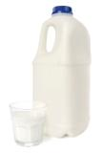
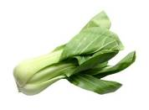
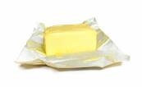
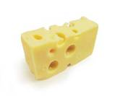
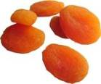
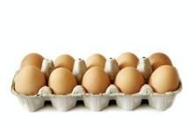
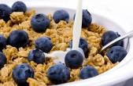
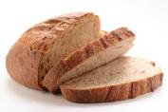
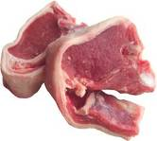
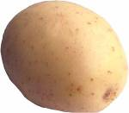
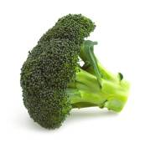
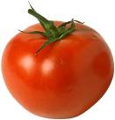
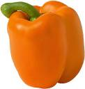
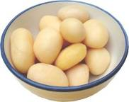
Where is vitamin A found?
Where is vitamin D found?
Where are B vitamins found?
Where is vitamin C found?

Slide 21
Special Diets
Name some special diets children may have in an early years or school setting.

Slide 22
Special diets
Vegan
Vegetarian
Religious diets
Cultural diets
Food allergies
Food intolerance
Individual diets –personal

Slide 23
Unit 1
Assessment Tasks
Complete 1.1 , 1.2, 1.3
Read handouts given and answer in full
1.1 – explain the various aspects that make up a balance diet for children
1.2 Show me the amounts from the food groups they should have for this age range and examples of foods you would provide. Can explain very briefly what these nutrients would provide
1.3. Show me the amounts from the food groups they should have for this age range and examples of foods you would provide. Can explain very briefly what these nutrients would provide

Slide 24
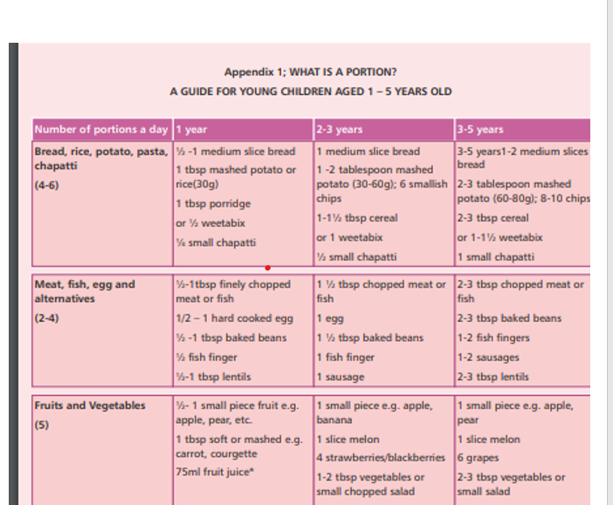
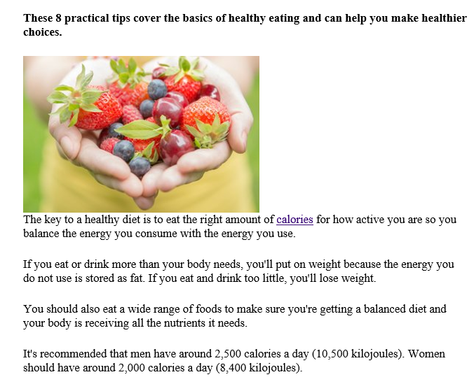
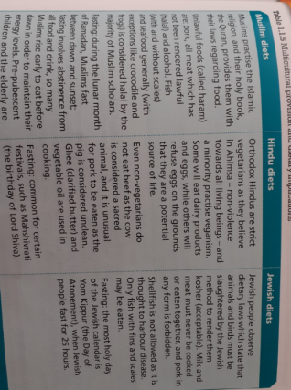
Handouts on Moodle
Learning outcome 1.2 & 1.3
Learning outcome 1.1
Learning outcome 1.2 & 1.3
Menu for special diet photo’s 1.1, 1.2, 1.3

Slide 25
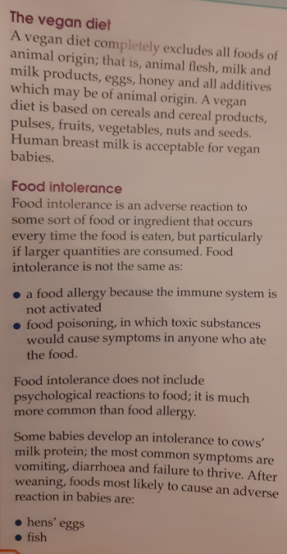
Unit 1
Assessment Tasks Menu planner with special diets
Learning outcomes 1.1, 1.2, 1.3
Complete each menu making it balanced as well as meeting the children’s dietary needs
Use this handout for information on special diets

