Slide 1
NCFE/Cache Level 1 Working with Children
Adult and community learning

Slide 2
Learning Outcomes
Session 2
By the end of the session you will be able to:
Recap week 1
Child care providers
Recognise what is quality care
Discuss the Early Years Curriculum
Explore linking knowledge and practical skills with your children-

Slide 3
Online rules
During this session classes, we agree:
We will behave towards each other as we would in a physical classroom.
No personal details given within the group – can speak to me on a one to one afterwards
Turn your video on for the session
Mute your audio unless you need to speak
Use protocols such as hands up if you wish to speak
Children should not be in the background whilst the session is active – if you need to communicate with your child turn your video off
If you need to leave temporarily – send a message to the tutor
General Online safety
Safe sites- lock and key
Not sharing passwords
Filters and blockers
Beware of spam and fake emails

Slide 4
Group Agreement
How do we wish to work as a group so everyone can successfully complete the course in this environment
Example:
Everyone listening to each other with out interrupting
Respect our differences and different opinions
Treat everyone equally and fairly
Feel able to ask questions even if seem bit basic
Acknowledge each other’s contribution – body language
Not to be in a noisy environment
Accept comments and ideas in spirit of learning and improvement
Be open to new ideas
To pay attention and not multitask –limit distraction
Feeling comfortable
Supportive environment
Have fun
Confidentiality
Safeguard self and others
Punctuality
Everyone has a voice

Slide 5
Introductions – names and games
Write to me only ….tell me something about yourself you would like to
share with the group
Something that may not be too obvious!
Ideas
Secret crush
How old you are
Hobby you may have
Favourite TV programme
Interesting skill you have
What you wanted to be when you grew up
………etc etc
When I read out the statements –others have to guess from the group who it may be…..
Keep in clean ladies!!!!

Slide 6
Providers and Services
What types of places do children 0-11 yrs attend by themselves to be cared for, learn skills or be educated ?

Slide 7
Children’s centres
Two year old groups
Afterschool Clubs
Nursery
Childminder
Crèche
Primary school
Kumon maths
Summer camps
Brownies, clubs e
Playcentre
Nanny
Au pair
Adventure playgrounds
Sports clubs –swimming, football etc
Learning clubs – Explore learning,Kumon etc
Holiday playscheme
Foster parent
Children’s home
Youth club
Contact centres
Hospital

Slide 8
What age range of children do they provide for? (0-11years)
Hours of opening? (8am-6pm)
Approx cost per day/session (£££ )
Minimum training of staff (Level….)
Legal Status (Public, voluntary,
private, self employed)
Children’s centres
Two year old groups
Afterschool Clubs
Nursery school
Childminder
Crèche
Community nursery
Primary school
Playcentre

Slide 9
Can you work with childen?

Slide 10
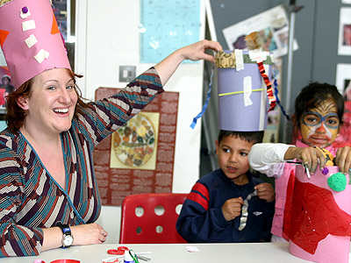
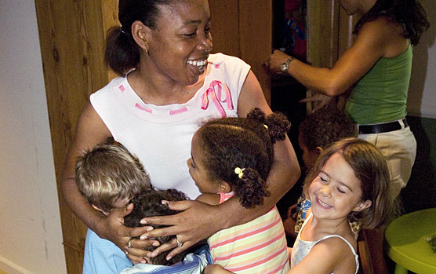
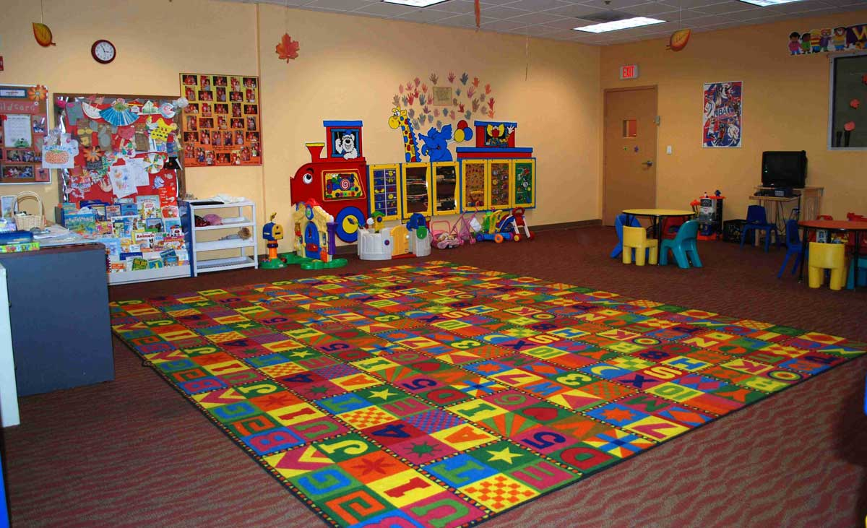
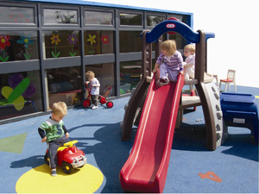
What does Quality Look like.......

Slide 11
What does Quality Look like.......
Your child is under 5 and you are going to choose a provider to look after her/him for three days a week
In pairs decide under the six headings what specific things you would look for when choosing the service

Slide 12
Early Years Foundation Stages

Slide 13
Early Years Foundation Stage Timeline.
Revised
Early Years Foundation Stages 2012
Revised
Early Years Foundation Stages 2021
Every Child Matters 2002
The Children Act 2004
Early Years Foundation Stages 2008
Death of Victoria Climbie.
Aim: to ensure agencies work together for the child. Whatever child’s background must be supported to meet outcomes:
Be happy, stay safe, enjoy & achieve, make a positive contribution
Economic well being
Revised 1989 Children Act. Protect & Safeguard children
Multidisciplinary working
Revised –updated changes in safeguarding and promoting of oral health
More focus on early language and extending vocabulary
Framework for setting standards for children under 5yrs covers learning, development & care
Looks at interest as child and individual needs. Covers six areas of learning and development
Revised – less
children’s assessment at
2 years and 5 years Partnership working with parents, emphasis on prime areas of learning.
Total of seven areas. 3 prime, 4 specific

Slide 14
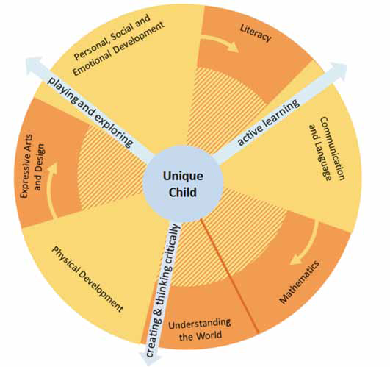
Early Years Foundation Stages
The Unique Child reaches out to
relate to people and things through the Characteristics of Effective Learning, which move through all areas of learning.
• playing and exploring
• active learning
• creating and thinking critically
Prime areas are fundamental,
• Personal, Social and Emotional Development
• Communication and Language
• Physical Development
Specific areas include essential
• Literacy
• Mathematics
• Understanding the World
• Expressive Arts and Design
Children develop in the context of relationships and the environment
around them. This is unique to each
family, and reflects individual communities
and culture

Slide 15
Complete the EYFS task worksheet

