Slide 1
Introduction to British Sign Language
Increase your communication with deaf people

Slide 2

Welcome to the Adult and Community Learning Service
Notes:
This powerpoint was designed by Charlotte Hopkins and Natalie Palmen.
It is called a ‘simplified version’ and uses images to convey the important messages of induction to our centres for learners.
By reducing the amount of text on each slide the presentation also works as a prompt to the CM or tutor aiding them to really engage with their learners without reading from the board. It makes the message more real!

Slide 3

IMPORTANT!
Do not be late!
Text or telephone the tutor if you cannot come to class
or you may lose your place
Alison 07808879044.
Notes:
Punctuality and Attendance.
This is given importance and not bunged on the end

Slide 4


If there is a fire
Leave all your things
Go out of the building using the nearest fire exit
Notes:
Fire Evacuation Procedures

Slide 5



About the centre…
Toilets
Refreshments
First aid
Notes:
Other very important H & S information

Slide 6




In class…
Mobile phones OFF or on SILENT
No food and drink near
the computers.
Tidy up after yourself.
Notes:
House rules……

Slide 7

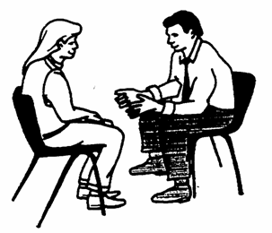
Please…
Respect other people
Speak to your teacher or the Centre Manager if you have a problem
Notes:
As well as being about comments and complaints this slide also offers the opportunity to raise SAFEGUARDING awareness. You can draw attention to the posters around the centre and offer an access point for people to come forward with abuse issues and be referred to the relevant support.

Slide 8
Safeguarding is Important. Please…
Respect other people
Speak to your teacher or the Safeguarding Officer – David Coleman on 07525387549 if you have a problem with how you are treated.
Notes:
As well as being about comments and complaints this slide also offers the opportunity to raise SAFEGUARDING awareness. You can draw attention to the posters around the centre and offer an access point for people to come forward with abuse issues and be referred to the relevant support.

Slide 9
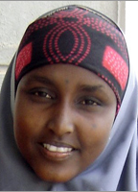
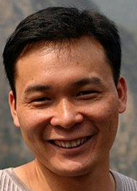
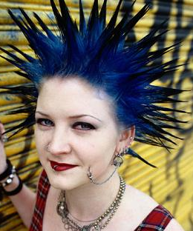

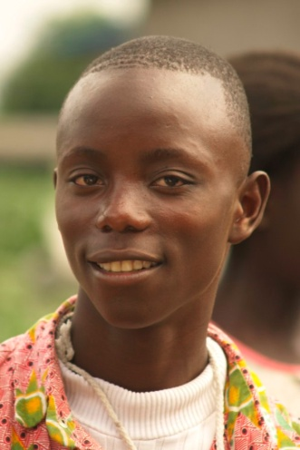
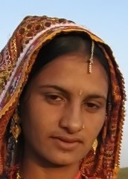
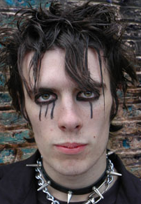
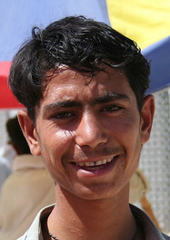
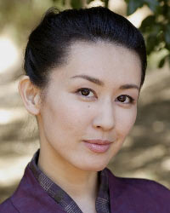
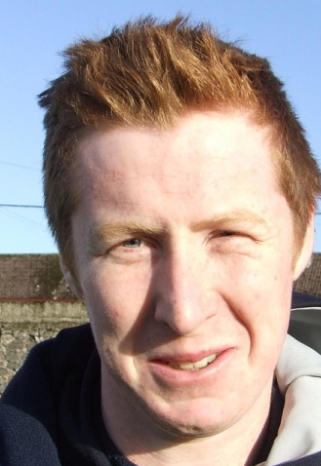



Slide 10

What next?..........
Information and Advice to help you move on to work and further learning
Notes:
Talk about progression opportunities in you centre and how to access them.
Also talk about our partners and ways they can help

Slide 11
Course dates and times
This course runs from Tuesday 21st Sept 2021
- Tuesday 16th November 2021
Half Term – no class on 26th October

Slide 12
Learning Objectives for today
Induction to the course
Introduction to Moodle – virtual learning environment
An Introduction to deaf awareness
Introducing British Sign Language
Learn the fingerspelling alphabet
Be able to introduce yourself to others using BSL

Slide 13
Introduction to Moodle
Moodle is our Virtual Learning Environment
You can find it at:
https://aclgateway.islington.gov.uk/
You will have your own username and password emailed to you to login

Slide 14
Moodle Induction
Now we are going to use Moodle to complete our:
Individual Learning Plans
Learner Profiles
Health and Safety Checklists

Slide 15
introductions
1. Introduce yourself to the group:
You might like to say:
Your name
What experience if any do you already have of British Sign Language?
What do they hope to achieve by attending this course?
One thing they have really enjoyed doing recently.

Slide 16
Intro to BSL video

Slide 17
Deaf Awareness
https://www.youtube.com/watch?v=fqKEUhMLW-E - Rise
https://www.youtube.com/watch?v=f5aI9rBi03o – top deaf awareness tips (nice girl)
https://www.youtube.com/watch?v=WzVWbCxJpJo – Deaf Awareness week (nice man)
2021https://www.youtube.com/watch?v=7TpUtRENzqw
Deaf awareness week 2021 (funny)

Slide 18
Let’s learn to communicate
Fingerspelling
https://www.youtube.com/watch?v=DgIvXXdwjvw

Slide 20
Write down the letters to spell your name
Now practice making the letters

Slide 21
Let’s introduce ourselves to the group and practice some greetings
Practice the following signs

Slide 22
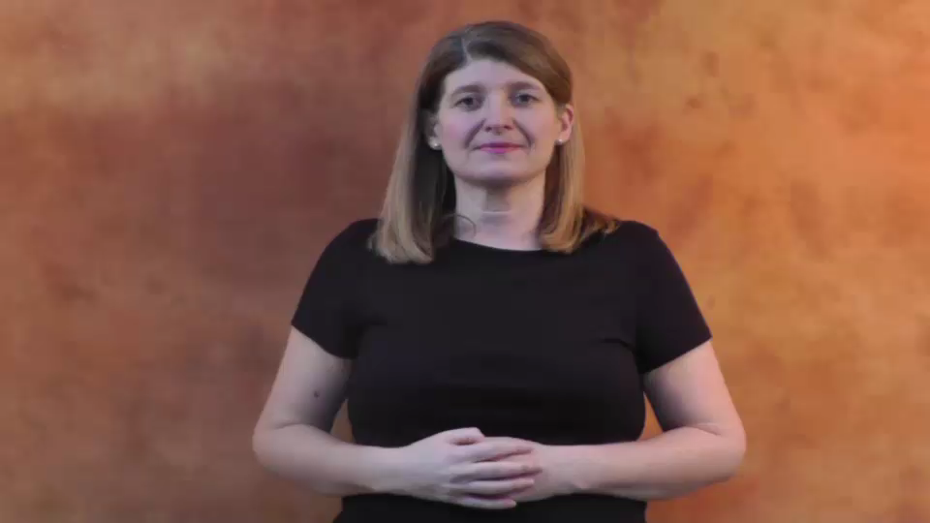
Greetings
Hello my name is (BSL order hello name me)

Slide 23
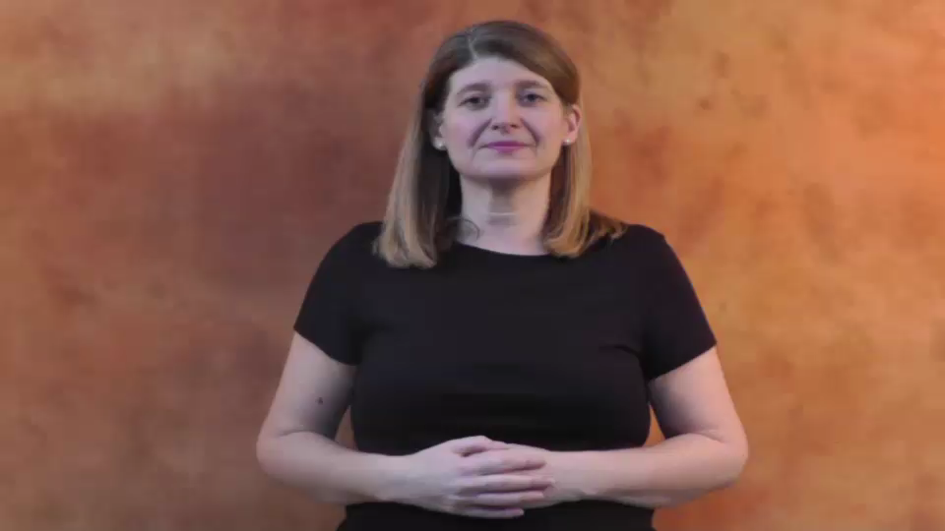
Hello what is your name?
(BSL order name you what?)

Slide 24
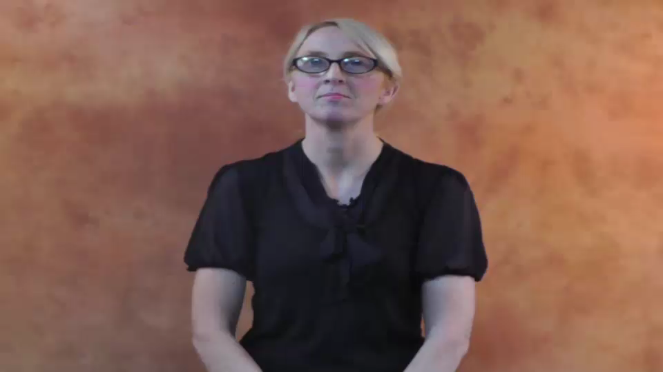
Hello how are you?

Slide 25
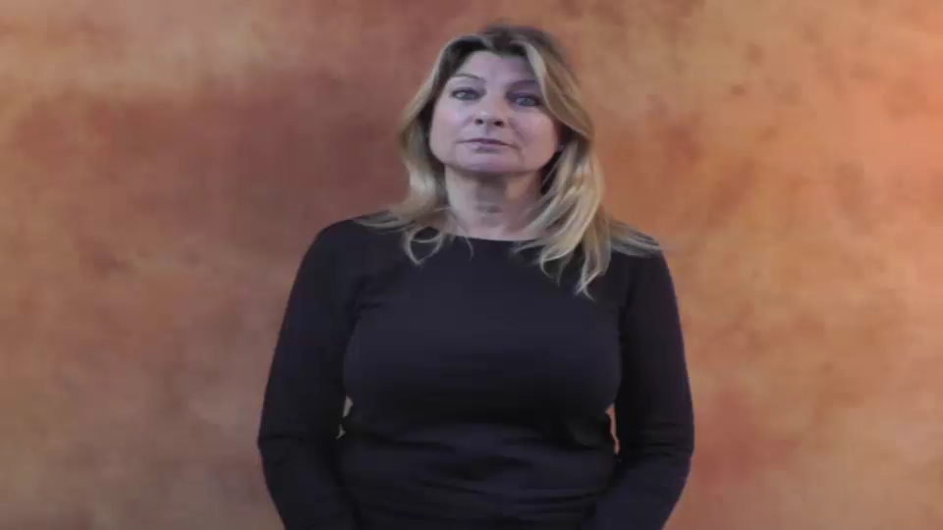
Good morning how are you?

Slide 26
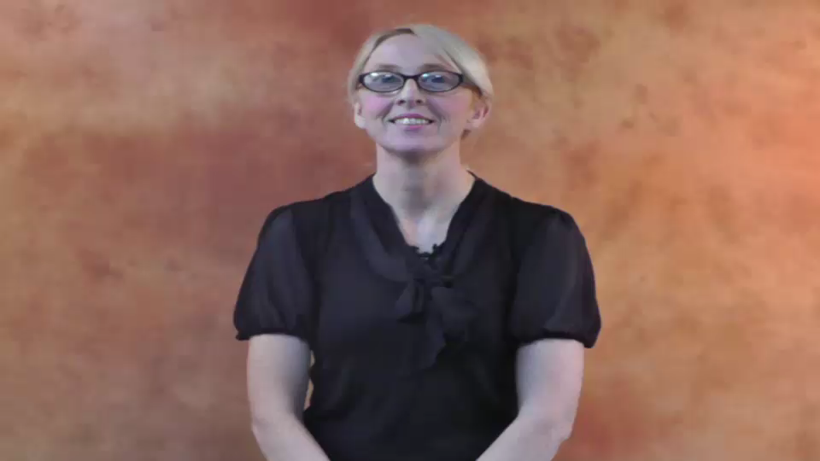
Good morning are you alright?

