Slide 1

Welcome to ESOL Entry 2
Islington Adult Community Learning
Induction Pack

Slide 2


Teacher: Petra Belikova
Contact details:
Email: petra.belikova@islington.gov.uk
Mobile: 07971 613271
Learning venue:
Light Project Pro International
The Exchange
Watkinson Road
London
N7 8DE
This Photo by Unknown Author is licensed under CC BY-SA

Slide 3

AUTUMN TERM 2021
Course start date: 20th September
Course end date: 15th December
Half-term break: 25th October - 29th October
Times of your course:
Monday 10 am – 12 pm
Wednesday 10 am – 12 pm
How long is the course?
10 weeks per term
There is an opportunity to attend all 3 terms: autumn, spring and summer.

Slide 4

Our topic this term:
Me and My Health
This is also the exam topic

Slide 5




Attendance and punctuality
Come to every class
100% attendance is expected
Don’t be late!
Be ready to learn

Slide 6

If you are ill or have an
urgent appointment:
Tell your teacher
You can email, text, or WhatsApp
petra.belikova@islington.gov.uk
Tel: 07971 613271
Please do not arrange non-urgent appointments in class time.

Slide 7

Don’t be late for your class!
Your class starts at 10 am
Notes:
Ask learners to circle the correct time which will relate to their class

Slide 8






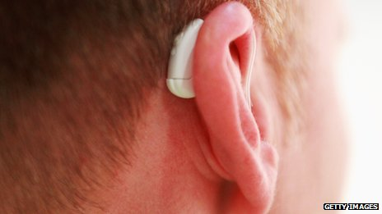
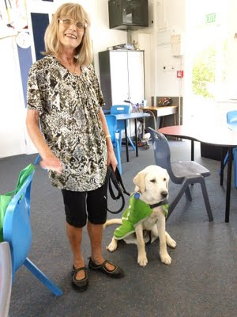




Slide 9





For your course you will need
a pen
no sharing
A folder (ring binder) and an A4 notebook

Slide 10



Keep your folder in order

Slide 11


Do your homework

Slide 12



Tutorials
All learners get time to talk with their teacher one-to-one.
This is called a

Slide 13

Your learning plan:
Your teacher will support you to set learning goals for your individual learning plan.
Assessment:
You will be assessed on the work you do on the course. You will keep a record of work showing what you have learned and how you are progressing.
Qualification:
If you are ready, you will be able to take an exam: City and Guilds.

Slide 14

After completing your course:
You can continue with ESOL at the same level until you
complete full level
You can progress to higher level ESOL courses
You may be able to continue your learning with us by joining other ACL courses:
Functional Skills English
Maths
Digital/ computer skills
Family learning
Employment skills

Slide 15
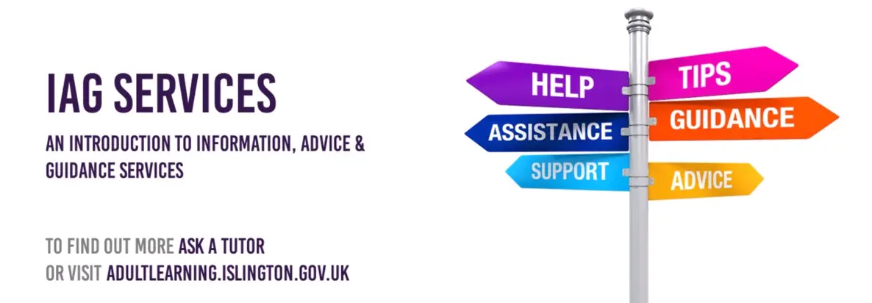
Information, Advice & Guidance - to help you move on to work and further learning
You can book a confidential 1-1 appointment with a qualified advisor. The advisor will help you explore your opportunities to move forward with your employment, education and training.

Slide 16

Employment support
Get help writing your CV, searching for jobs, filling in application forms and interview tips. Also get information on courses to help you improve your skills and chances of gaining employment.

Slide 17

Other ACL courses
Digital/ computer skills
Functional Skills
English
Maths
Family learning
Vocational and employment skills (for example childcare, food hygiene)
vocational – (adjective) to prepare you for a specific type of work

Slide 18


Slide 19


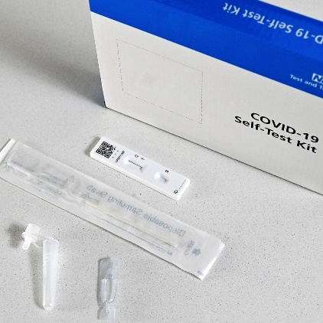


Covid 19 Safety
Wash your hands with soap regularly, for at least 20 seconds
Use the hand sanitiser provided
Do a lateral flow Covid test regularly
You don’t have to wear a mask,
but you can if you want to
If you are in a busy and crowded space with people you don’t normally mix with, wear a mask.

Slide 20

No smoking in the building
Notes:
The college has a no smoking policy and smoking is not allowed the garden area and especially in the front off the building

Slide 21

Fire exits and safety
If you hear a fire alarm, follow the green man

Slide 22
Fire Assembly Point
at the front of the building, opposite the main entrance
Notes:
Students should listen and follow the instructions of the fire marshals and stay of the gravel area

Slide 23
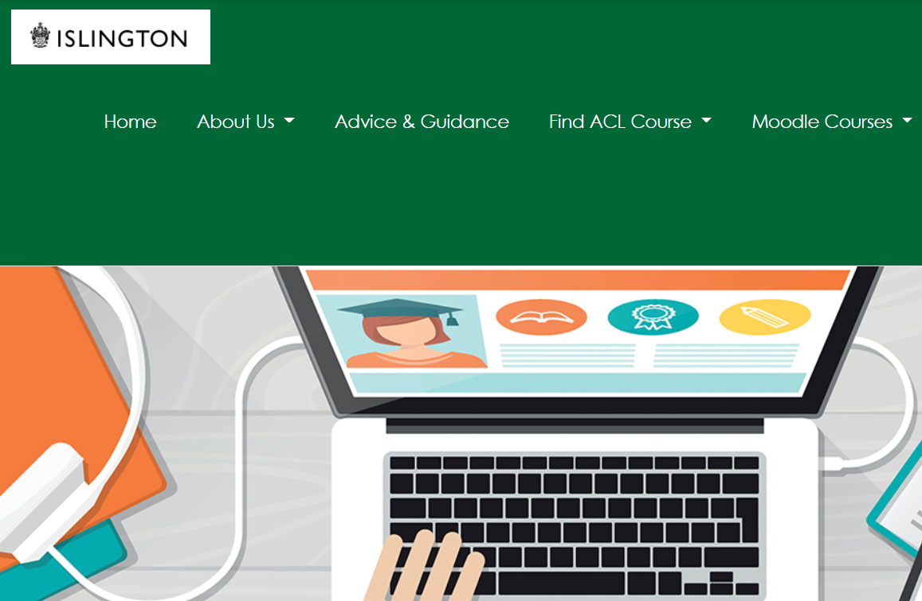
ACL Gateway website (also called Moodle)
You can access your course information and extra learning materials on the site.
Search for:
Islington ACL Gateway
https://aclgateway.islington.gov.uk/

Slide 24
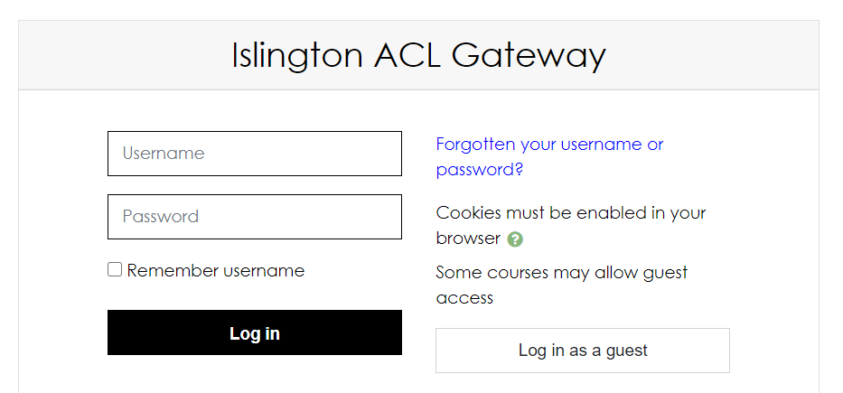
YOUR LOG IN DETAILS FOR ACL GATEWAY
Username:
21firstnamemiddlenamesurname
for example: 21johnsmith
21ahmedsaidmohammed
Password:
Welcome#1

Slide 25
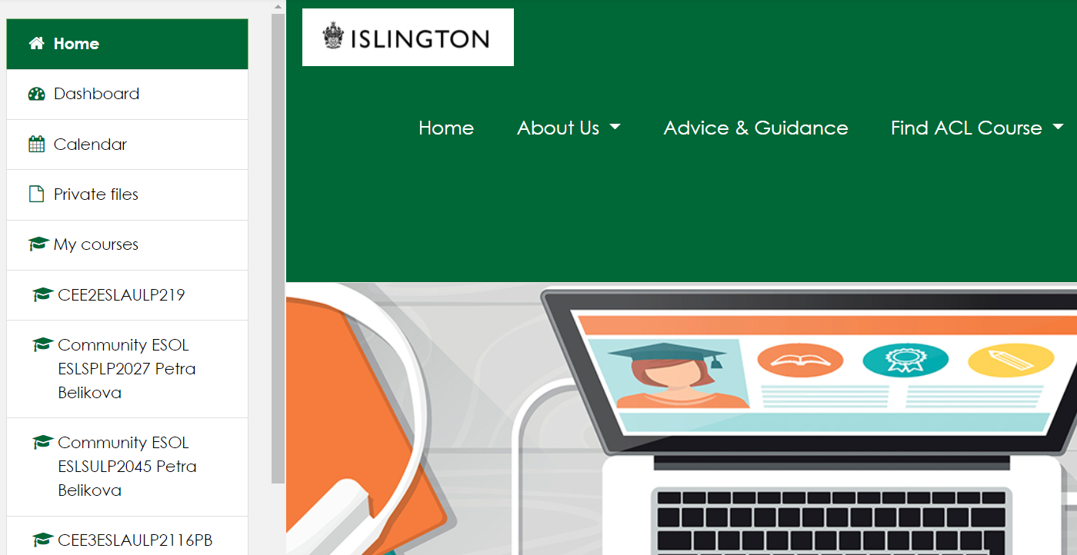
After you log in, you can access your ESOL course here
Your online course code for this term: ESLAULP219
or here

Slide 26
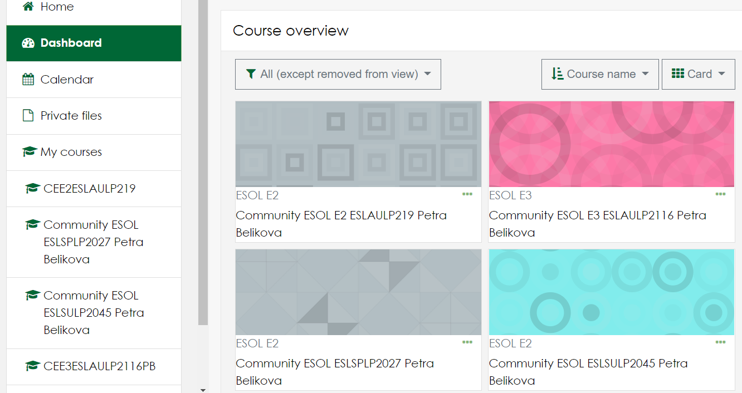
Your online course code for this term: ESLAULP219

